Slide 1
Tweed and Tweel

Slide 2
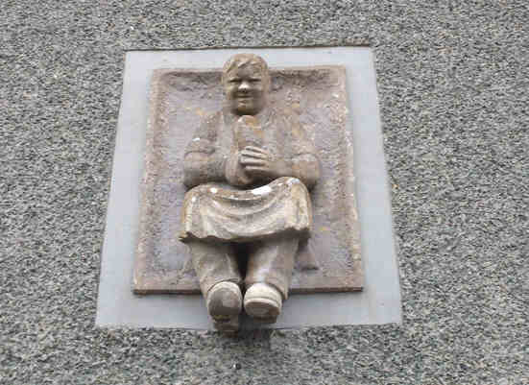

Slide 3
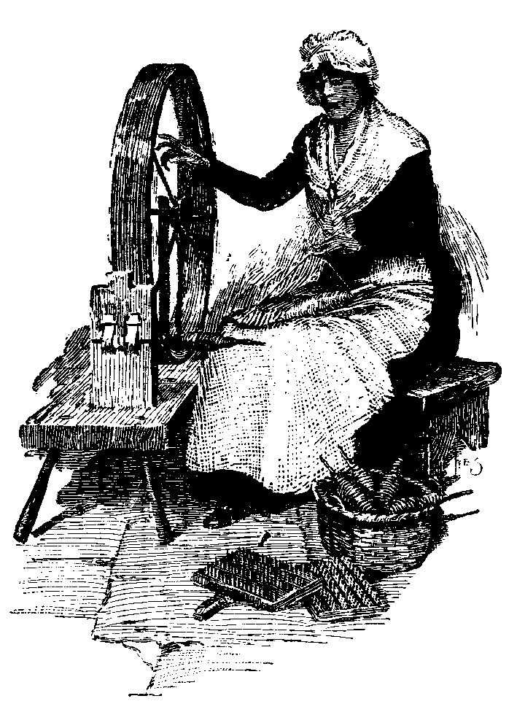
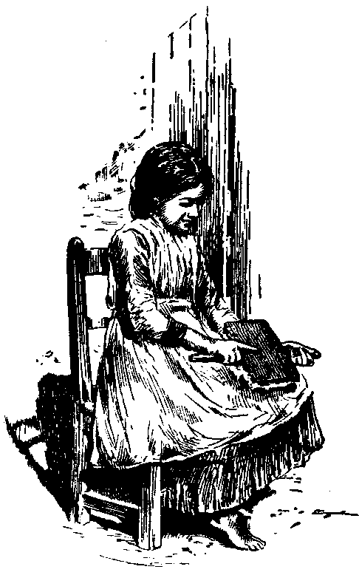
Young girl carding wool by hand
The spinning-wheel

Slide 4
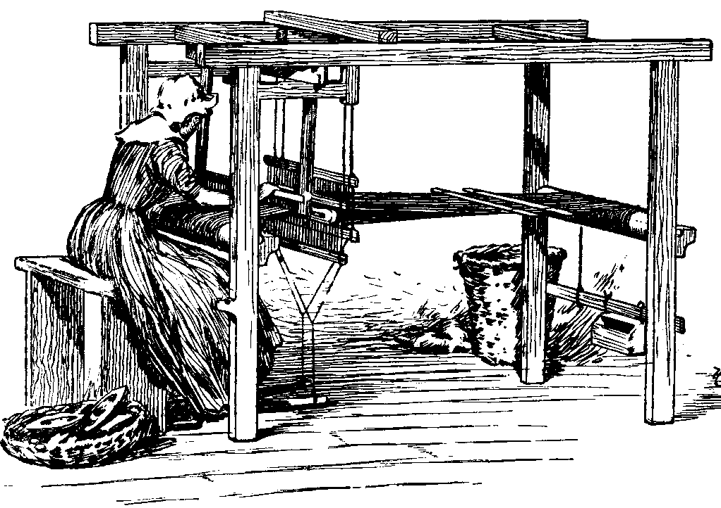
Working on a hand-loom frame

Slide 5
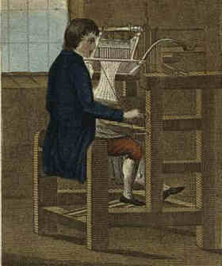
Working at a stocking frame

Slide 6
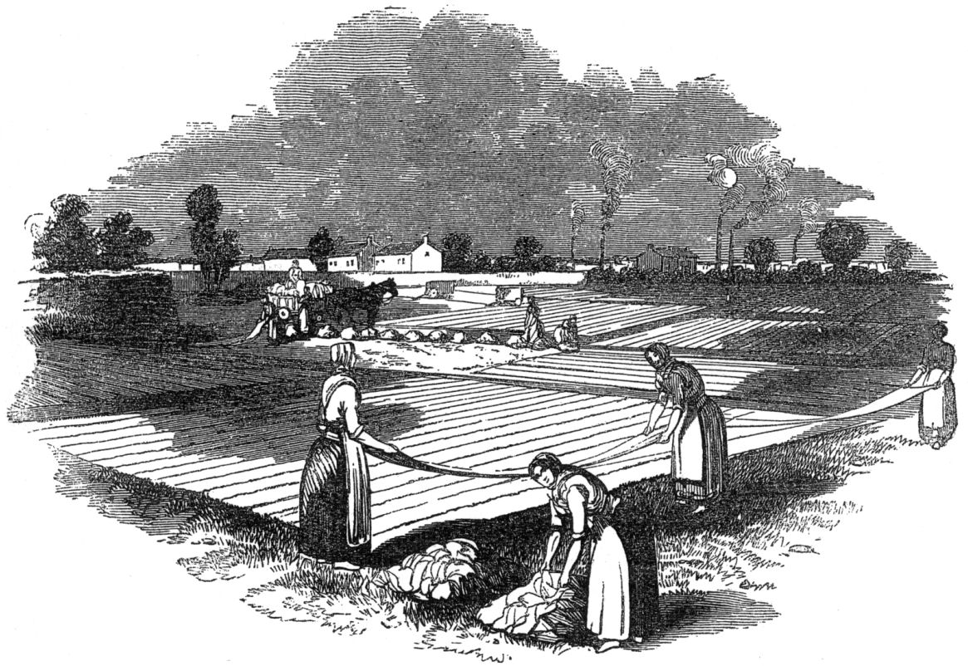
Linen bleaching field

Slide 7
The Motto of The Galashiels Manufacturers’ Corporation
“We Dye to Live ,
and We Live to Die”

Slide 8
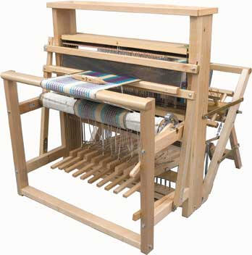
Hand-loom equipped with
John Kay’s “Flying Shuttle”

Slide 9
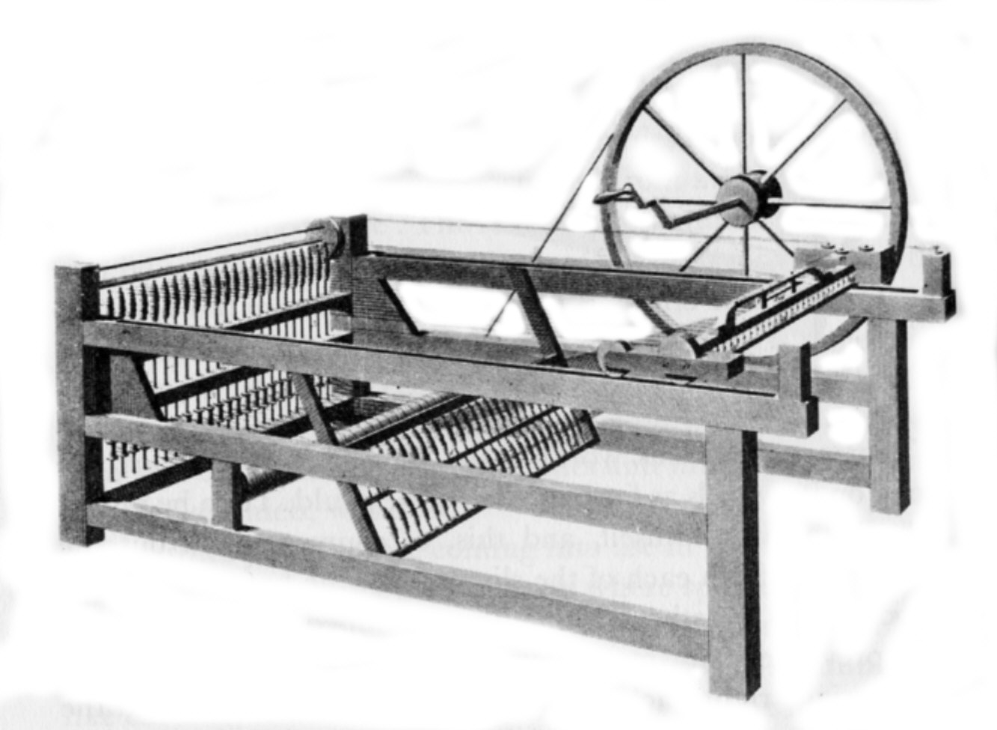
James Hargreaves’ “Spinning Jenny”

Slide 10
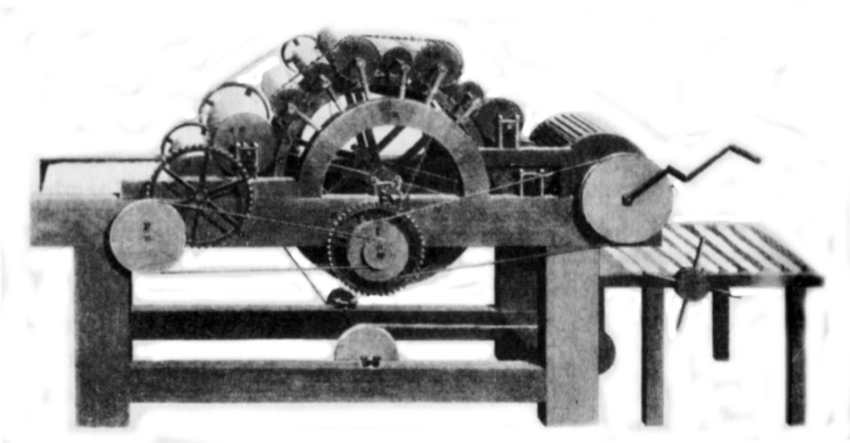
Carding machine

Slide 11
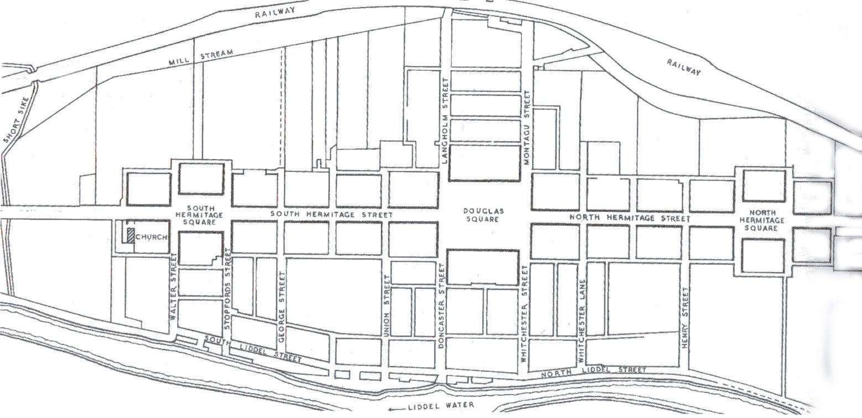
Newcastleton, 1793

Slide 12
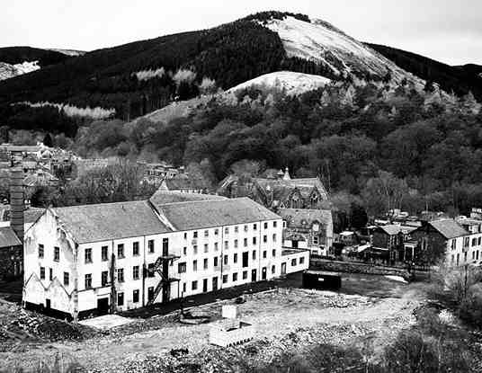
Caerlee Mill, Innerleithen

Slide 13
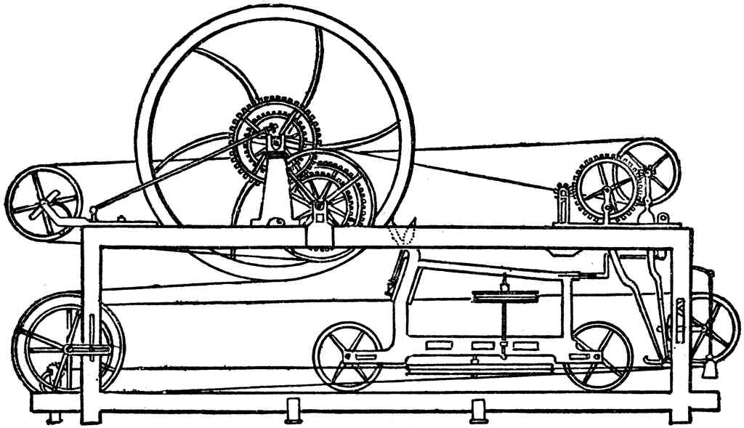
Spinning Mule

Slide 14
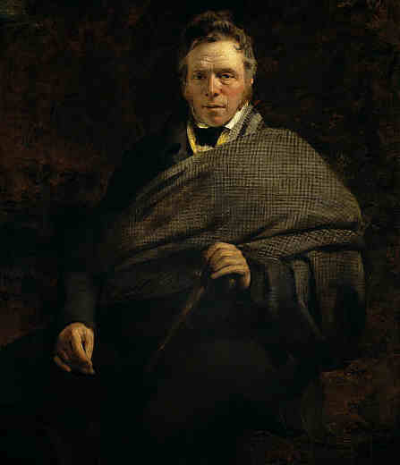
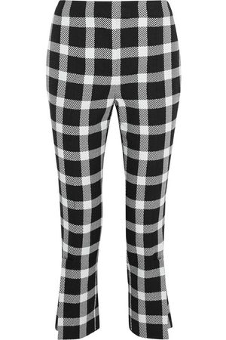
Shepherd’s Plaid
trousers
James Hogg, “The Ettrick Shepherd”, 1830

Slide 15
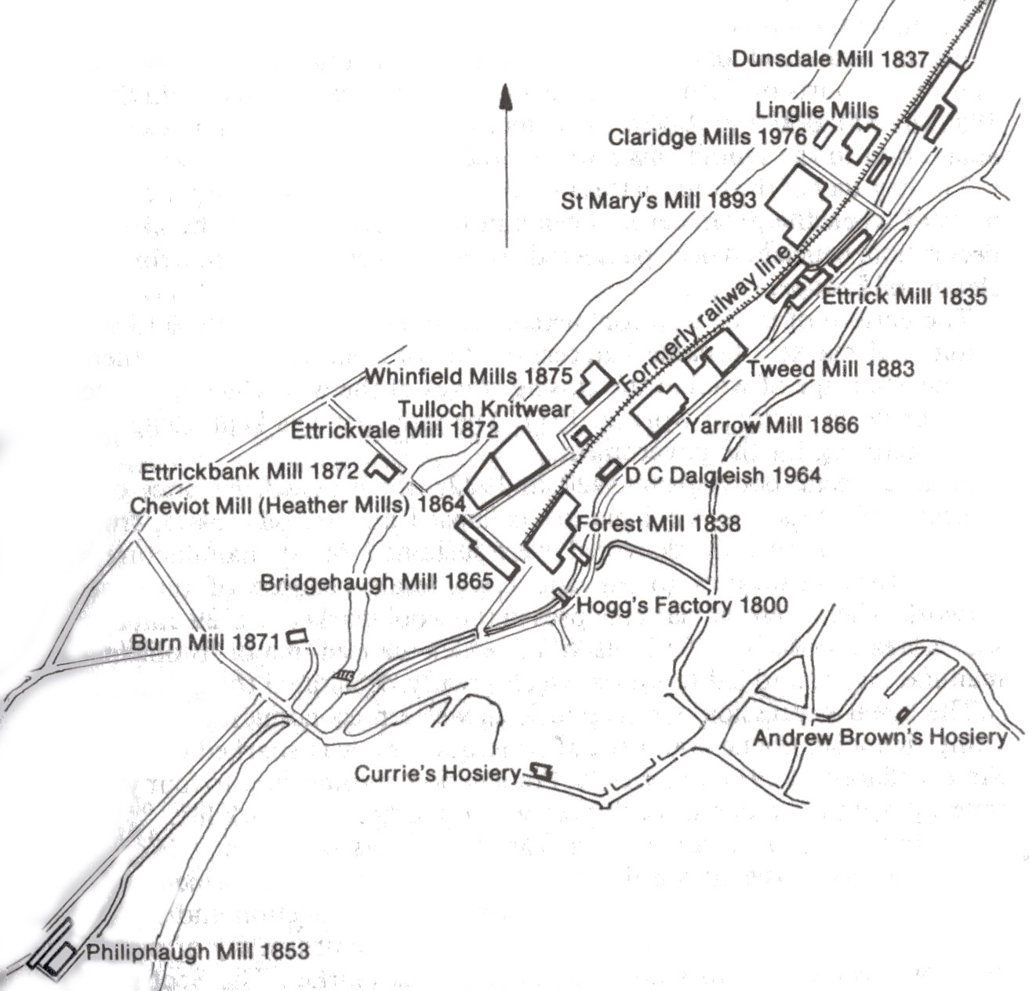
Selkirk’s Woollen Mills

Slide 16
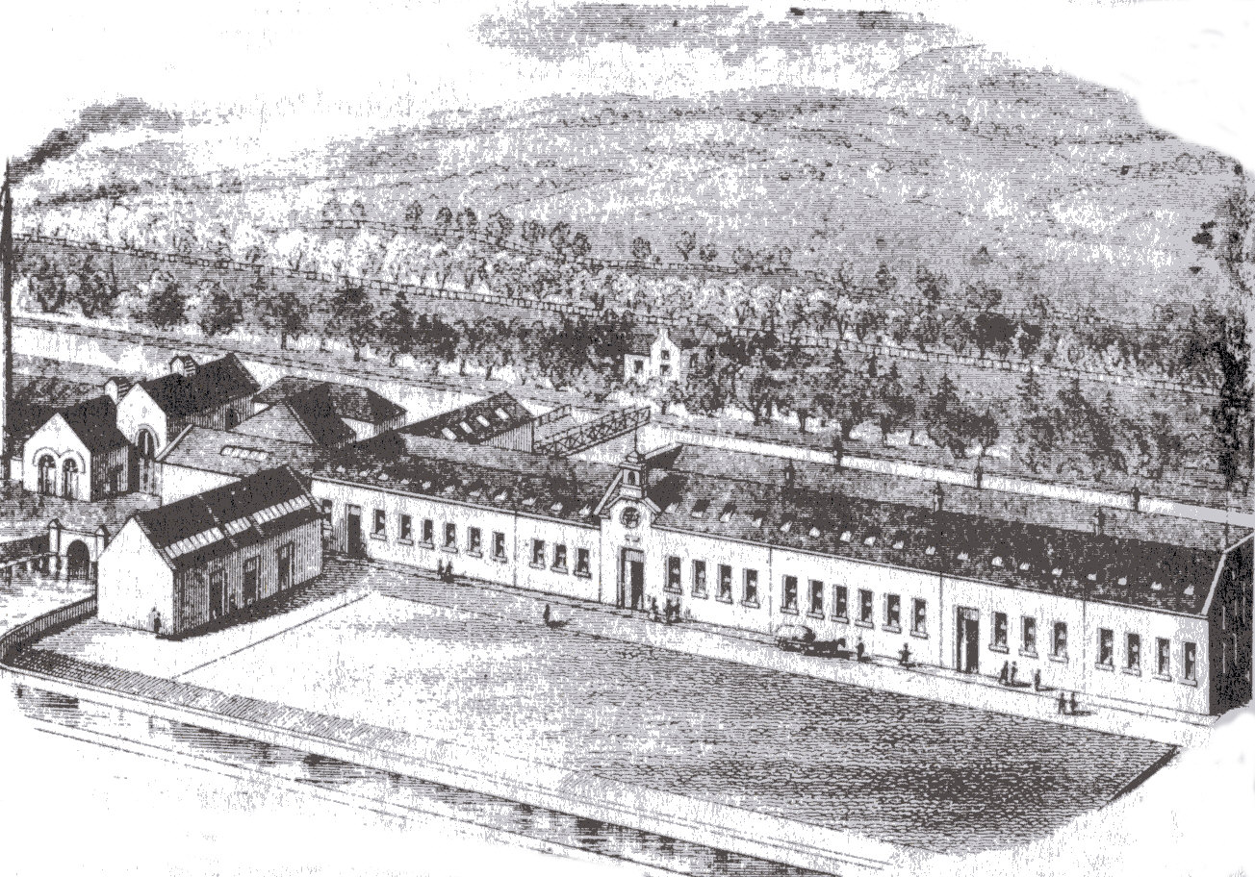
Philiphaugh Mill, Selkirk

Slide 17
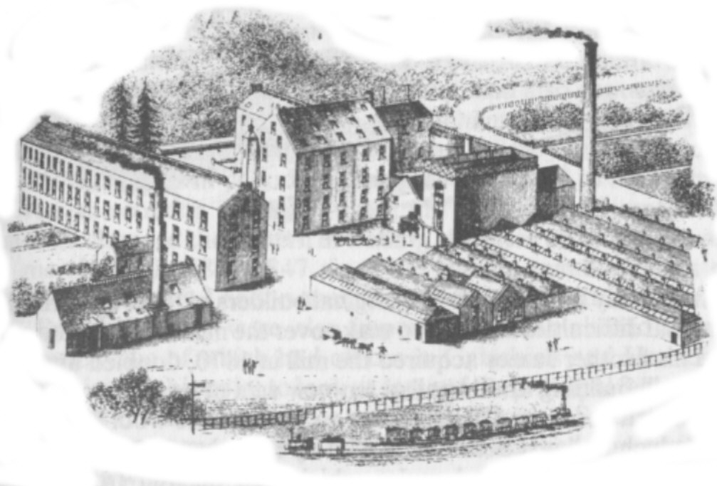
Forest Mill, Selkirk

Slide 18
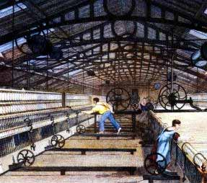
Steam-powered woollen mill, circa 1840

Slide 19
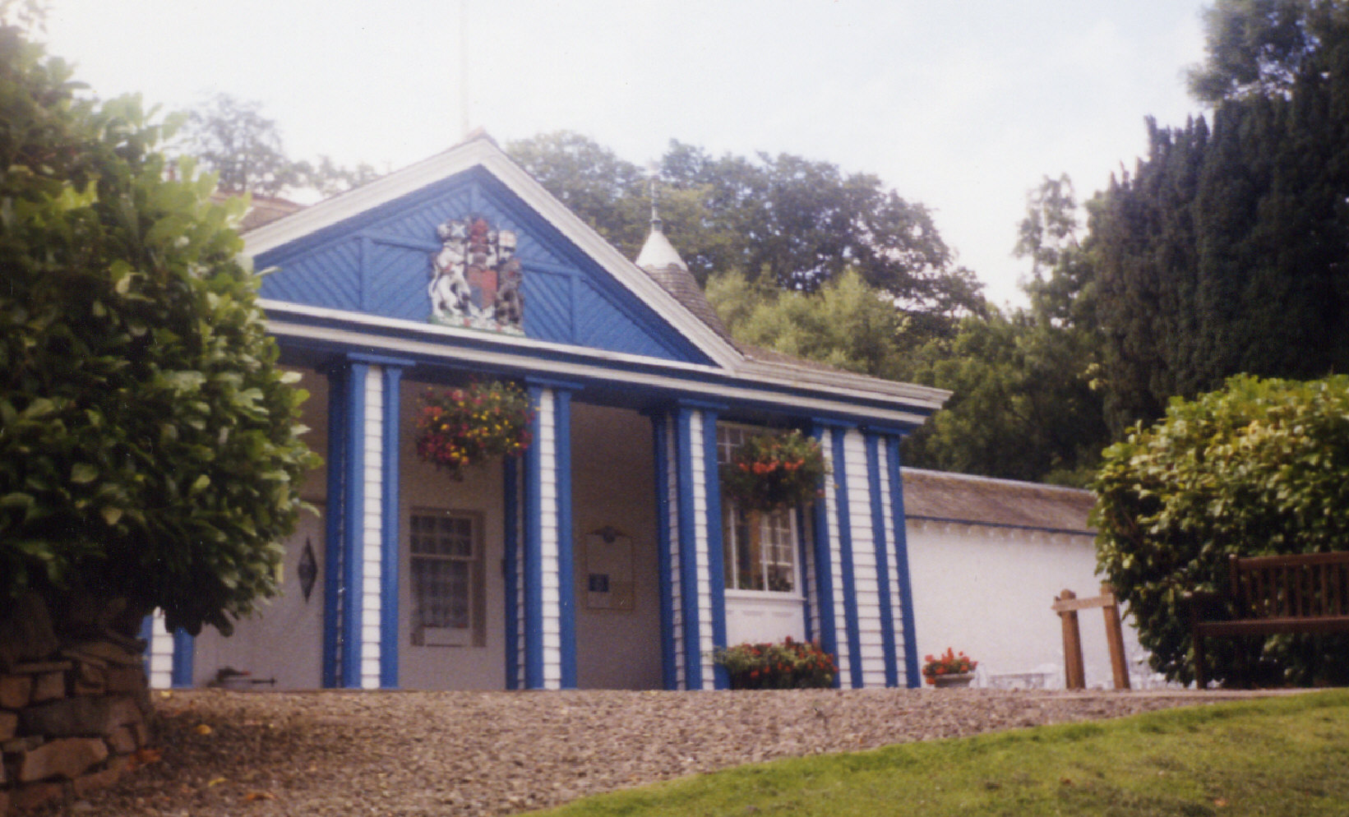
St Ronan’s Well, Innerleithen

Slide 20
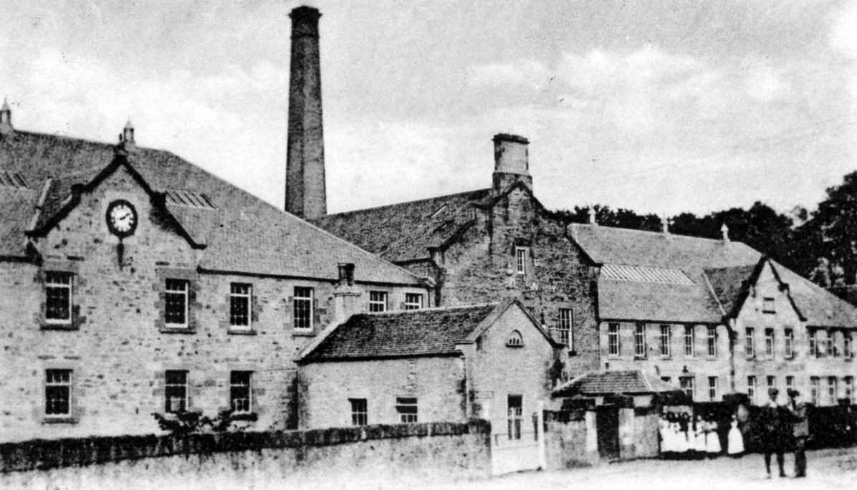
Chirnside Paper Mill

Slide 21
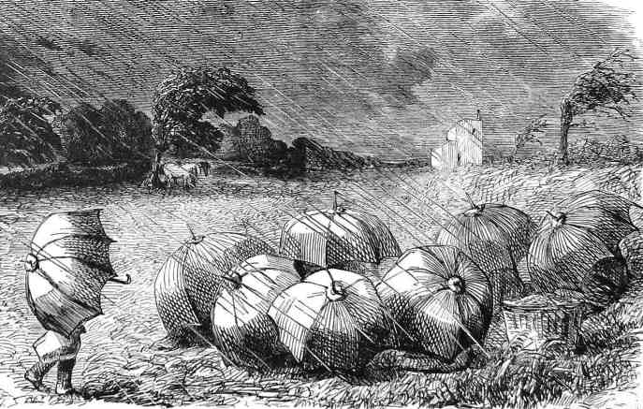
The Pic-Nic - THE END

