Slide 1
Turnpikes and Trains

Slide 2
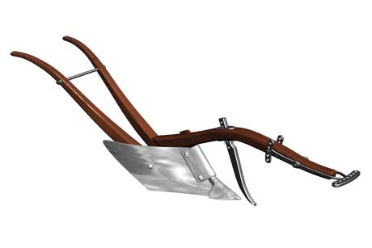
Small’s cast-iron Scotch Swing Plough

Slide 3
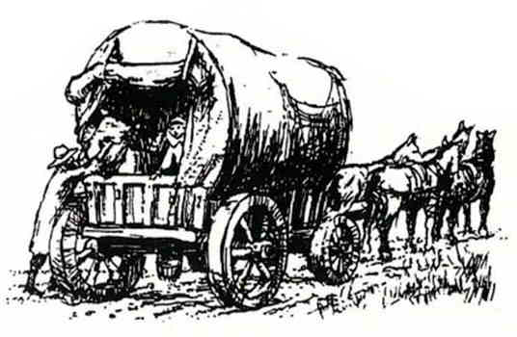
18th century stage wagon

Slide 4
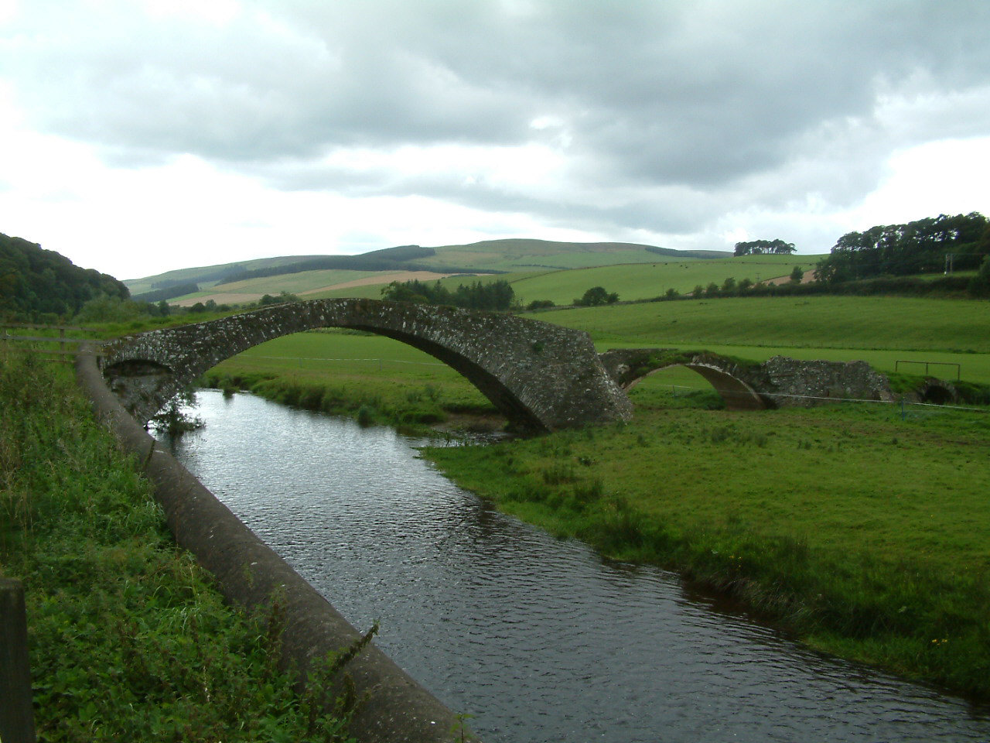
Pack-horse bridge over the Gala Water at Stow

Slide 5
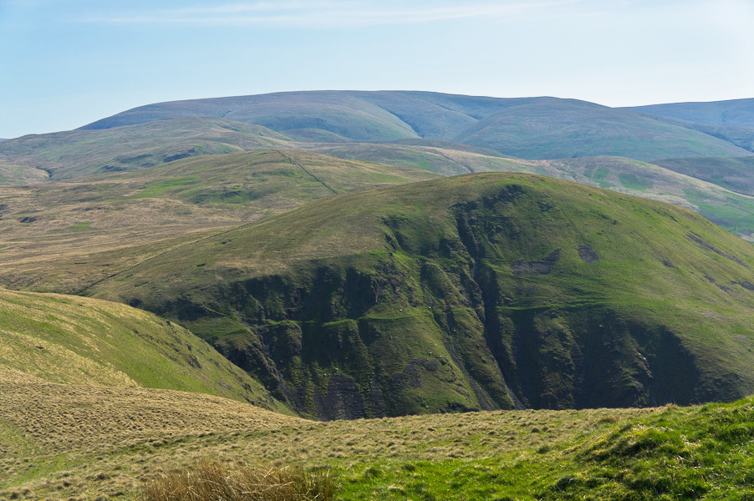
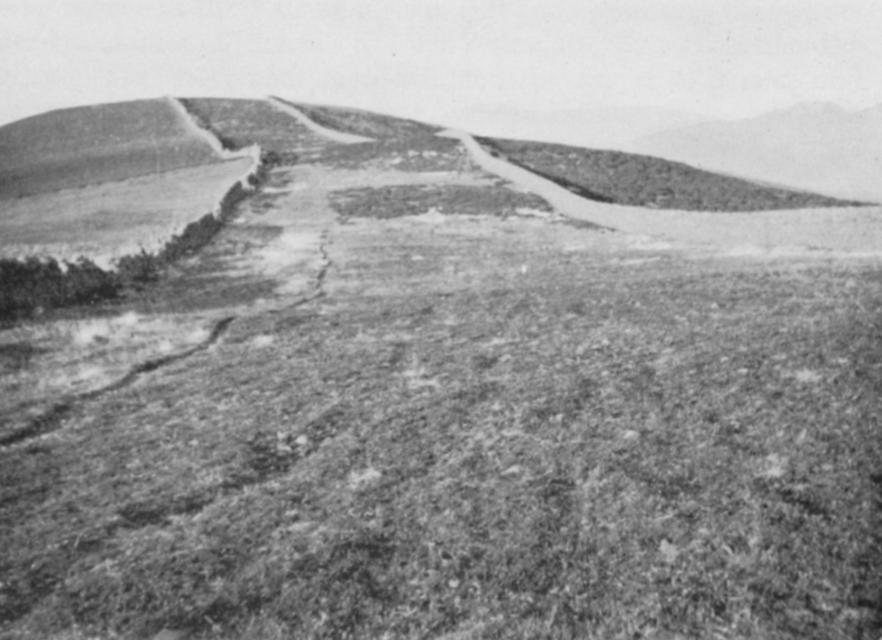
Drove road near Peebles
The “Devil’s Beef Tub”, near Moffat

Slide 6
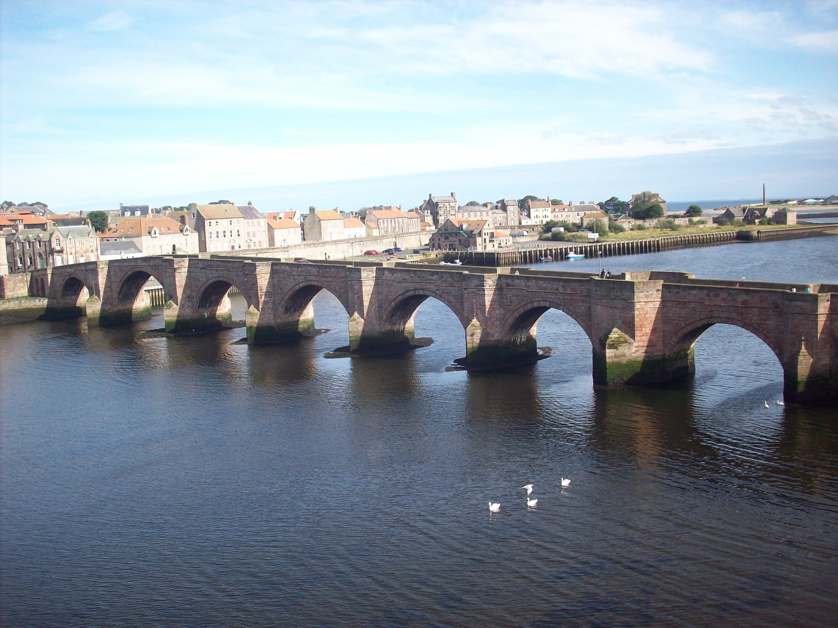
Berwick Old Bridge

Slide 7
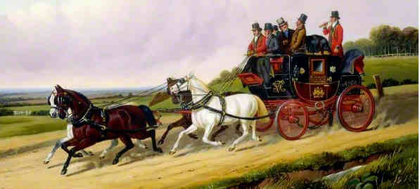
MAIL/STAGE COACH FARES, circa 1840
London to Edinburgh Mail - Inside £7 7s = £324
Outside £4 4s = £185
Kelso to Edinburgh Stage 10s 6d = £23
MAIL/STAGE COACH TIMES, circa 1840
London to Edinburgh Mail 56 hours
Kelso to Edinburgh 6 hours
Kelso to Hawick 4 hours
Kelso to Glasgow 13 hours

Slide 8
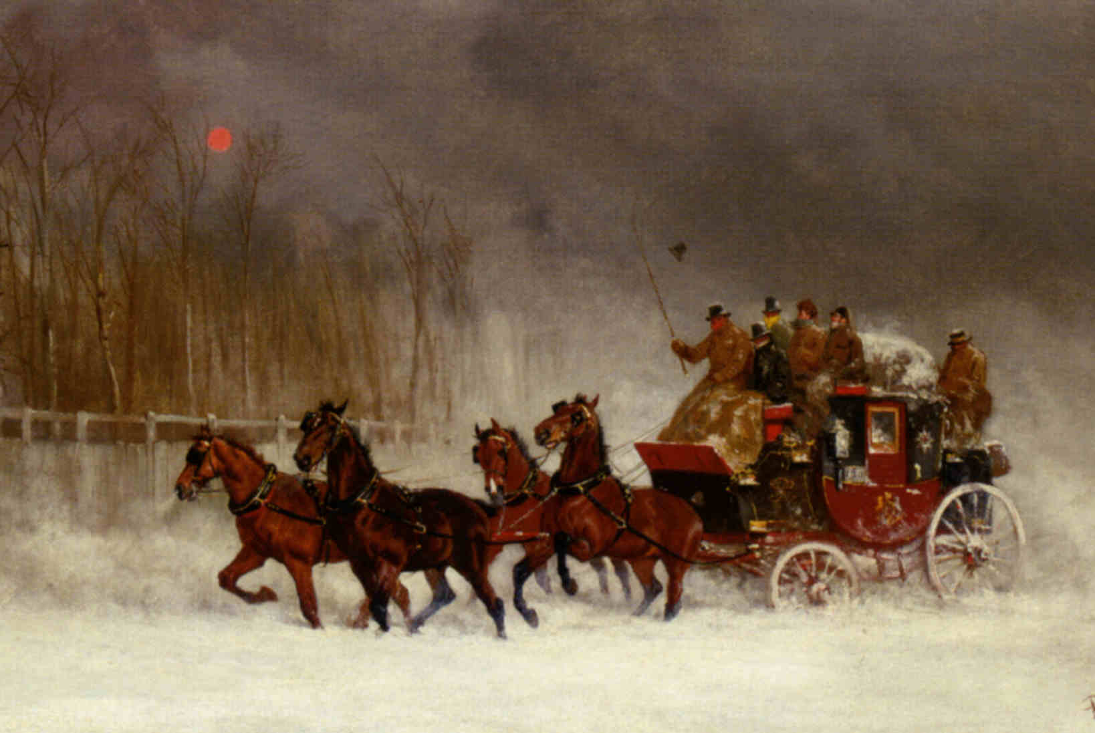
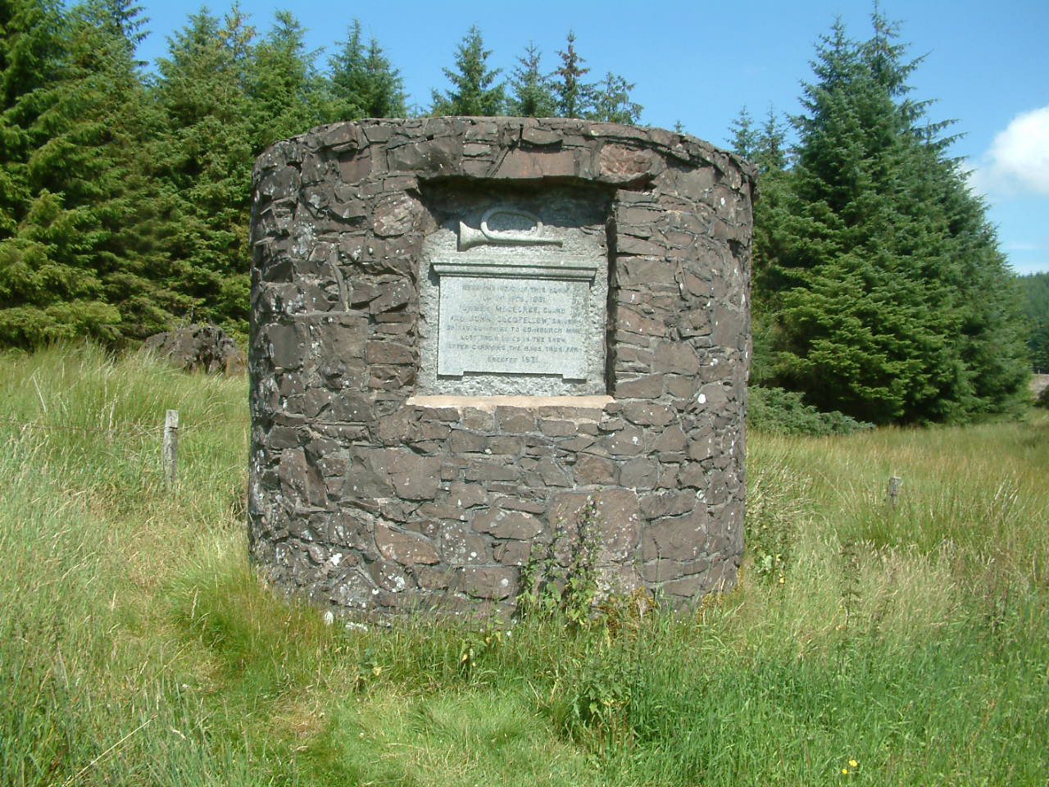

Slide 9
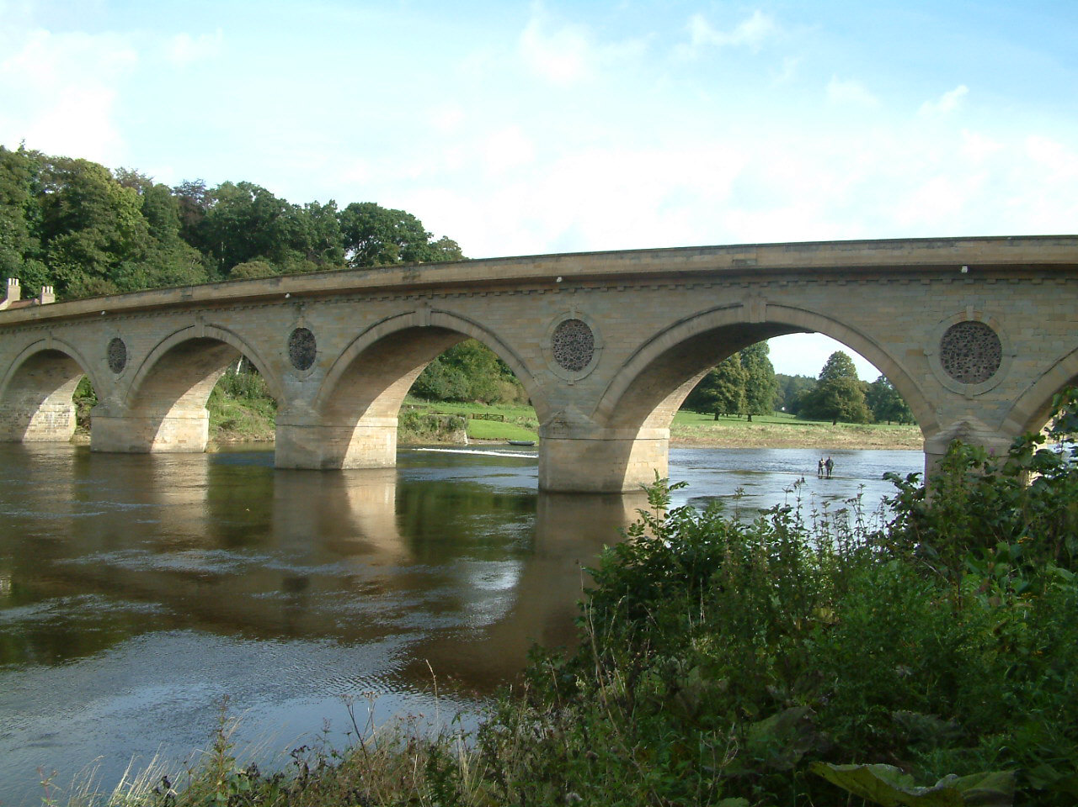
Coldstream Bridge, built 1763-7

Slide 10
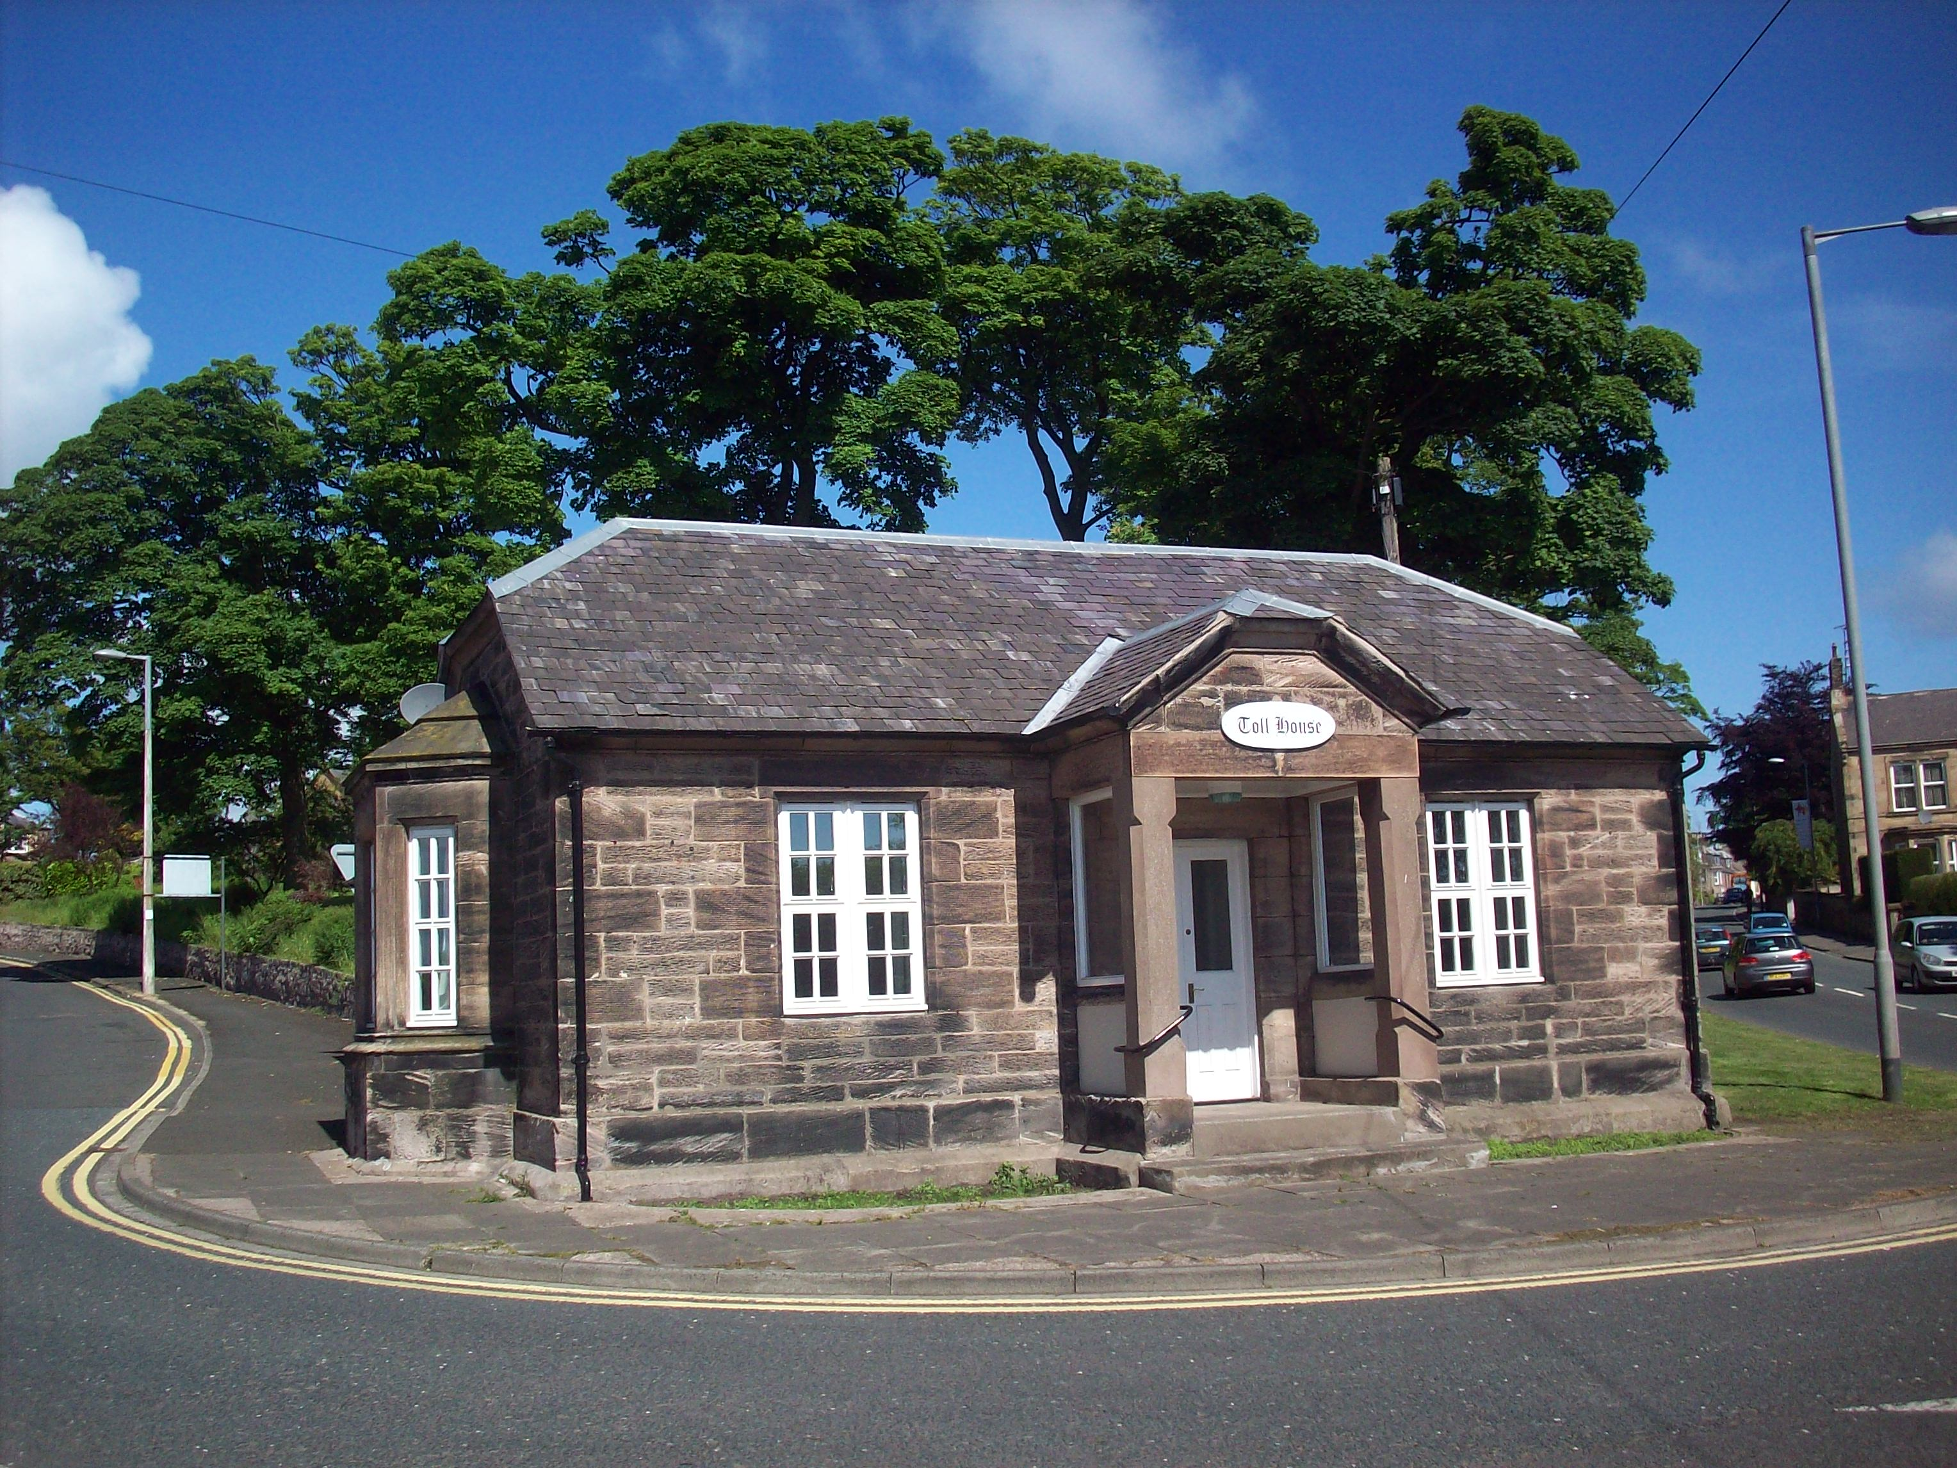
North Road Tollhouse, Berwick-upon-Tweed

Slide 11
Typical Toll Charges, circa 1820
For each coach, chaise, wagon, wain, cart and other carriage
drawn by 6 or more horses, mules or other beasts of draught 1s 6d (=£3.30)
Ditro drawn by 4 horses, etc. 1s (=£2.20)
Ditto drawn by 2 horses, etc. 6d (=£1.10)
Mounted horses 1½d (= 27p)
Horses, led 1d (= 18p)
Cattle 10d per score (= £1.80)
Calves, sheep, lambs and hogs 2½d per score (= 45p)

Slide 12
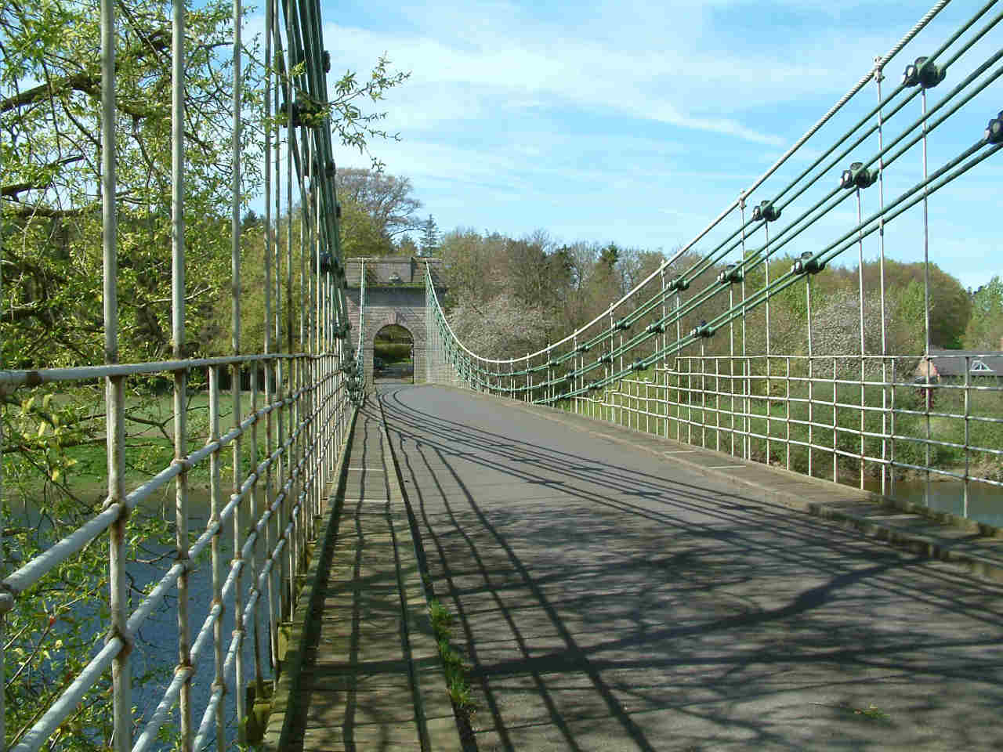
Union Chain Bridge of Suspension
(opened 1820)

Slide 13
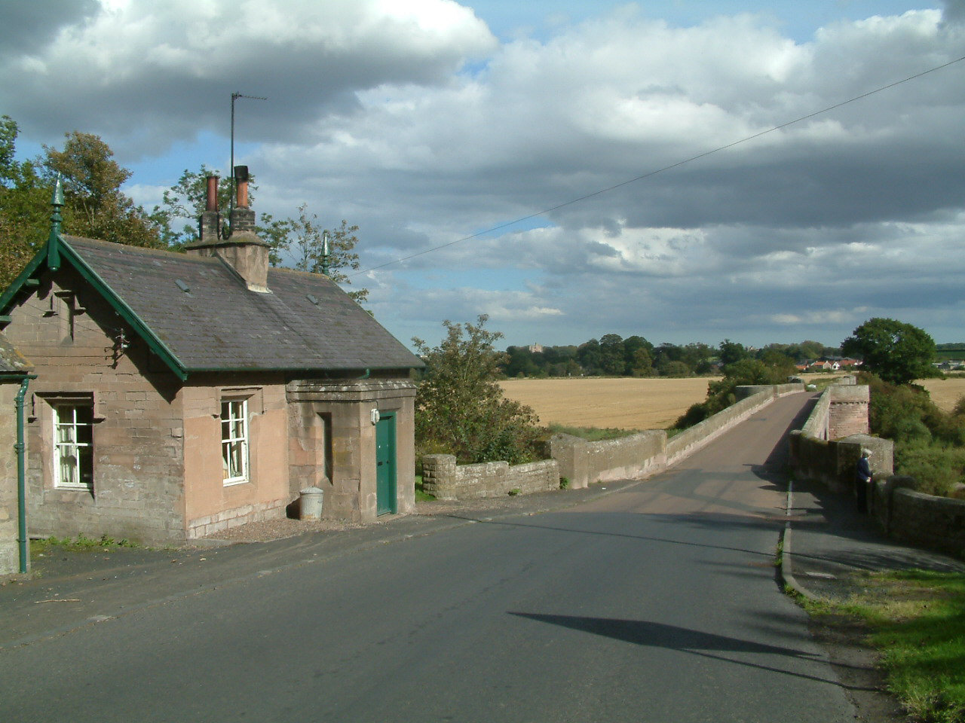
Norham Bridge and Tollhouse (built 1885)

Slide 14
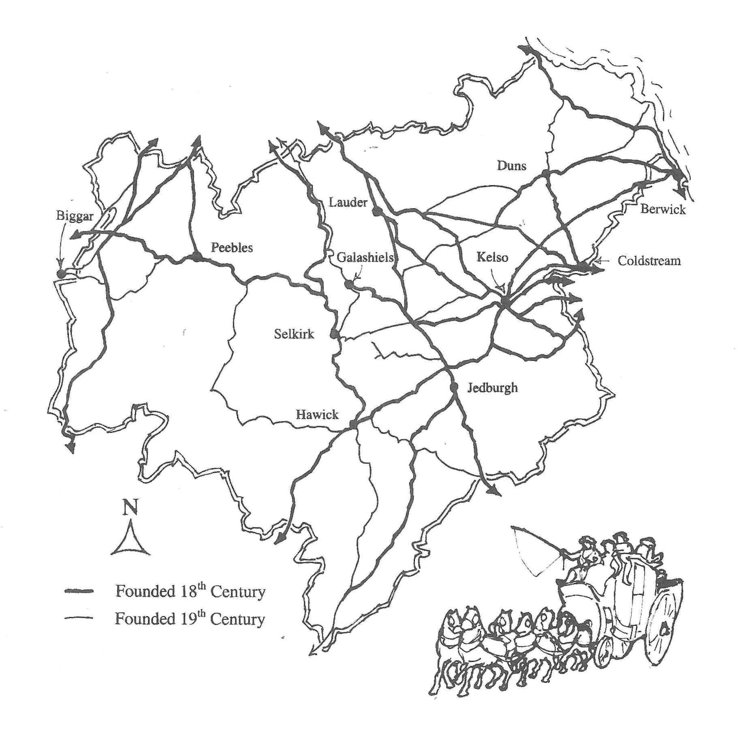
Turnpikes in the Scottish Borders

Slide 15
STAGECOACHES IN THE BORDERS
Blucher (c. 1800-s47) Jedburgh to Edinburgh
Border Union (1825-50) Kelso Cross Keys to Berwick-upon-Tweed King’s Arms
Chevy Chase (1830-47) Edinburgh to London via Jedburgh
Commercial Traveller (1795-1830s) Kelso Cross Keys to Edinburgh
Dart (1825-37) Berwick-upon-Tweed to Edinburgh
Ettrick Shepherd (1887-?) St Mary’s Loch to Moffat
Favourite (1822-50) Hawick to Kelso Cross Keys
Flower of Yarrow (1887-?) Selkirk to St Mary’s Loch
Peebles Fly (1795-1855) Peebles to Edinburgh
Royal Charlotte (Late Duke of Wellington) (1785-1845) Edinburgh to London via Coldstream
Royal Eagle (1820-49) Duns to Edinburgh
Royal George (?) Dumfries to Edinburgh via West Linton
Royal Union (1800s-46) Edinburgh to London via Berwick-upon-Tweed
Standard (1842-49) Hawick to Edinburgh
Star (Later Sir Walter Scott) (1800s-?) Hawick to Edinburgh
Tweed and Clydesdale Union (1835-?) Kelso Cross Keys to Glasgow
Tweedside 1 (1804-52) Kelso White Swan ton Edinburgh
Tweedside 2 (1825-50) Kelso White Swan to Berwick-upon-Tweed Hen and Chickens

Slide 16
Effect of the Railways on Toll Rental Charges
1836 1858
Shawburn & Selkirk £374 (£16,493) £135 (£5,826)
Crosslie £307 (£13,538) £18 (£777)
Ladyland £241 (£10,628) Not let
Thornilee £58 (£2,558) £45 (£1,942)

Slide 17
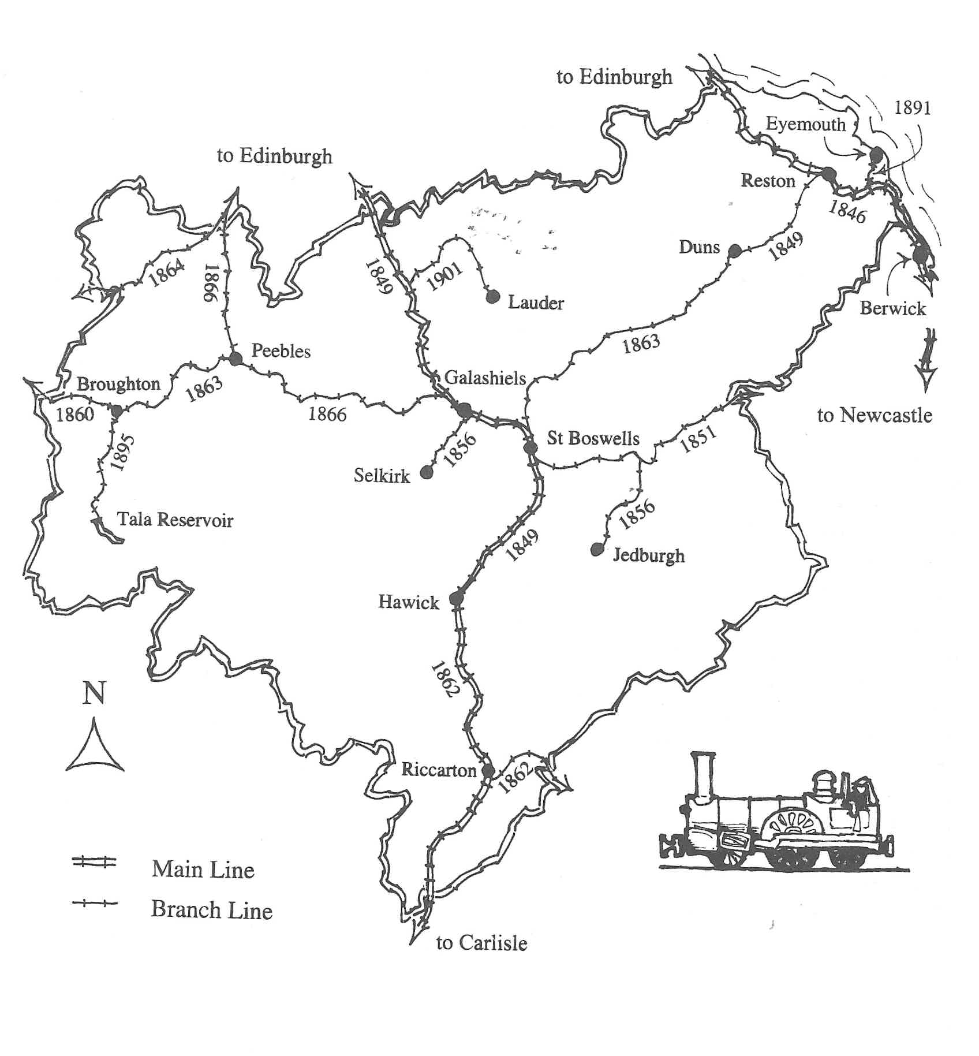
Railways in the Scottish Borders

Slide 18
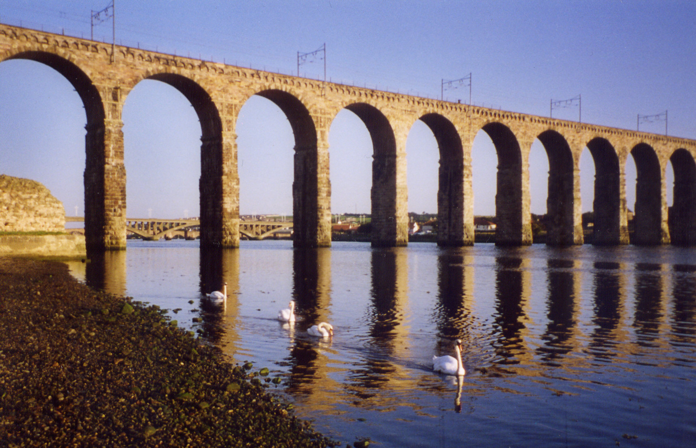
Royal Border Bridge, Berwick-upon-Tweed, 1850

Slide 19
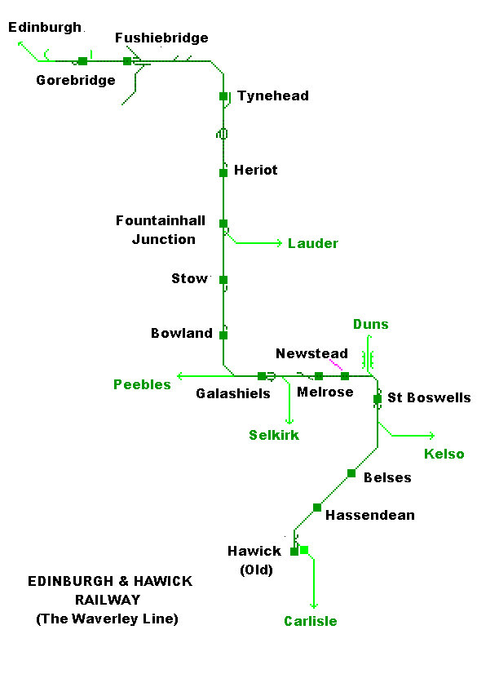
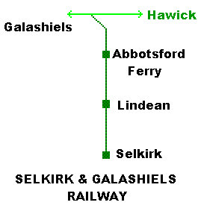

Slide 20
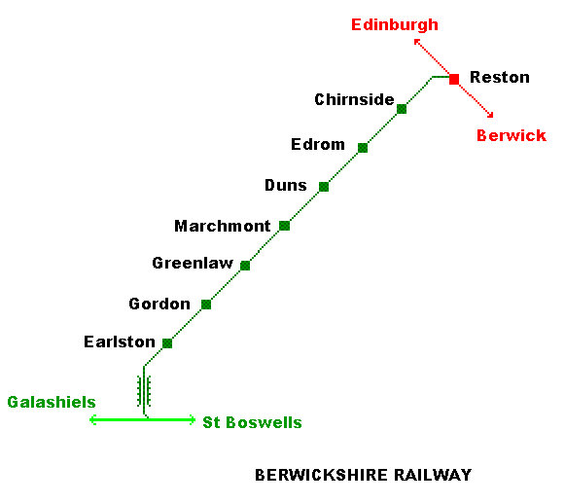

Slide 21
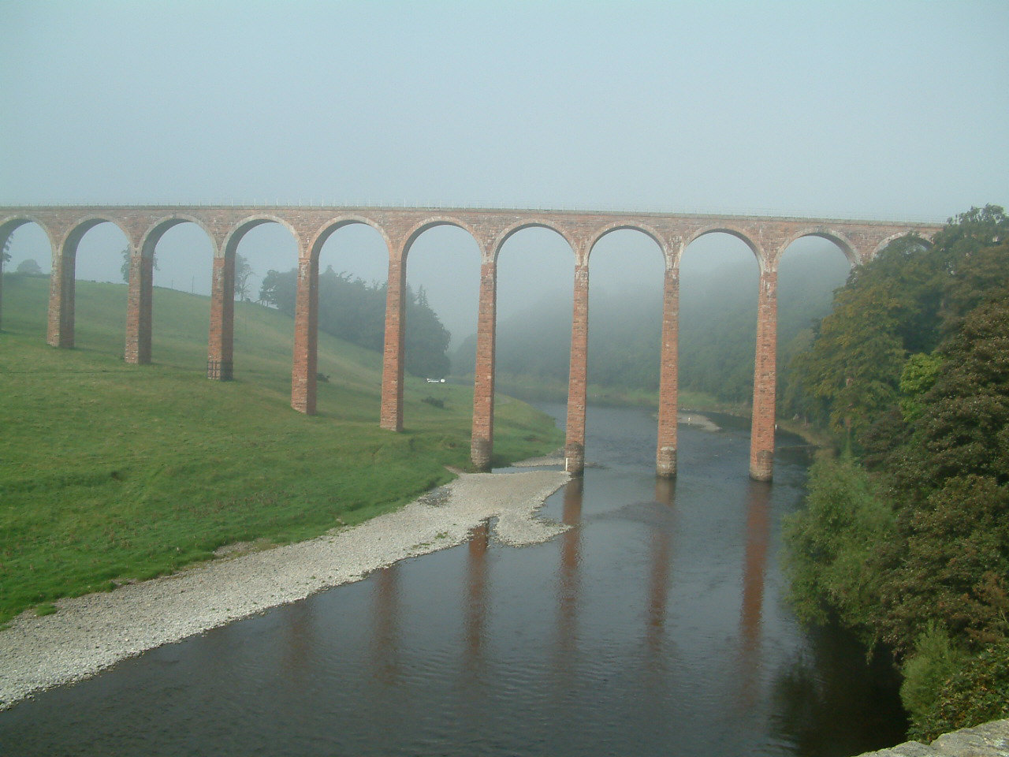
Leaderfoot Viaduct, 1865

Slide 22
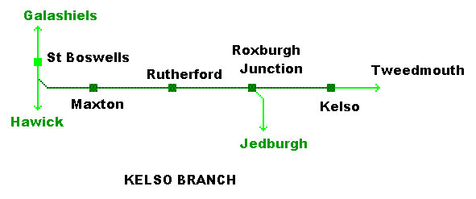
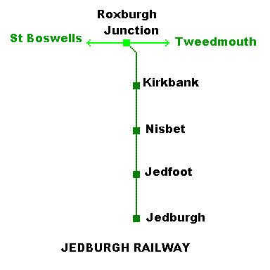

Slide 23
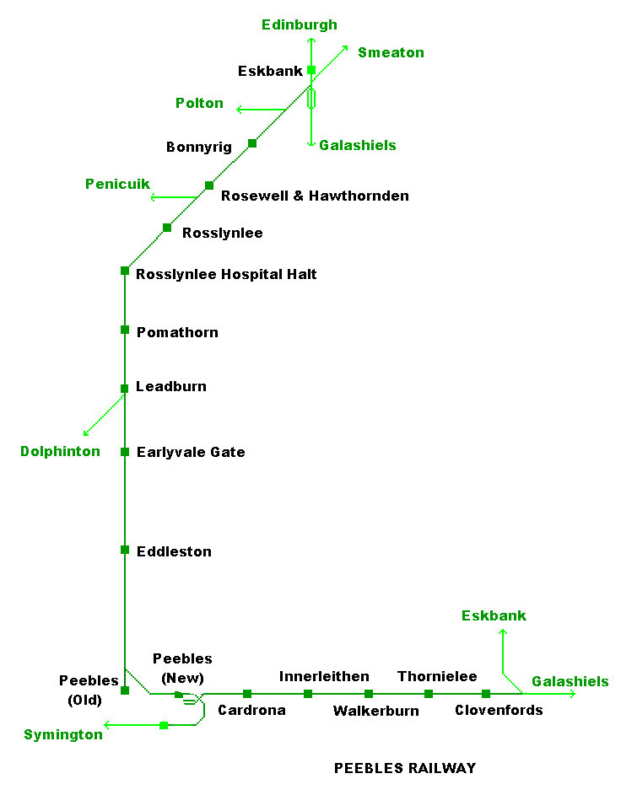

Slide 24
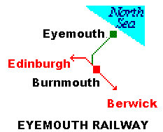
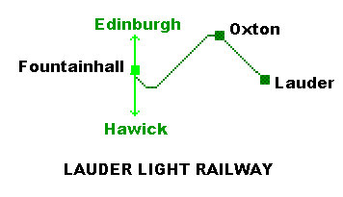

Slide 25
Railways in the Scottish Borders

