Slide 1
Cavaliers and Covenanters

Slide 2
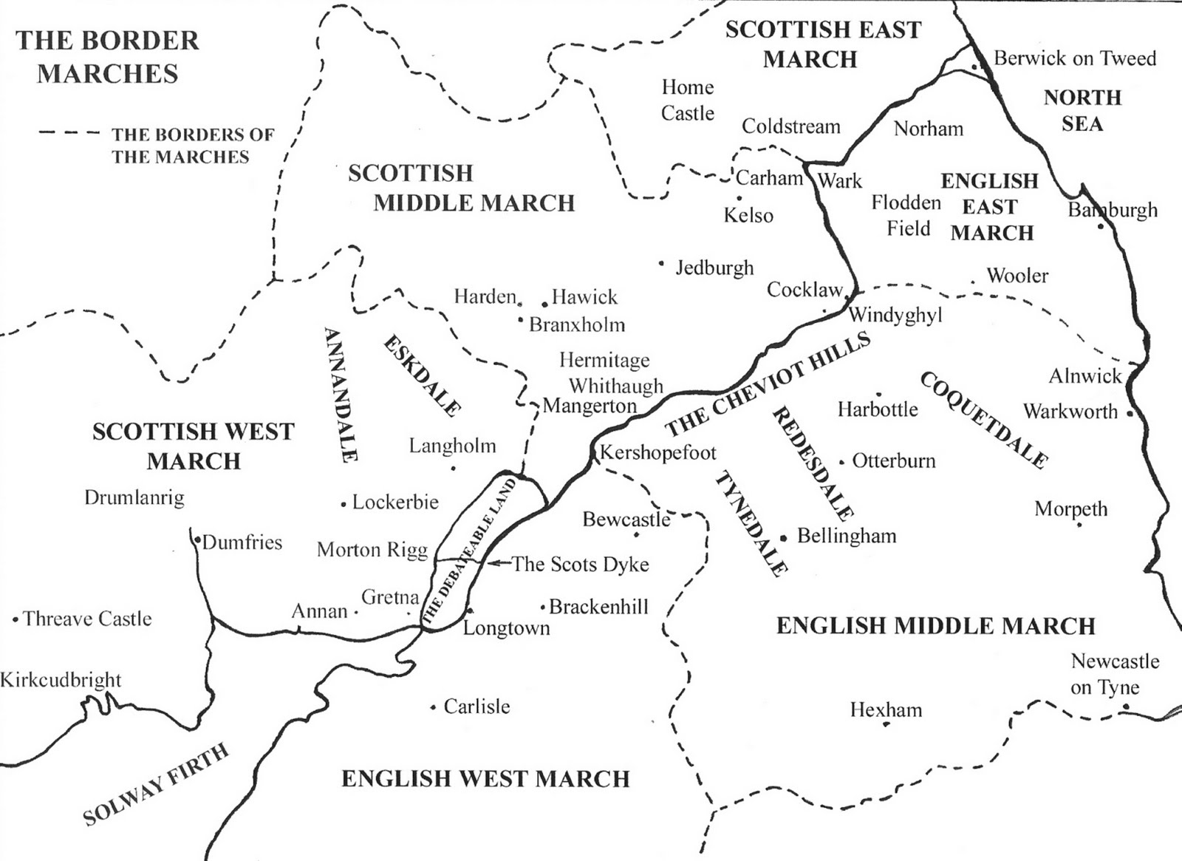

Slide 3
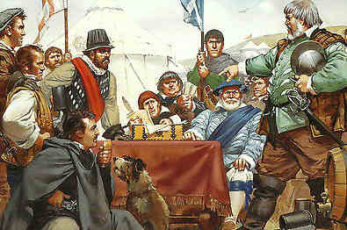
A Wardens’ Tryst

Slide 4
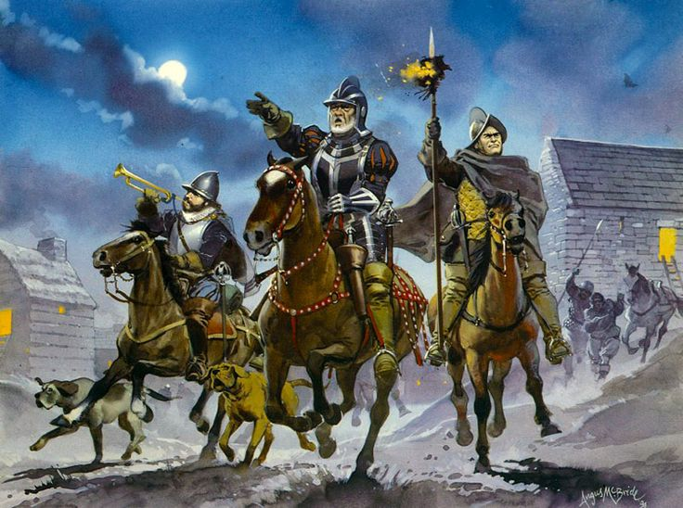
The “Hot Trod”

Slide 5
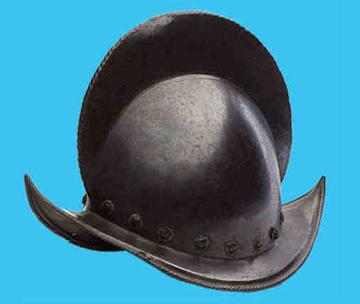
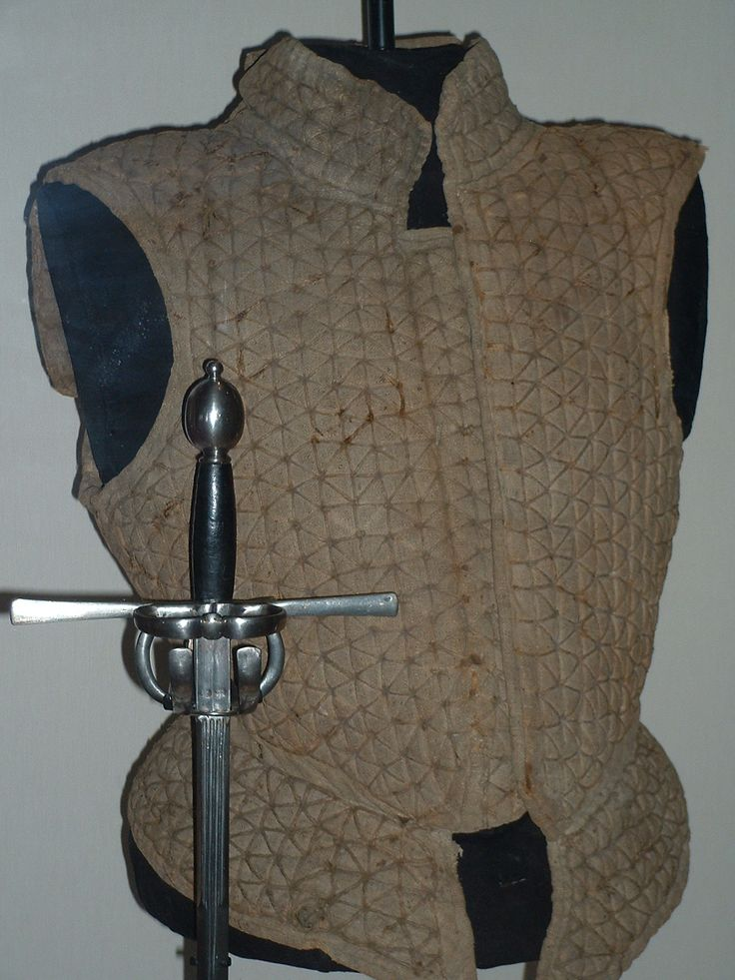
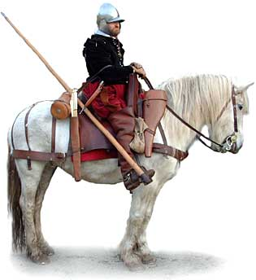
A padded jack
Morion helmet
Border reiver with burgonet helmet and lance

Slide 6
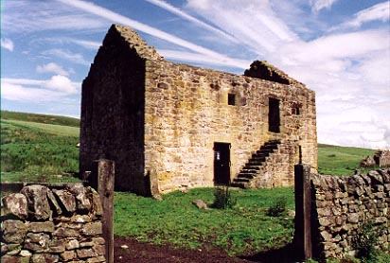
Woodhouses Bastle, Northumberland

Slide 7
SPOILS IN THE ENGLISH MIDDLE MARCH
From Sir Cuthbert Collingwood to Sir Francis Walsingham - 23rd August 1587
On 8th July 4 men of East Tevedale took out of Alnwick park, within half a mile of Sir John Forster’s house, 4 horses.
On 9th July 12 of the same took from Ditchburne, 40 beasts.
On 13th July 30 of the same, took at East Lilburne and Waperdon (Wooperton), hurting 5 men in peril of their lives in pursuit, 24 oxen and kyne and 60 sheep.
On 14th July 4 of the same took from Ingram church, 4 webbes of lead.
On 15th July 12 of same took out of Strangwood, John Horsley’s house, 120 sheep.
On 16th July 40 of West Tevedale took out of Byrkhouses in Redesdale, 40 oxen and kyne.
On 18th July 300 of East Tevedale took out of Warton within 2 miles of Harbottle, and hurt 3 men, 30 oxen and kyne, and 6 horses.
On same day 6 men of same took out of Fadon, 80 sheep.
On 20th July 20 of West Tevedale took from Horseley, besides 2 men hurt on defence, 30 kyne.
On 23rd July 8 of East Tevedale took at Beanly, 100 sheep.
On St. James’s Day 20 of Liddesdale came in the day time to Haughton upon the water of Tyne, and broke and spoiled the house of Thomas Erington gentleman, to the value of 100s in household stuff, and 30 kyne and oxen.
On 28th July 20 of East Tevedale came in the evening to Eslington, Sir Cuthbert Collingwood’s dwelling house, and hurt 2 off his servants, and took 3 geldings.
On 7th August The Laird of Bucclughe with 200 men, burned the Woodsde at Riddesdale and murdered one John Dunne.
On 9th August 160 OF West Tevedale burned Netherton within 2 miles of Harbottle and carried away 80 cattle.
On 11th August 400 of East Tevedale took up Old Bewick, and carried away 500 oxen and kyne, 600 sheep, 30 horses and mares. On same night other 40 took away from Reveley, and burnt a house, 200 sheep, 30 kyne and oxen, 15 horses.
SUM TOTALS
100 horses and mares, 1148 oxen and kyne, 1020 sheep besides 20 prisoners ransomed and many hurt in defence.

Slide 8
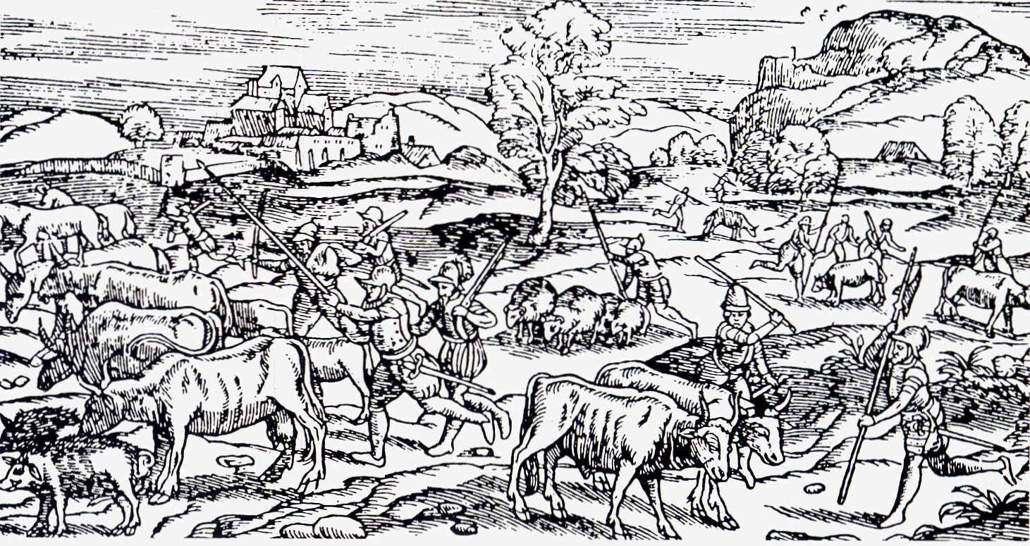
Foray of Scots raiders into Northumberland

Slide 9
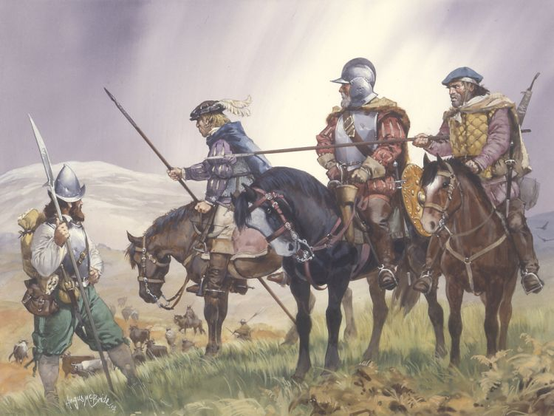
The “heidman”

Slide 10
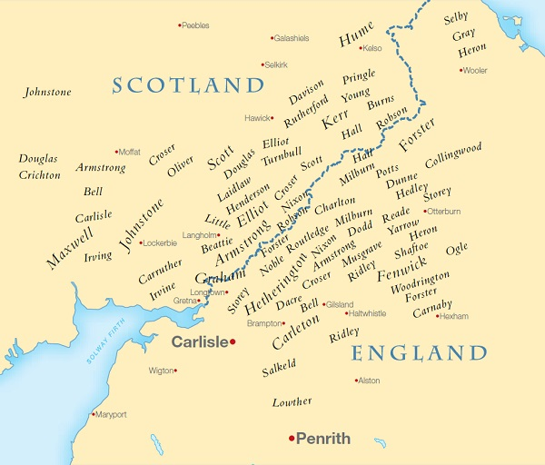
BORDER SURNAMES

Slide 12
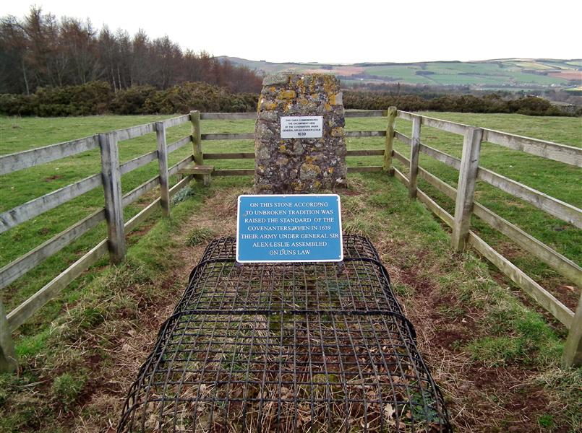
Covenanters’ Stone, Duns Law

Slide 13
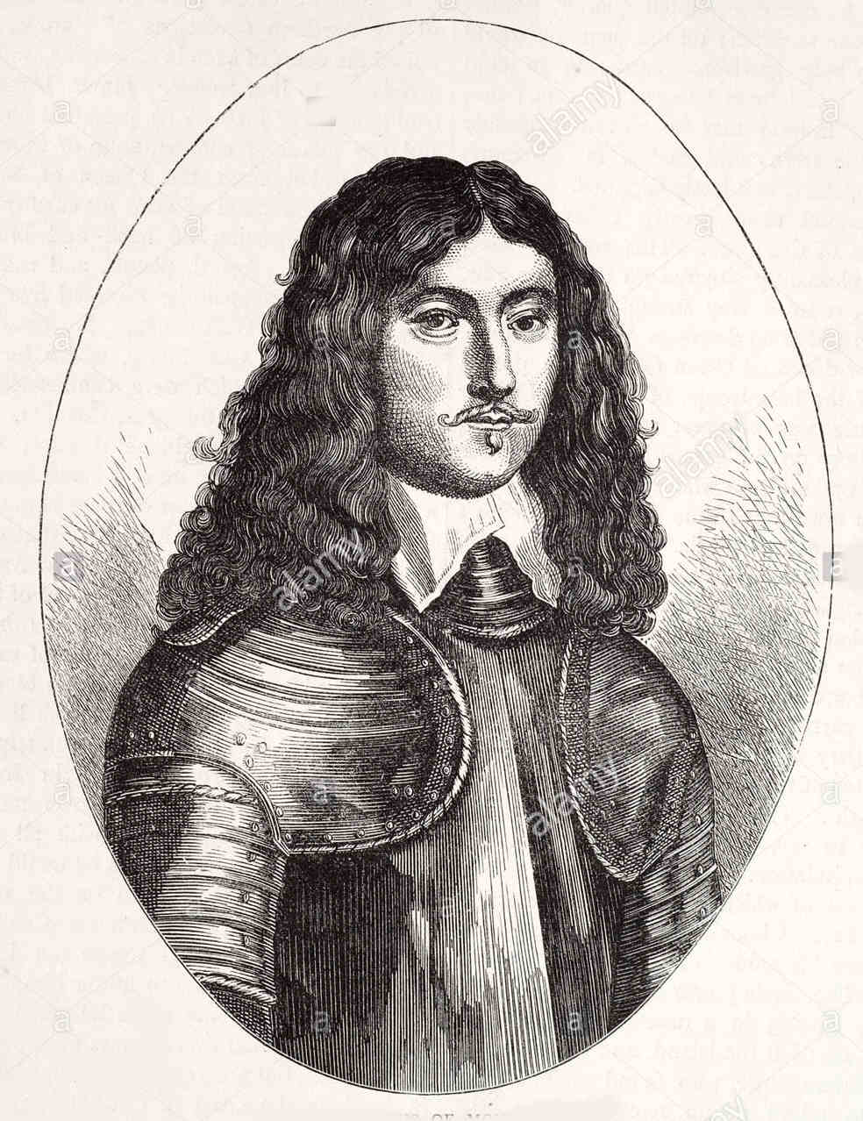
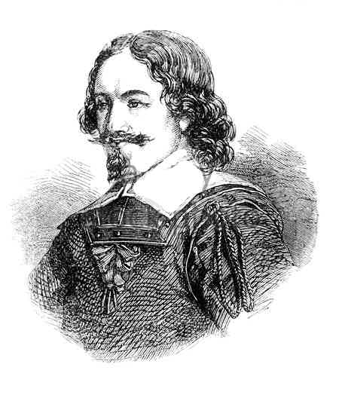
James Graham, Marquis of Montrose
General Alexander Leslie, Earl of Leven

Slide 14
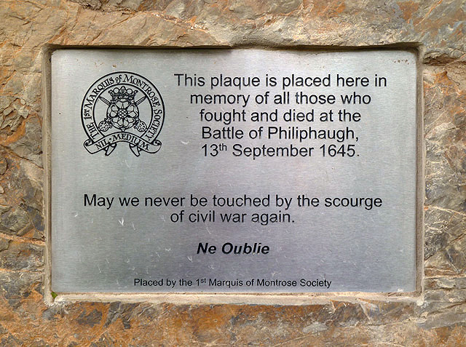
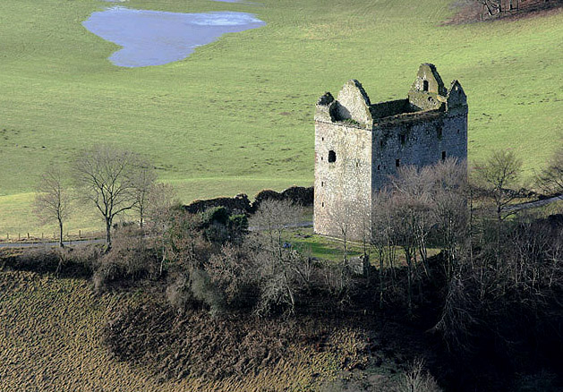

Slide 15
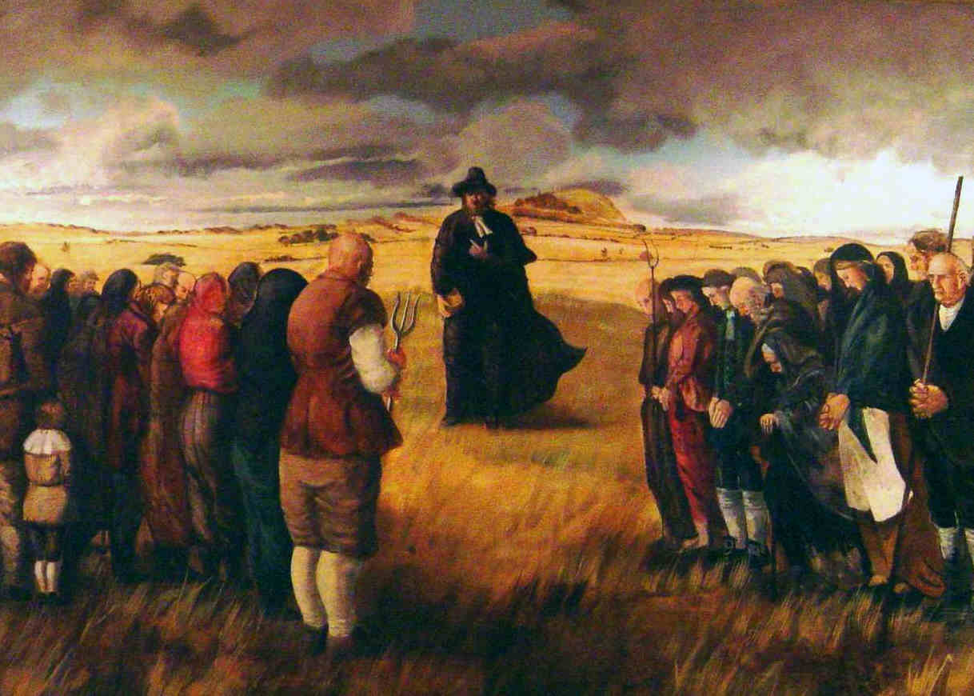
A Covenanters’ Conventicle

Slide 16
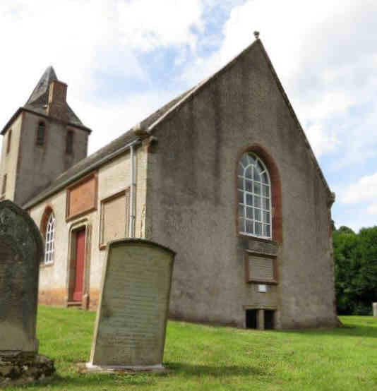
Polwarth Church

Slide 17
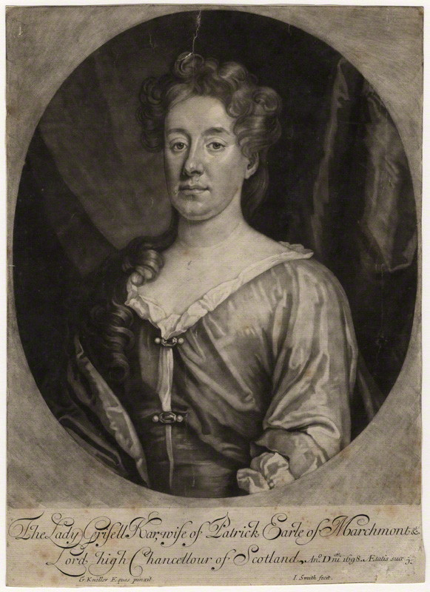
Grizzell Hume,
daughter of Patrick Hume, 1st Earl of Marchmont

Slide 18
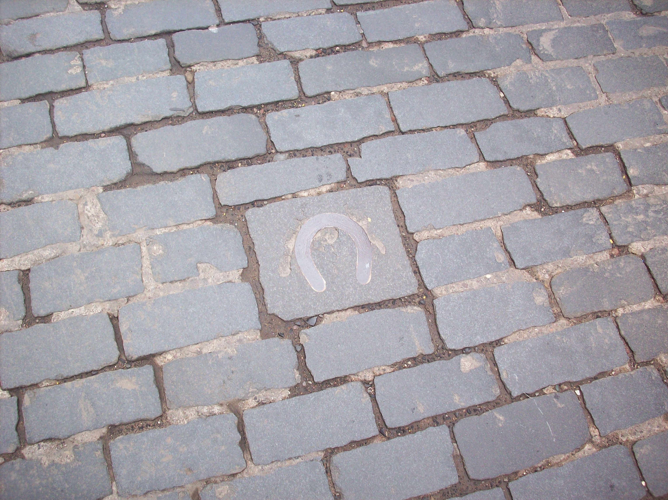
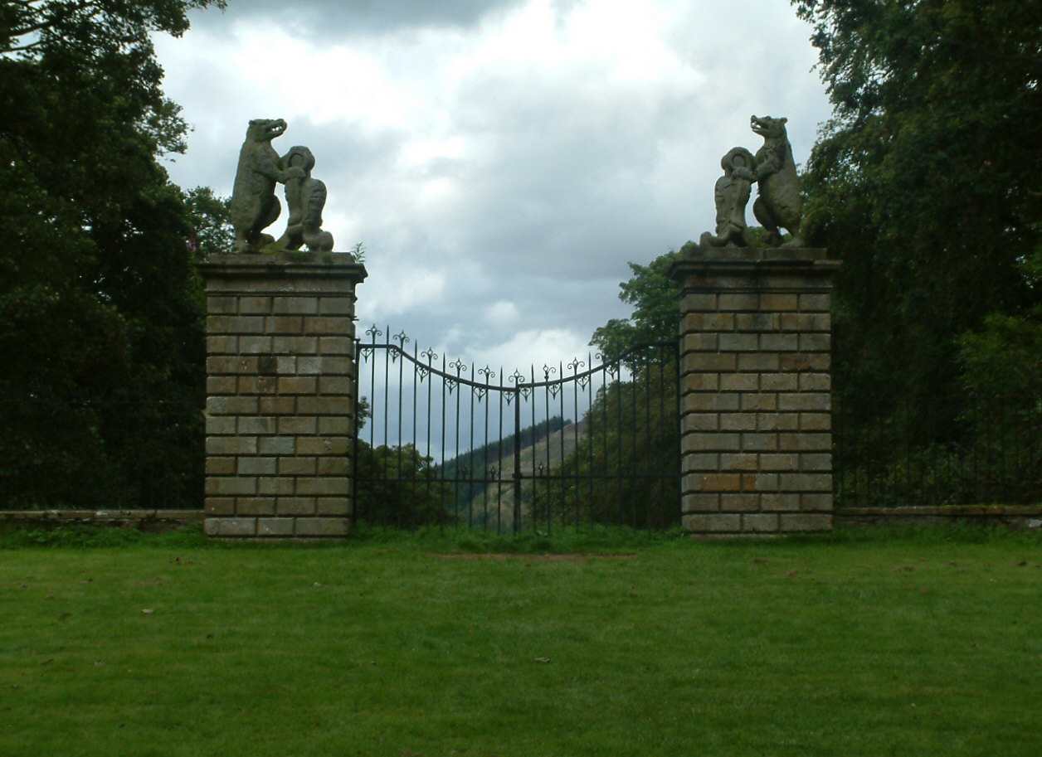
Bonnie Prince Charlie’s Horseshoe, Kelso
The Bear Gates, Traquair House

