Slide 1
Saints
and
Settlers

Slide 2
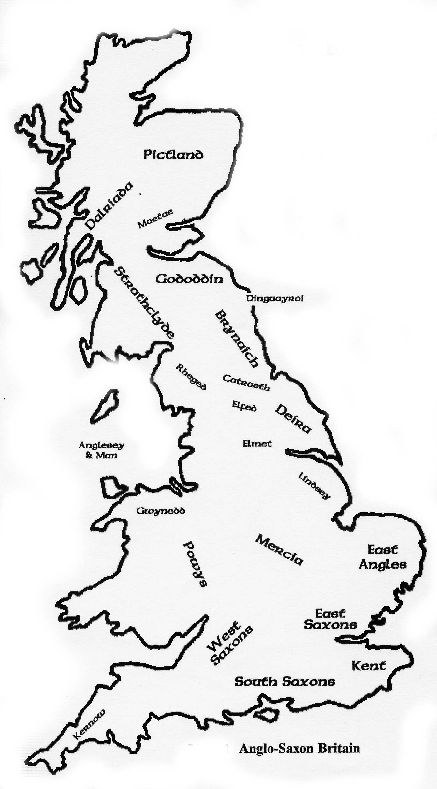
Anglo-Saxon Britain circa 600AD

Slide 3
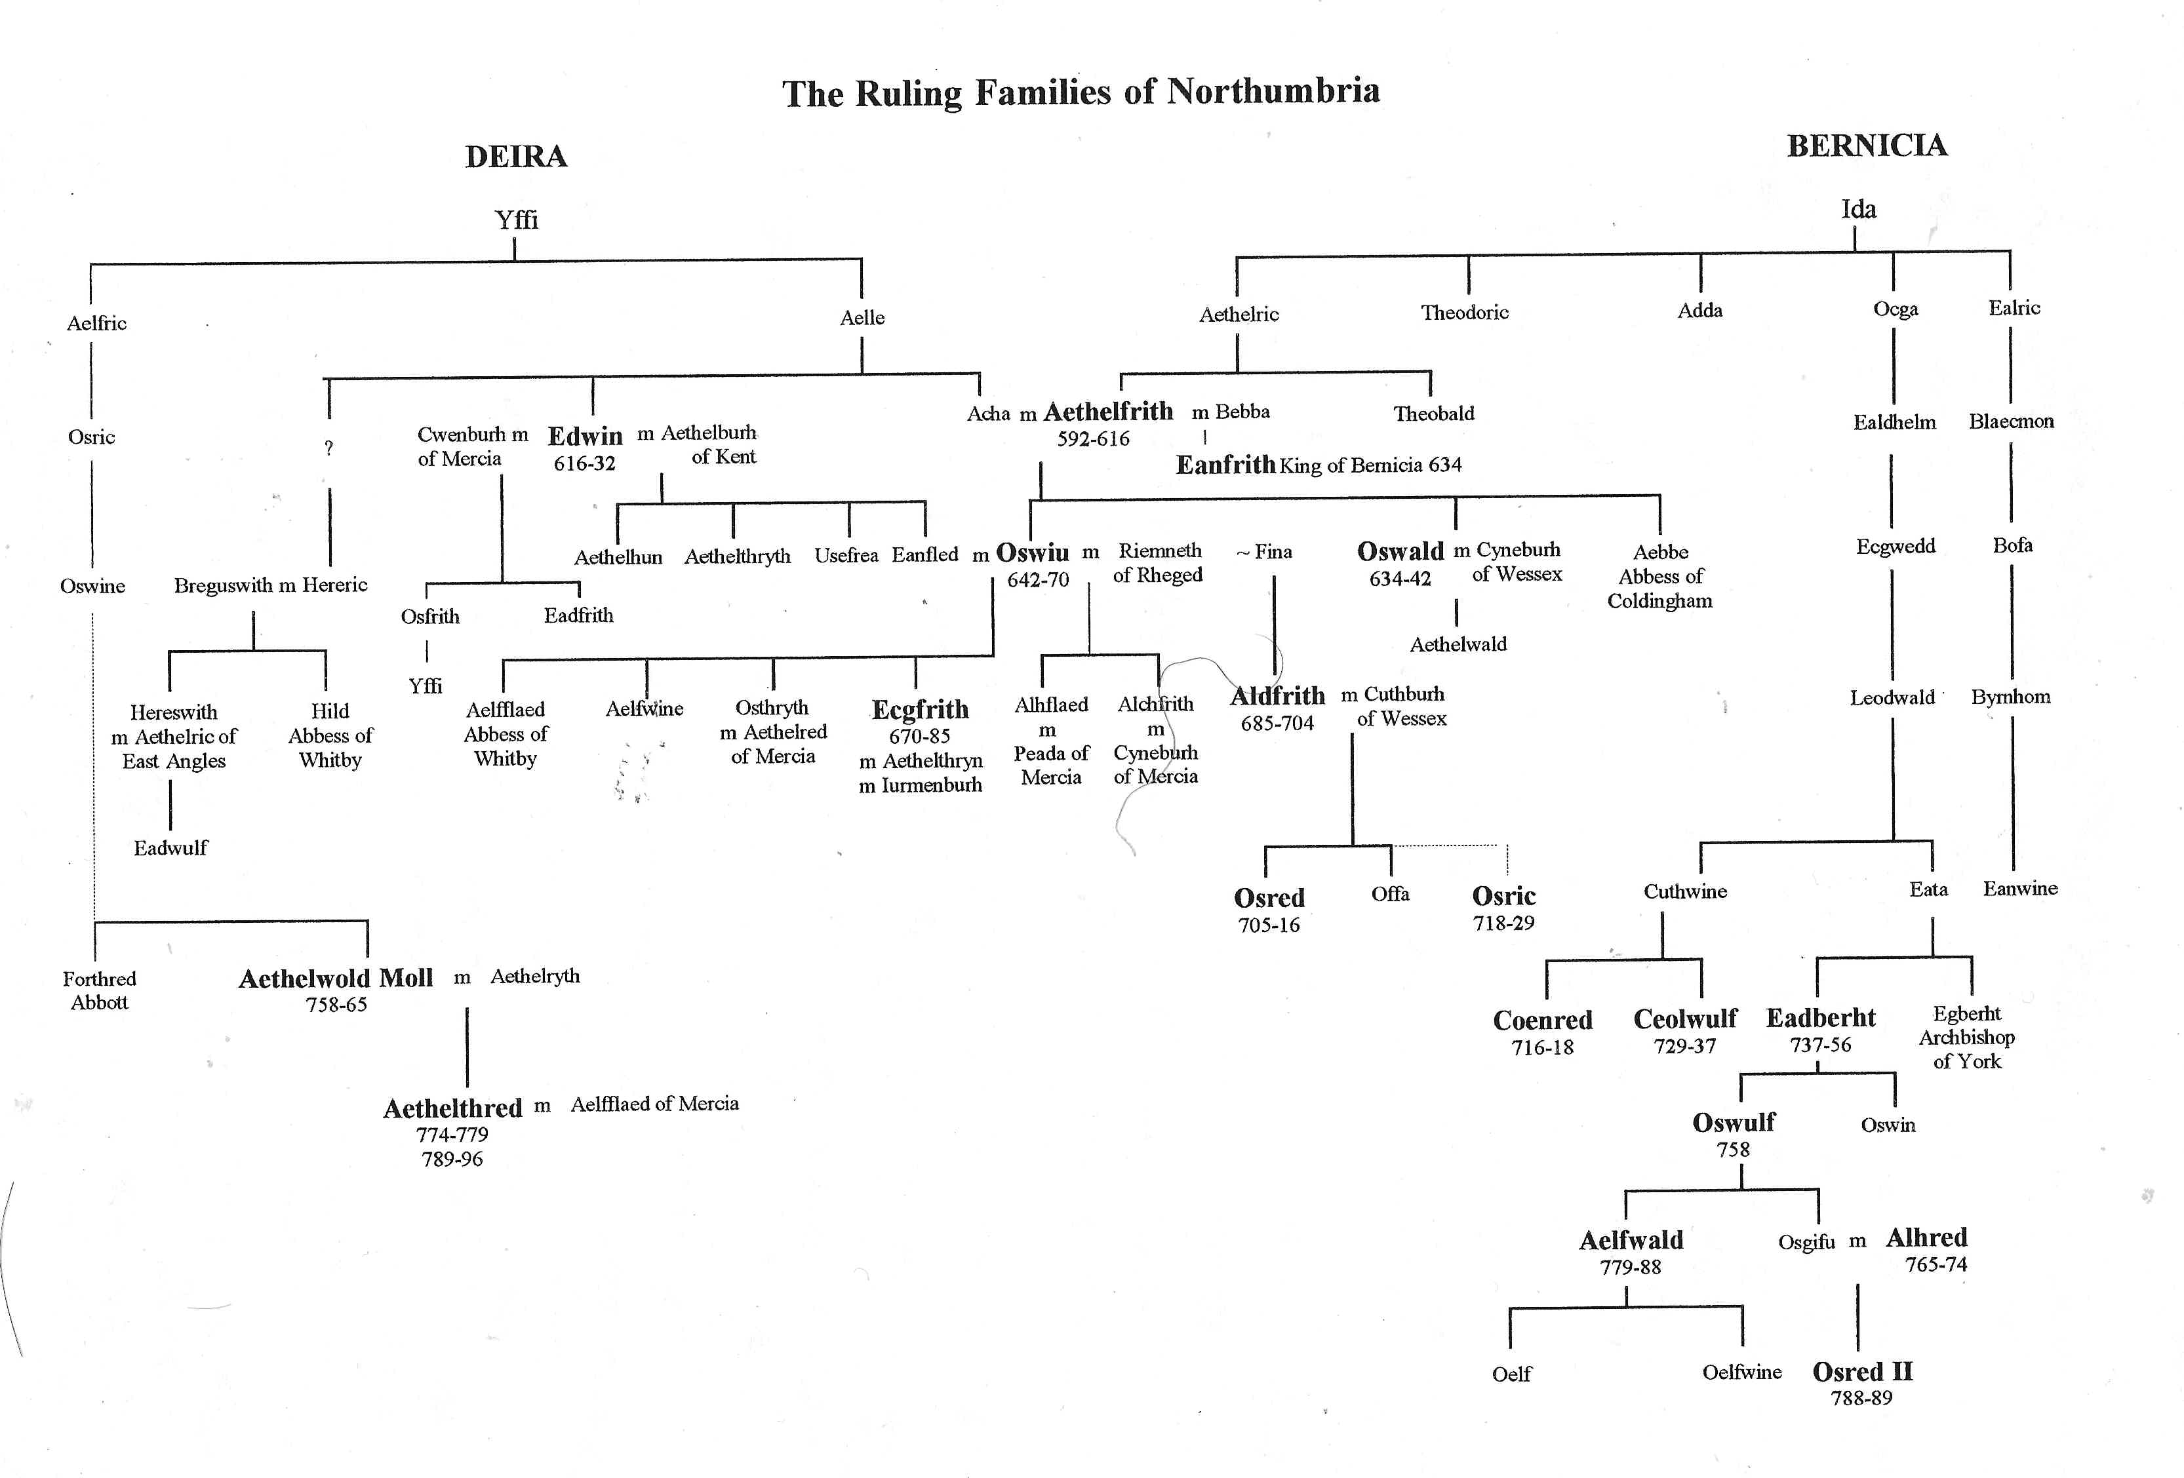
Ruling Dynasties of Northumbria

Slide 4
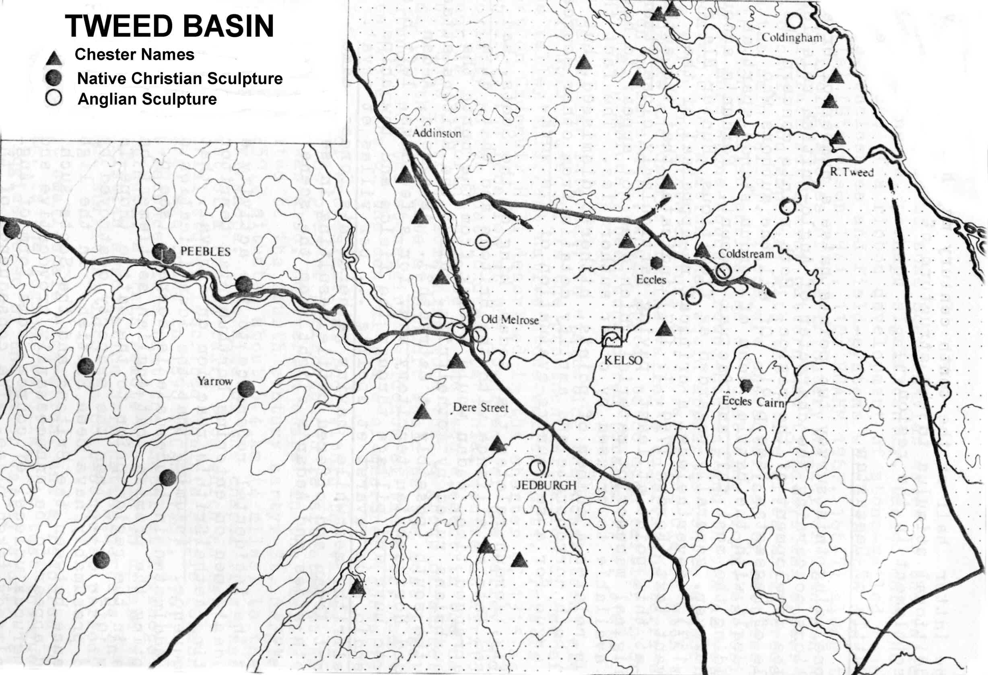

Slide 5
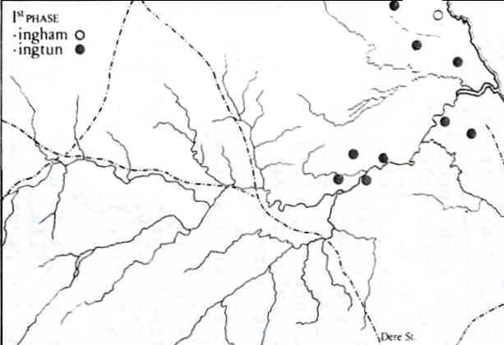

Slide 6
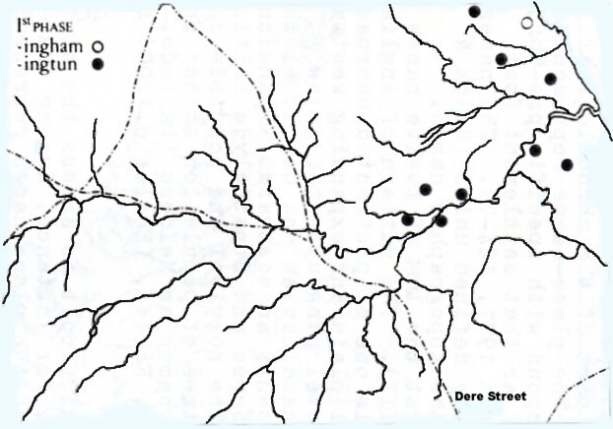

Slide 7
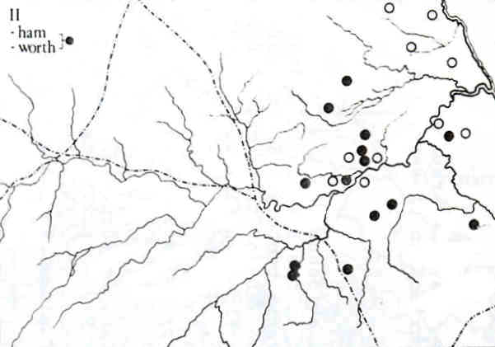

Slide 8
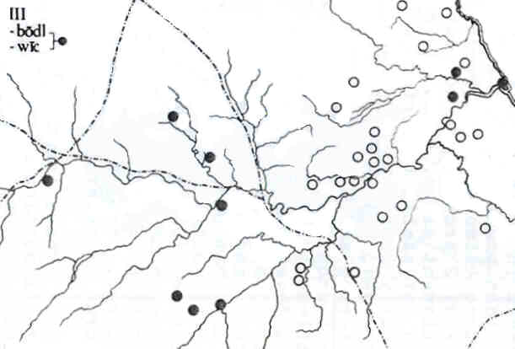

Slide 9
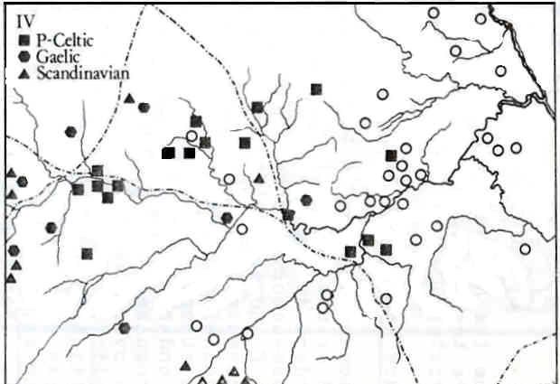

Slide 10
OLD ENGLISH PLACE NAMES
AKELD aic (oak) – helde (slope)
AYTON Eye – tun (estate)
BIRGHAM brycg (bridge) – ham (hamlet)
CESSFORD Cessa’s – worth (enclosure)
DARNCHESTER derne (hidden) – caestre (fortress)
DARNICK derne (hidden) – wic (village)
EARLSTON Erchel’s – denu (valley)
FELKINGTON Felca’s - ing (people’s) tun (estate)
HAWICK haga (fortified enclosure) – wic (village)
INGRAM angr (grass) – ham (hamlet)
KELSO calc (chalk) – hoh (hill)
MOREBATTLE mere (lake) – botl (house)
OXNAM oxna (oxen) - ham (hamlet)
SMAILHOLM smail (small) – ham (hamlet)
SWINTON swin (boar or pig) – tun (estate)
WARK weorc (fortification)
YETHOLM geat (gate)– ham (hamlet)

Slide 11
BRITHONIC (CELTIC) PLACE NAMES
CARFRAE cair (fortress) – bre (hill)
ECCLES eccle (church)
INNERLEITHEN inbbhir (confluence) – Leithen (of the Leithen Water)
MELROSE maol (bare) - ros (peninsula)
MINTO mynnydd (moorland) – heuch (low land by a river)
PEEBLES pebyll (temporary shelter)
POLWARTH (B + OE) pol (pool) – worth (enclosure)
TRAQUAIR tref (chief settlement) – Quair (on the Quair Water)
YARROW gardbh (rugged) – abh (stream)
YEAVERING gabhar (goat) – din (hill)

Slide 12
Ruling Dynasties of Northumbria

Slide 13
