Slide 1
FOOD AND DRINK
Archive photographs courtesy of Berwick Record Office

Slide 2
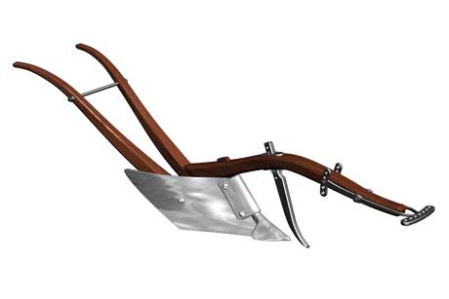
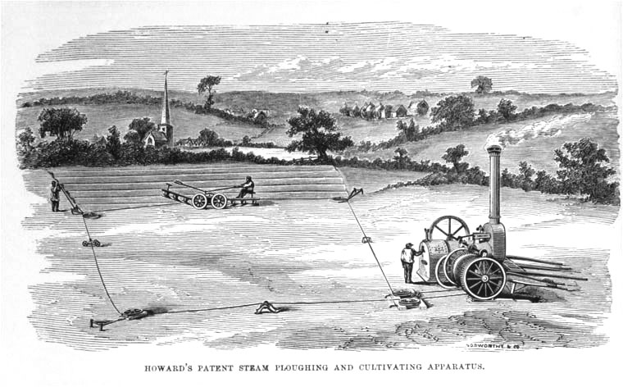

Slide 3
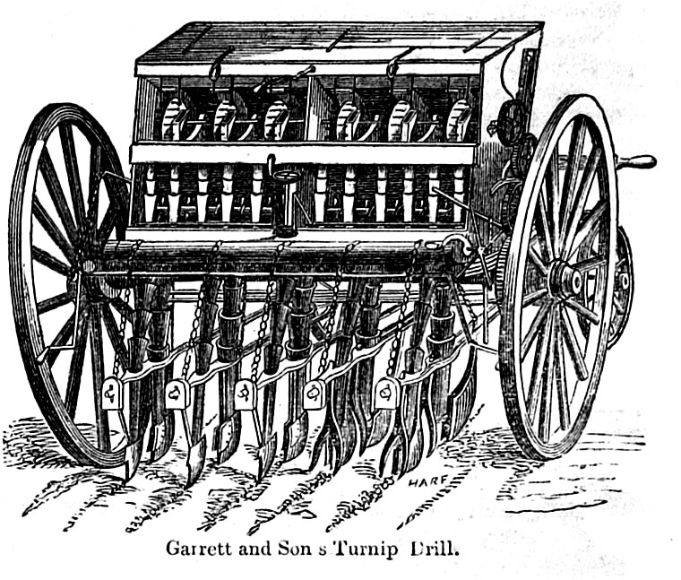
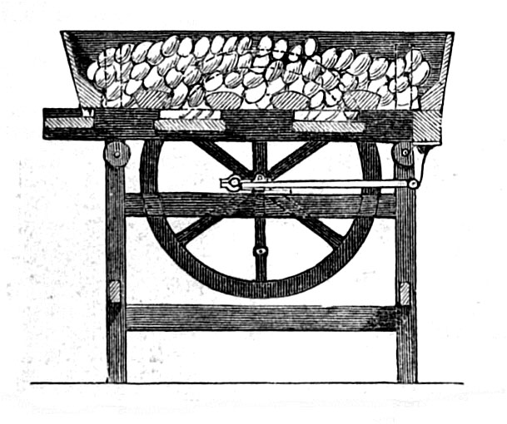
GARDNER'S PATENT
TURNIP CUTTING MACHINE
The above MACHINES being made upon a correct principle, are found to be more effective and perfect in operation than those of any other construction.
In cutting Swedish Turnips their superiority is decidedly manifest.
The Turnips are cut with great ease and exactness, and little waste, into pieces ¾ of an inch wide and ½ an inch thick, suitable for Lambs or Sheep, at the rate of Two Bushels per minute.
WM WILSON & SON, IRONMONGERS,
AGENTS FOR BERWICK-UPON-TWEED
Berwick Advertiser, 20th February 1841

Slide 4
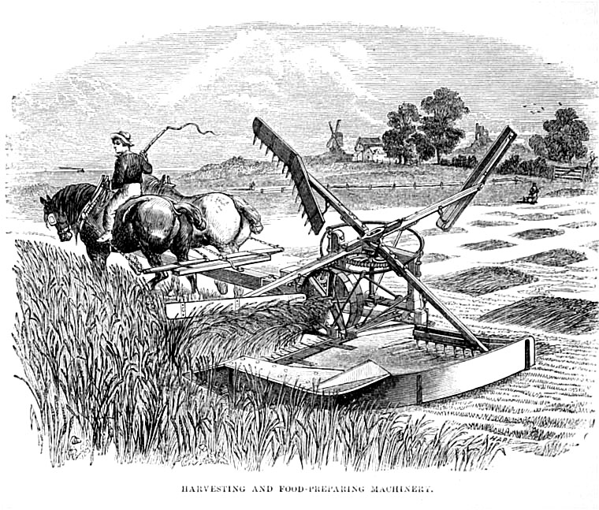
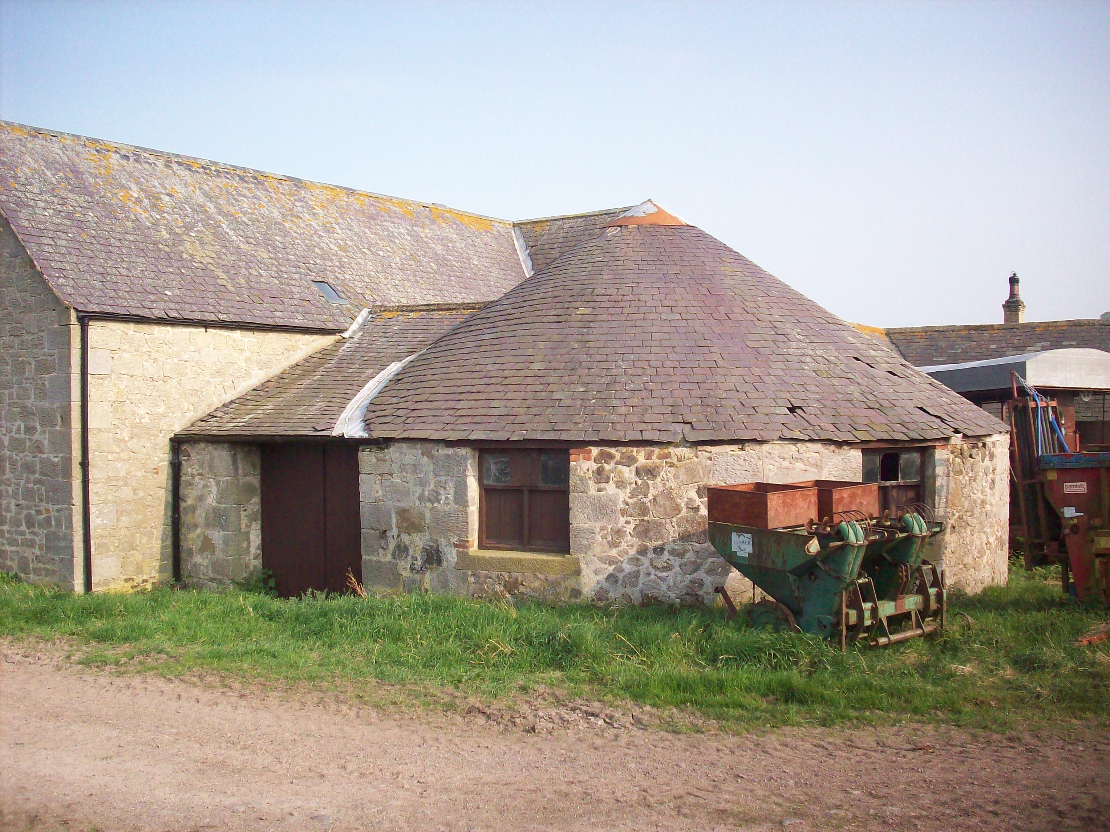
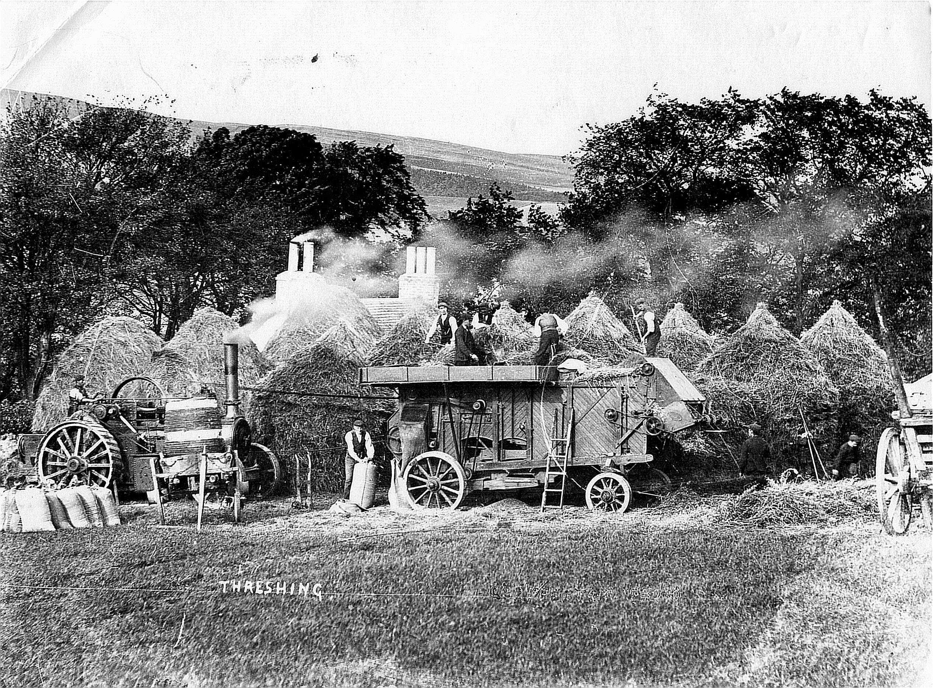
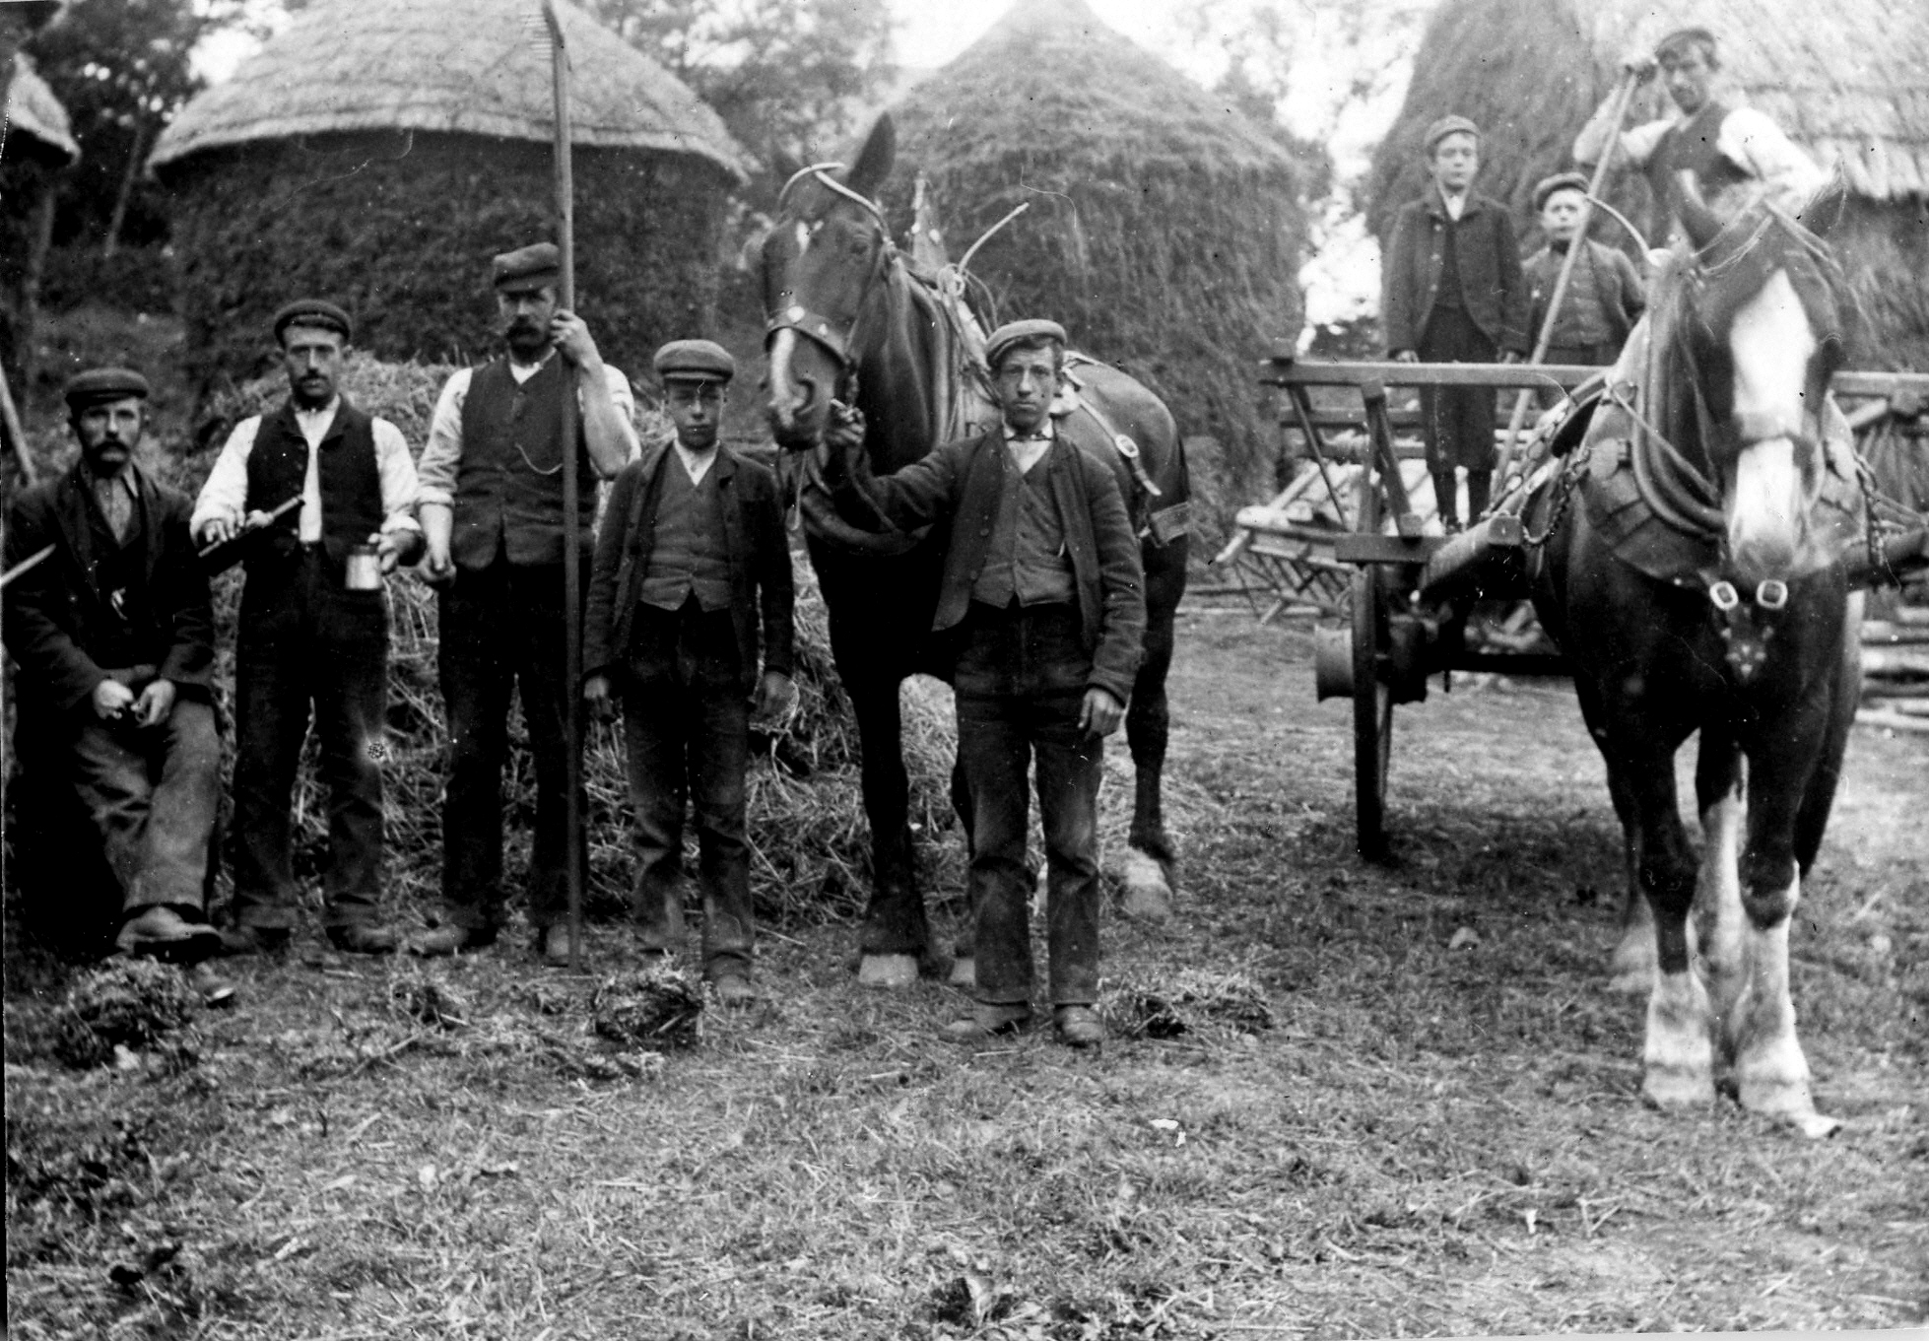
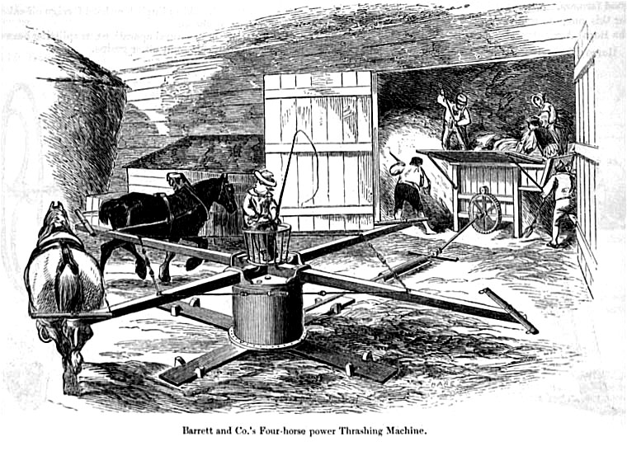
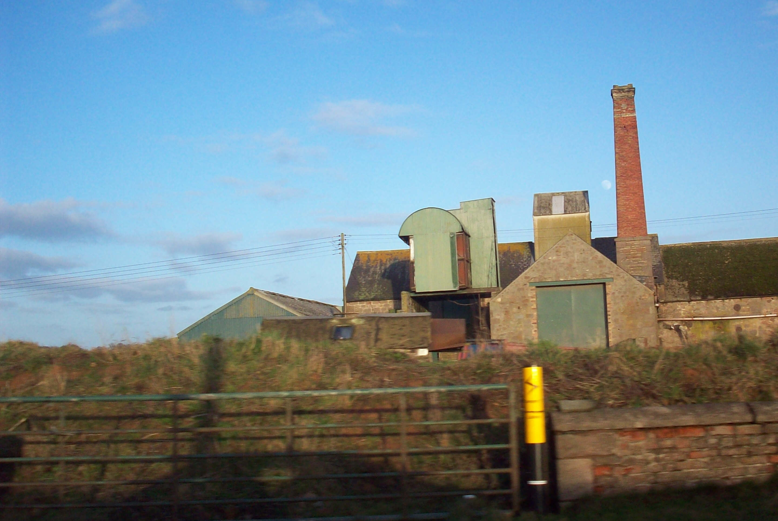

Slide 5
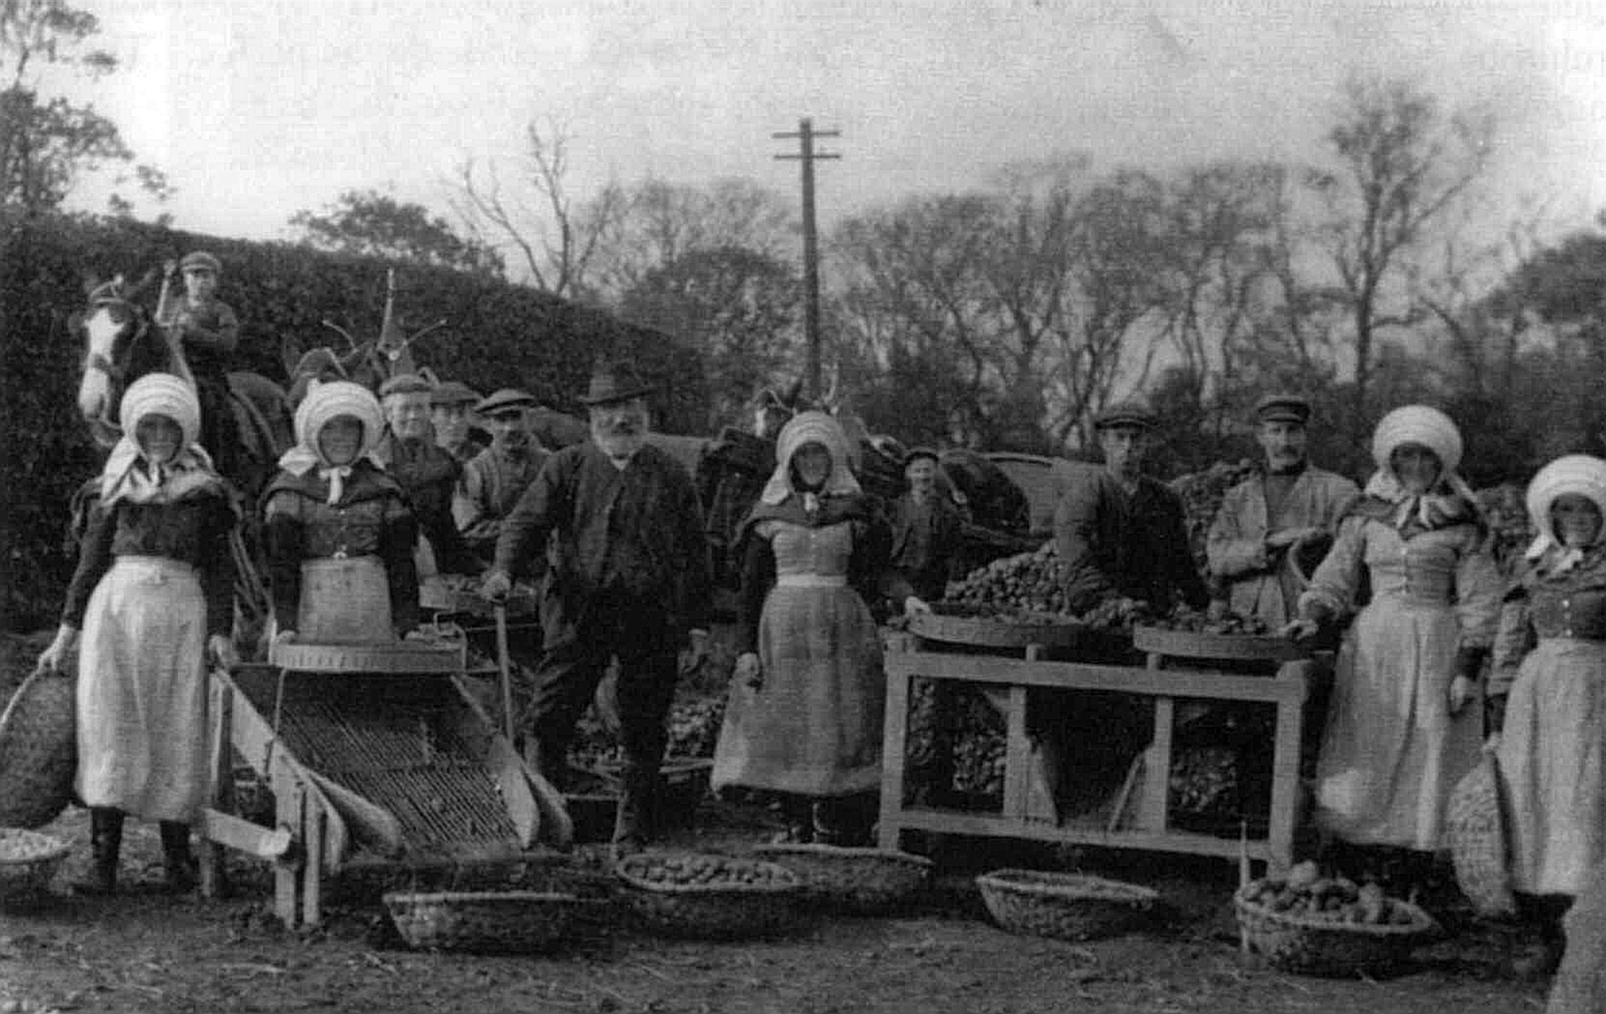
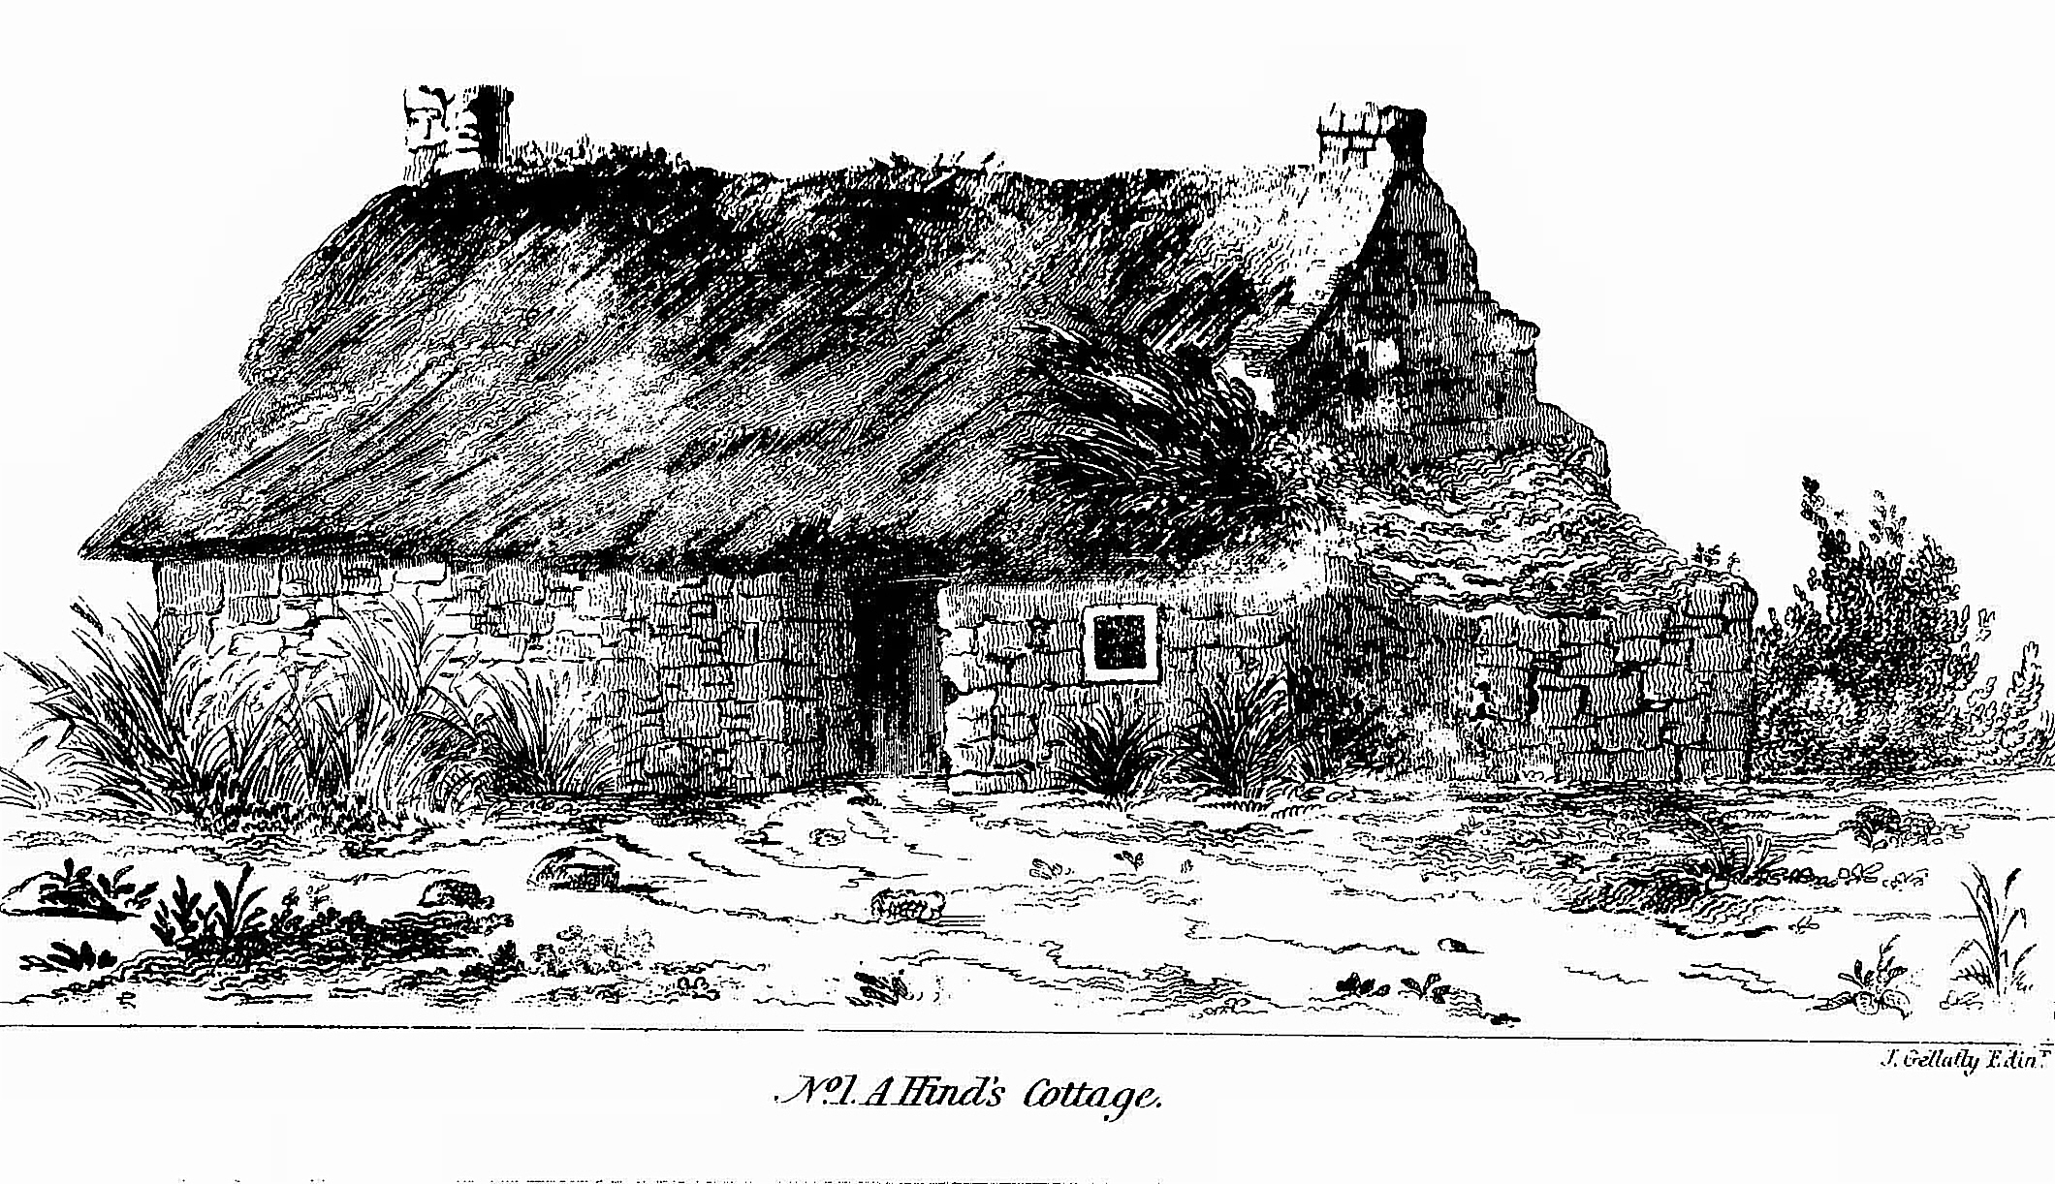
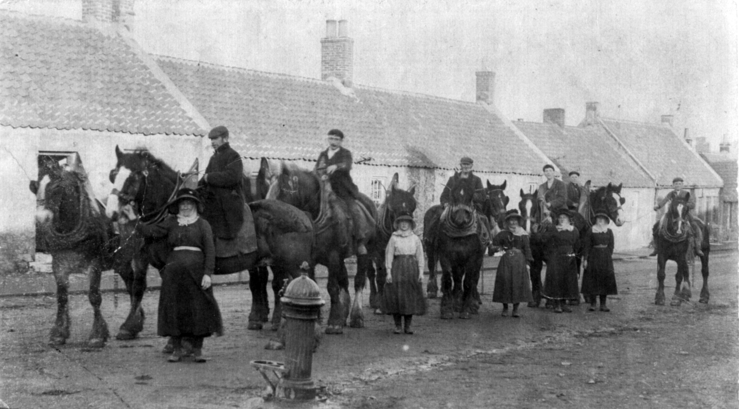

Slide 6
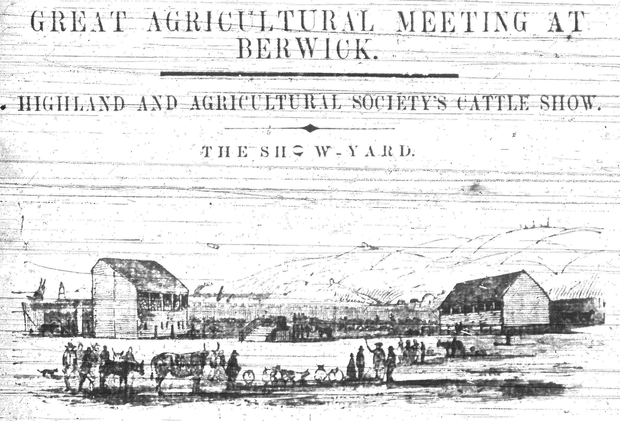
HARVEST BEER
THE BORDER BREWERY COMPANY begs to inform the FARMERS of the District that the Price of their HARVEST BEER is 24s per Barrel of 36 Gallons.
Berwick & Kelso Warder, 18th August 1841

Slide 7
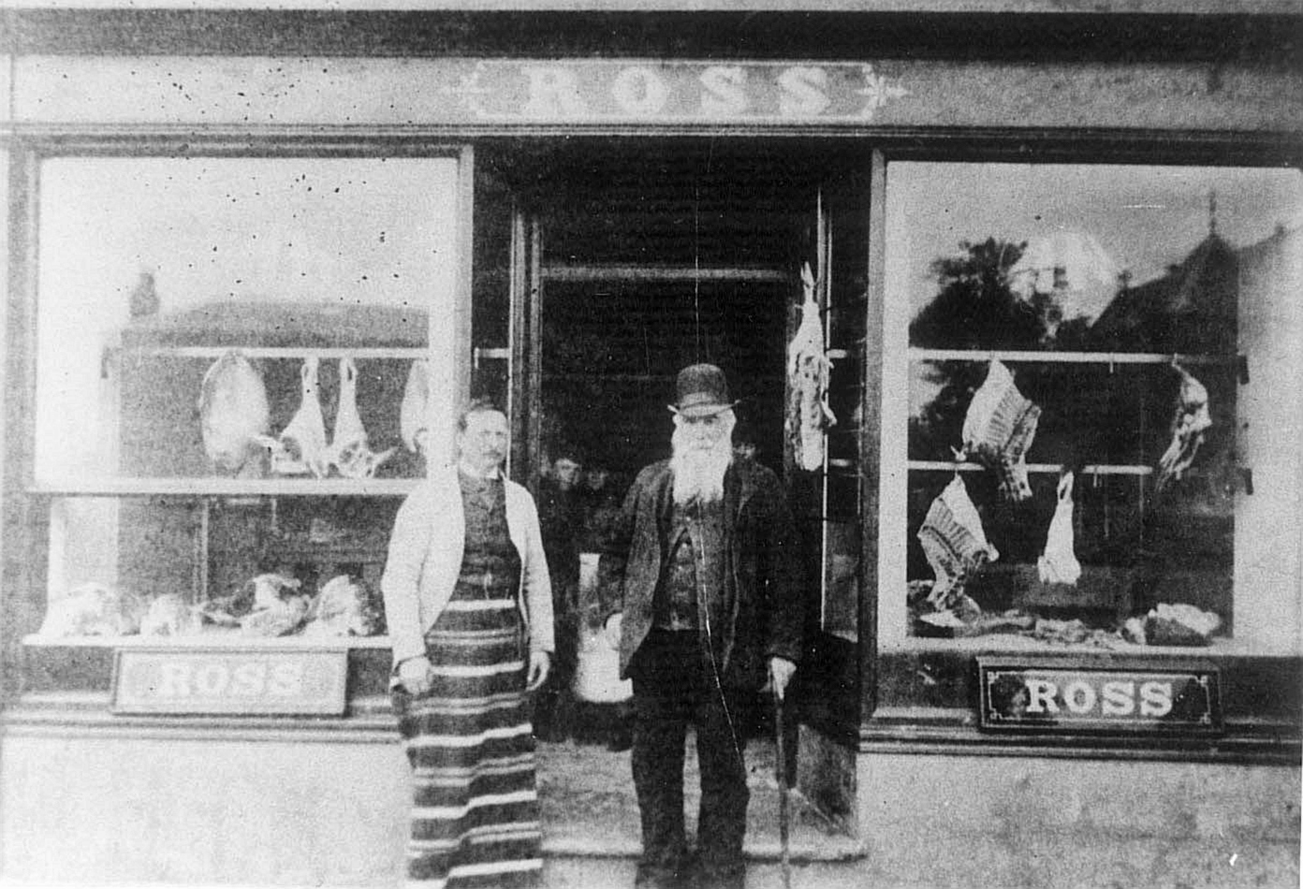
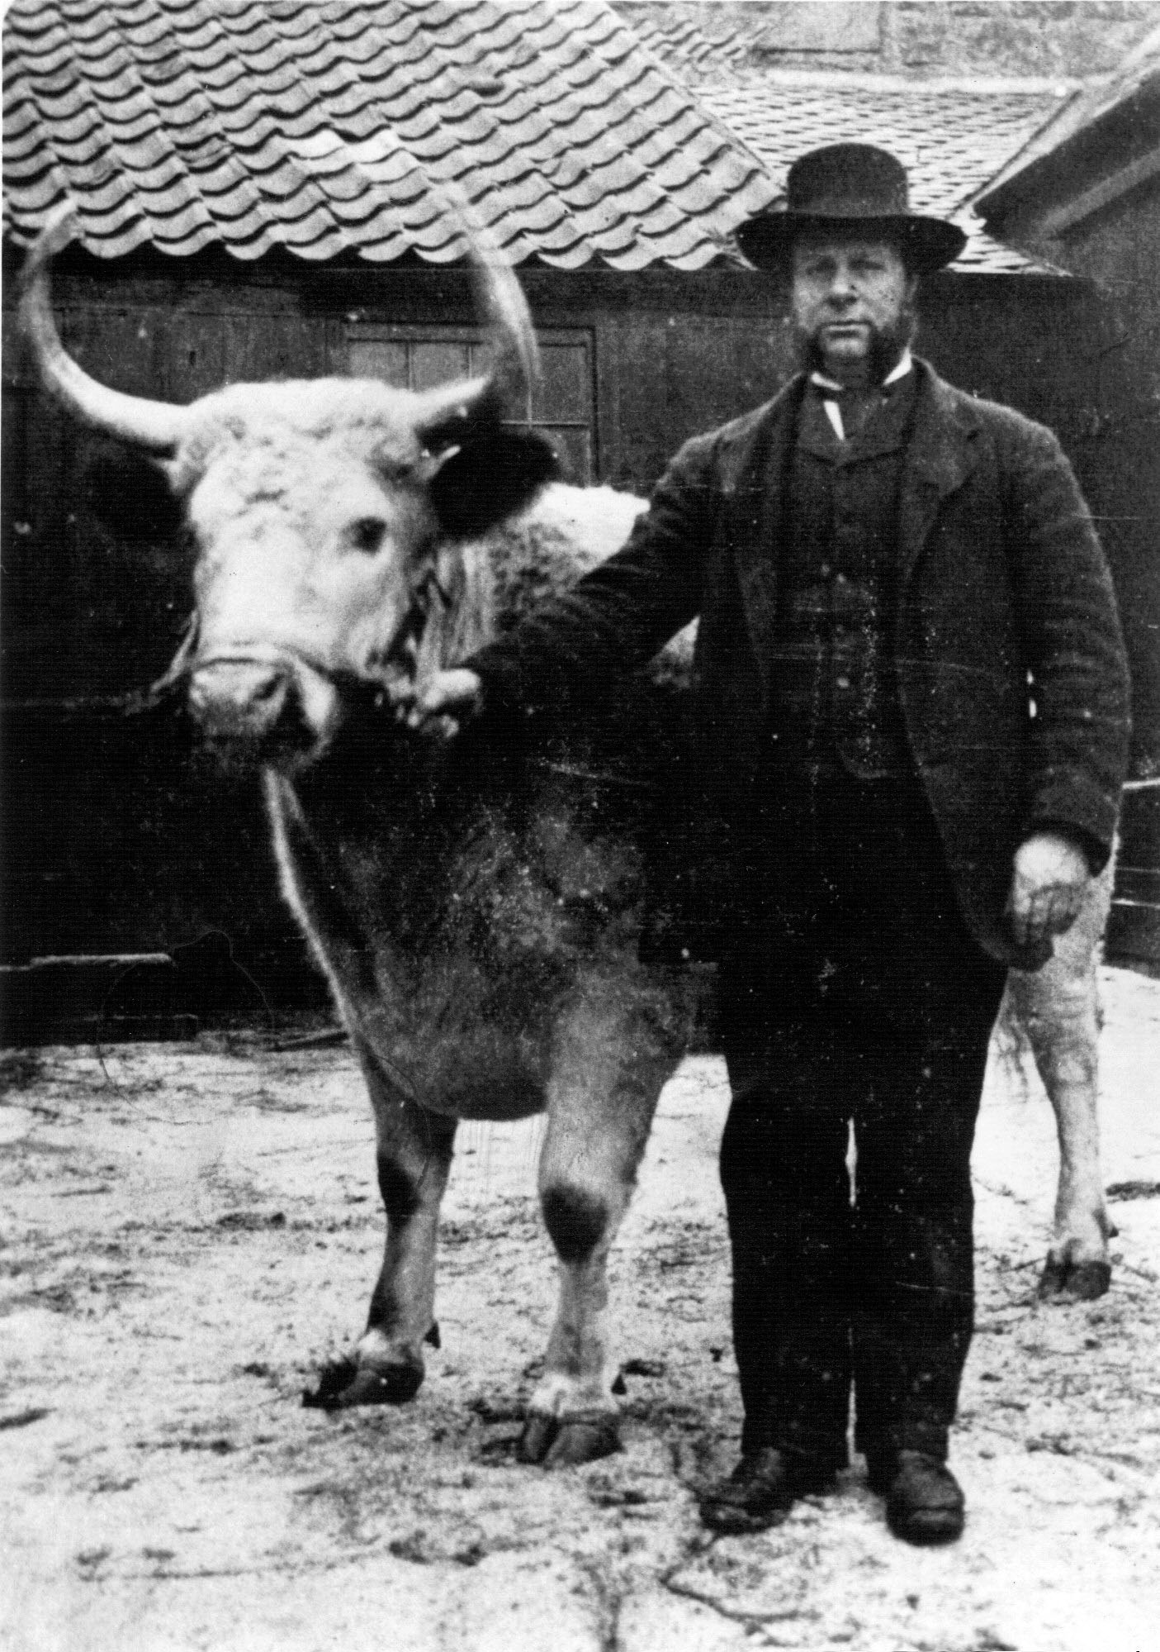
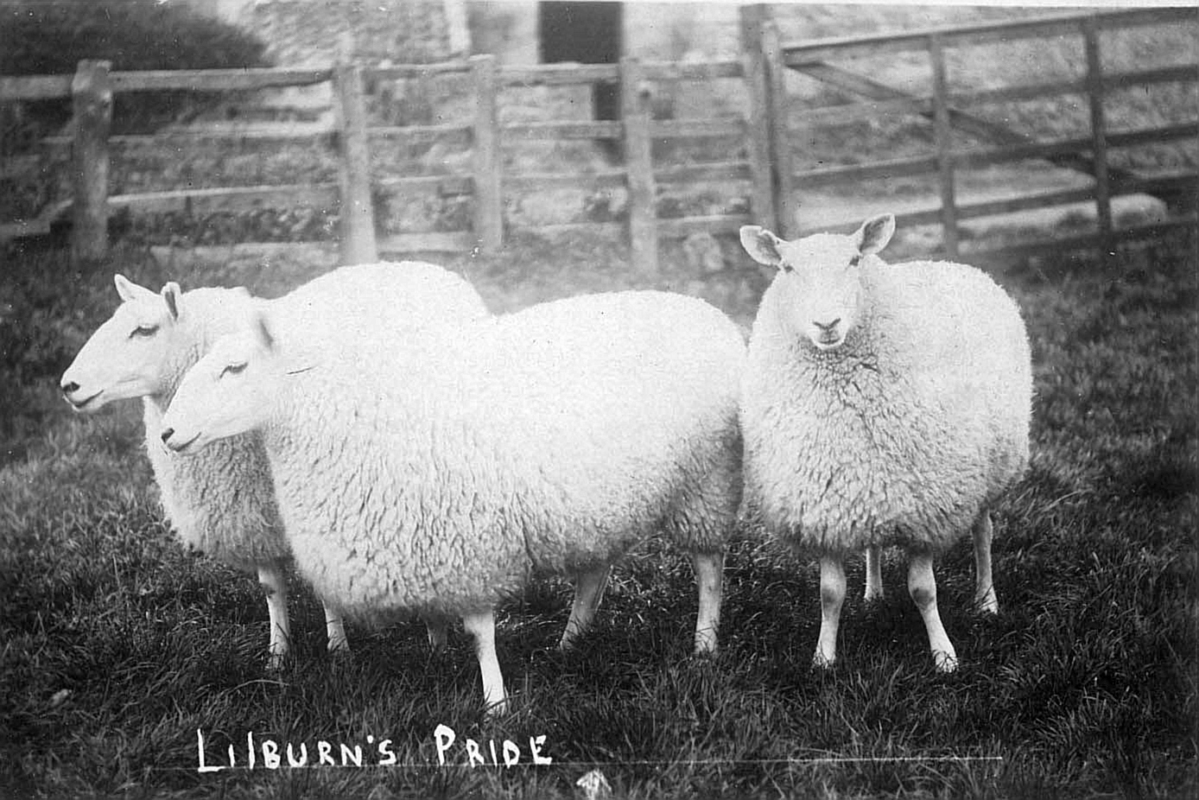
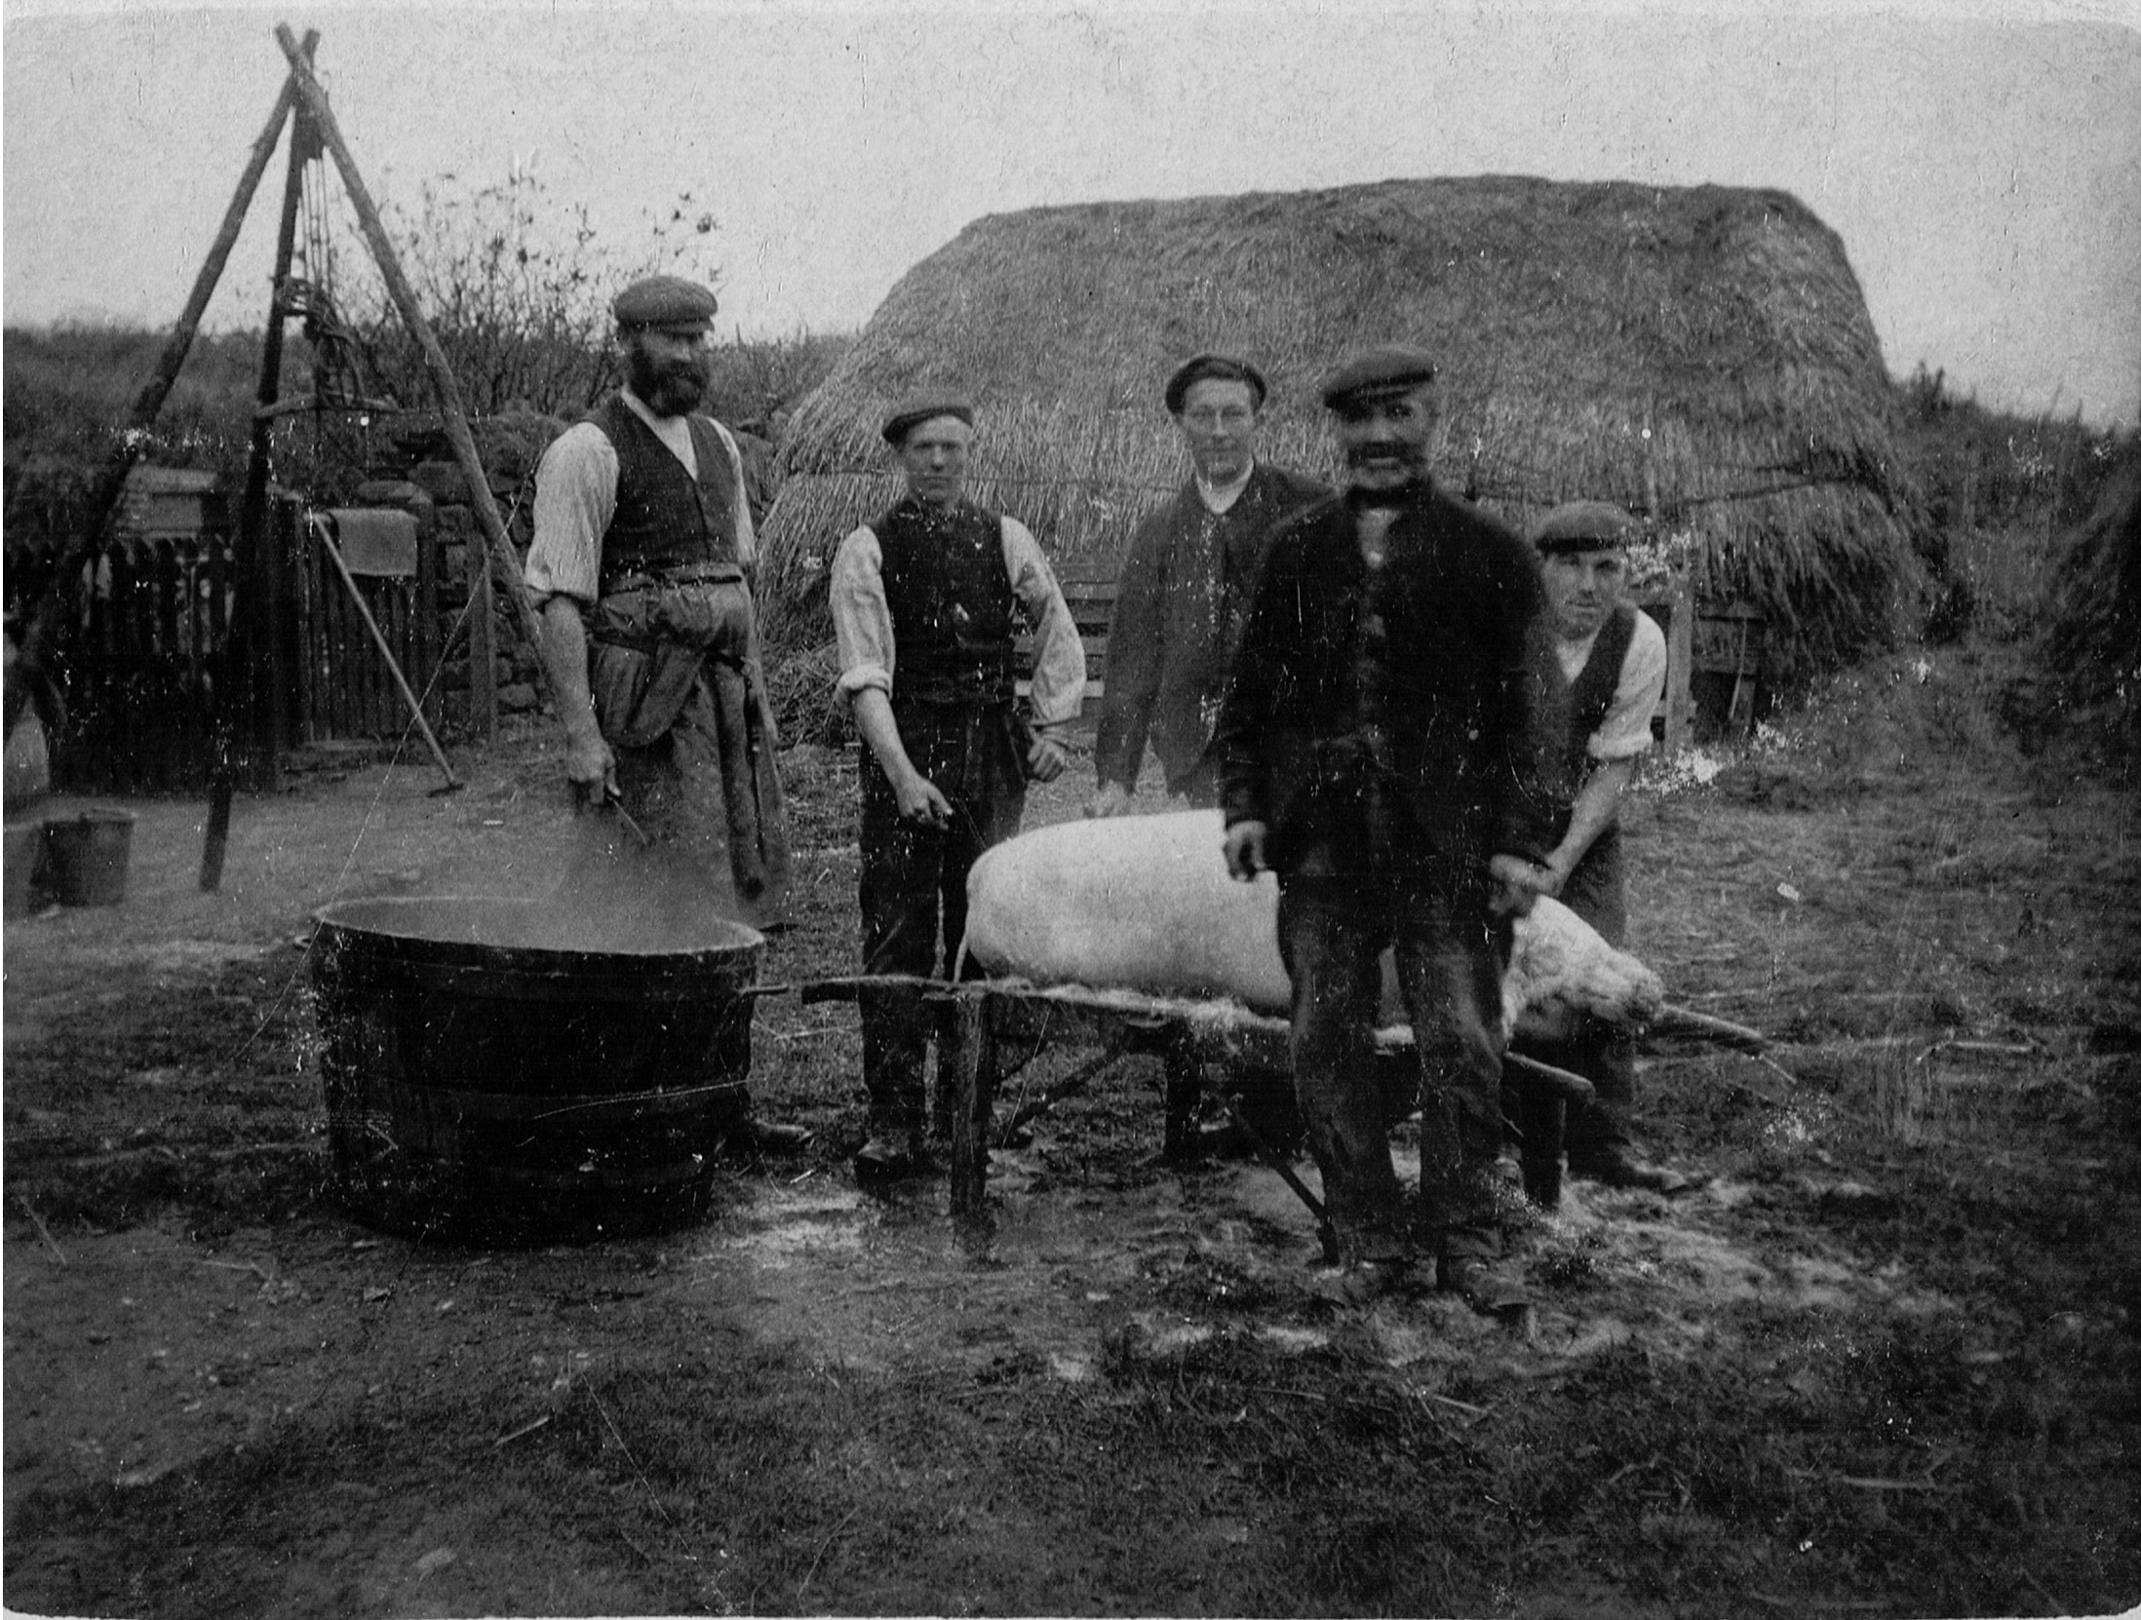

Slide 8
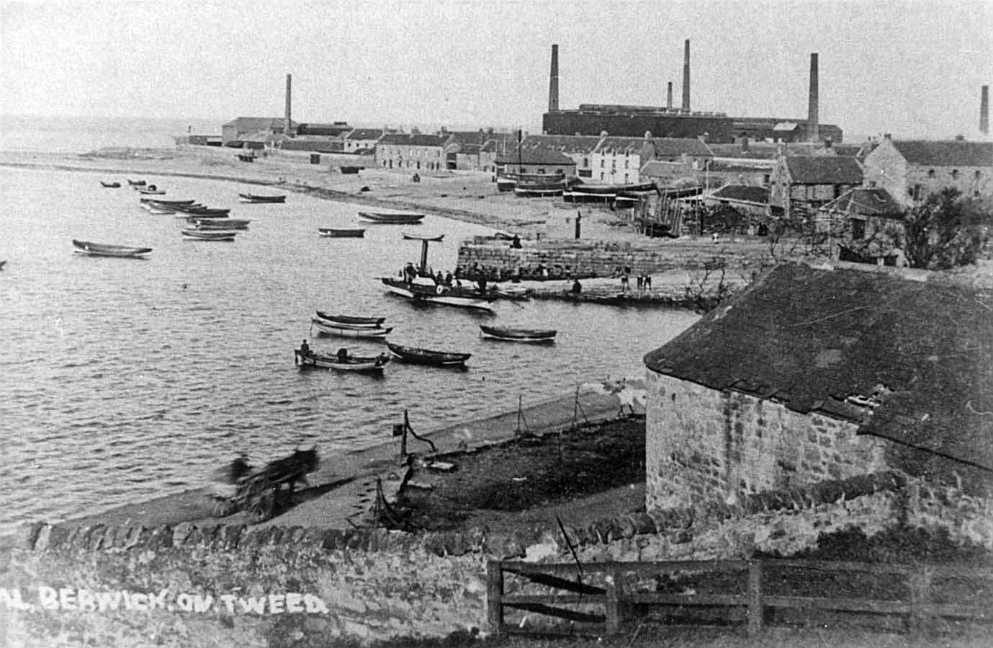
MANURES
CROSSMAN & PAULIN having lately erected WORKS at SPITTAL have now the undermentioned MANURES in Stock, and ready for delivery, either at the Works or at their Warehouses in Berwick
DISSOLVED BONES
SUPERPHOSPHATES from Bone Ash or Mineral Phosphates
SPECIAL MANURES manufactured for Cereals or Root Crops as ordered
BONE DUST
NITRATE OF SODA
MURIATE OF POTASH
ICHABOE GUANO
PHOSPHATIC GUANO
SULPHURIC ACID
AGRICULTURAL SALT, &c.
Berwick Journal,
17th April 1868
GUANO
The SUBSCRIBERS having been appointed Agents for the Sale of this new and powerful MANURE, intend showing a Sample at the Great Agricultural Meeting on the 30th, when they will distribute printed circulars, descriptive of its introduction, application, etc., and will be glad to receive orders for delivery in October.
BANKS AND SON, Haddington
Berwick & Kelso Warder,
25th September 1841
MANURES
Johnson & Co. Have on Sale and ready for Delivery at Ord Bone Mill
DISSOLVED BONES
SPECIAL MANURES
SUPERPHOSPHATES
BONE DUST
SULPHATE OF AMMONIA
NITRATE OF SODA
SULPHURIC ACID
Berwick Advertiser,
6th July 1866

Slide 9
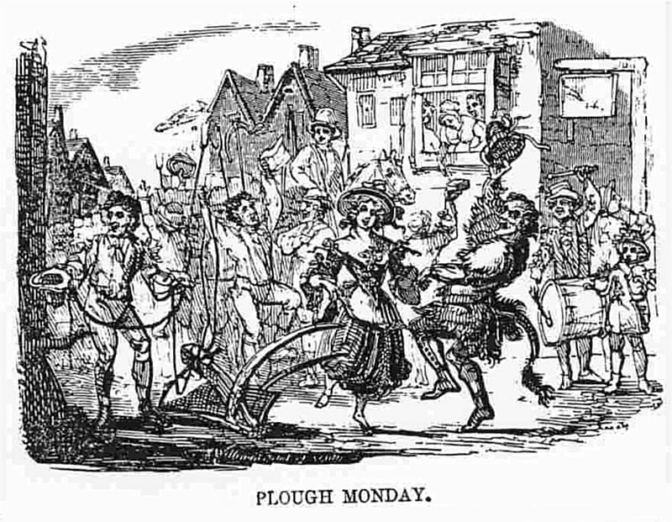
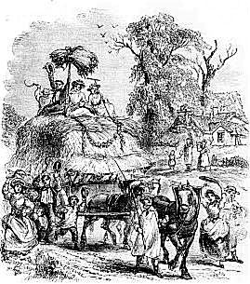

Slide 10
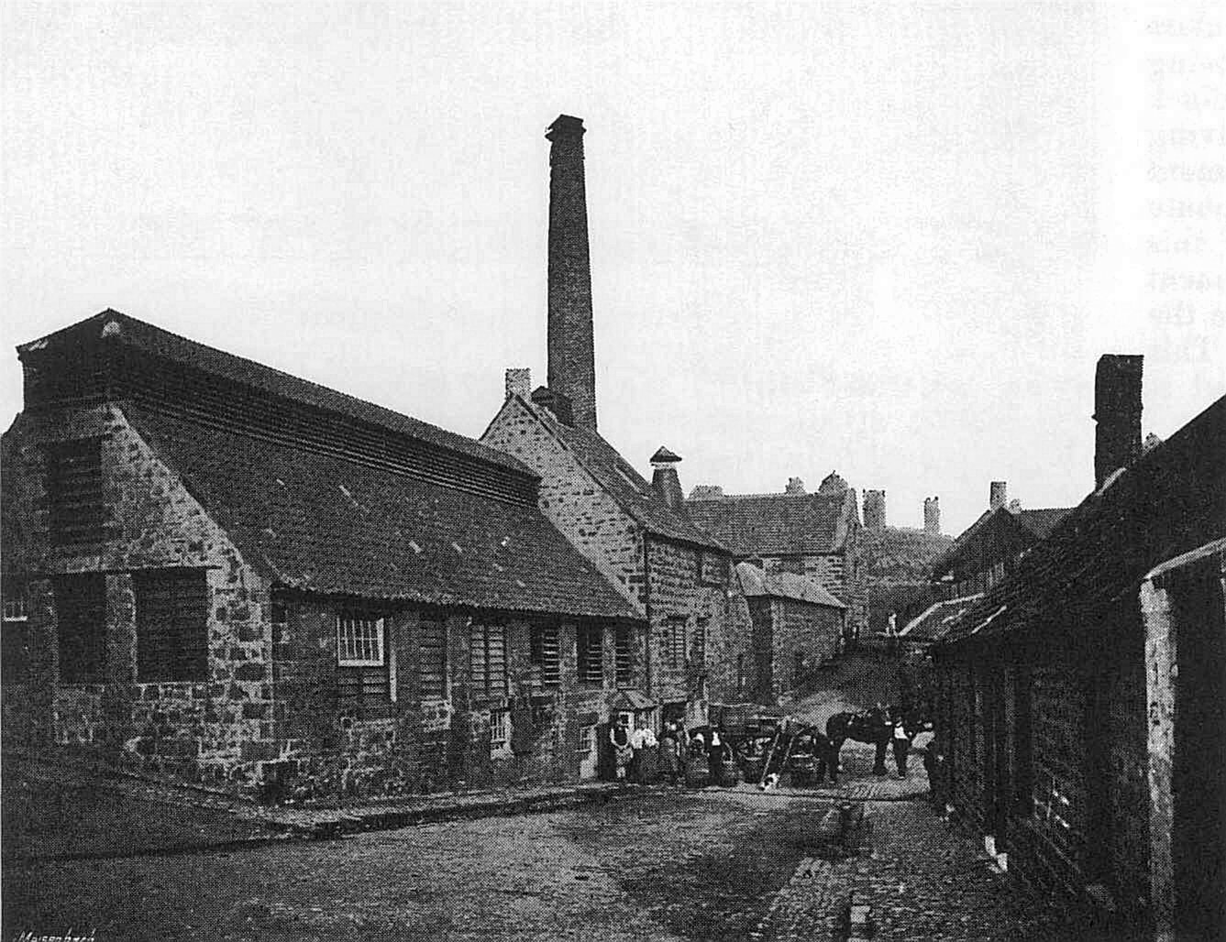
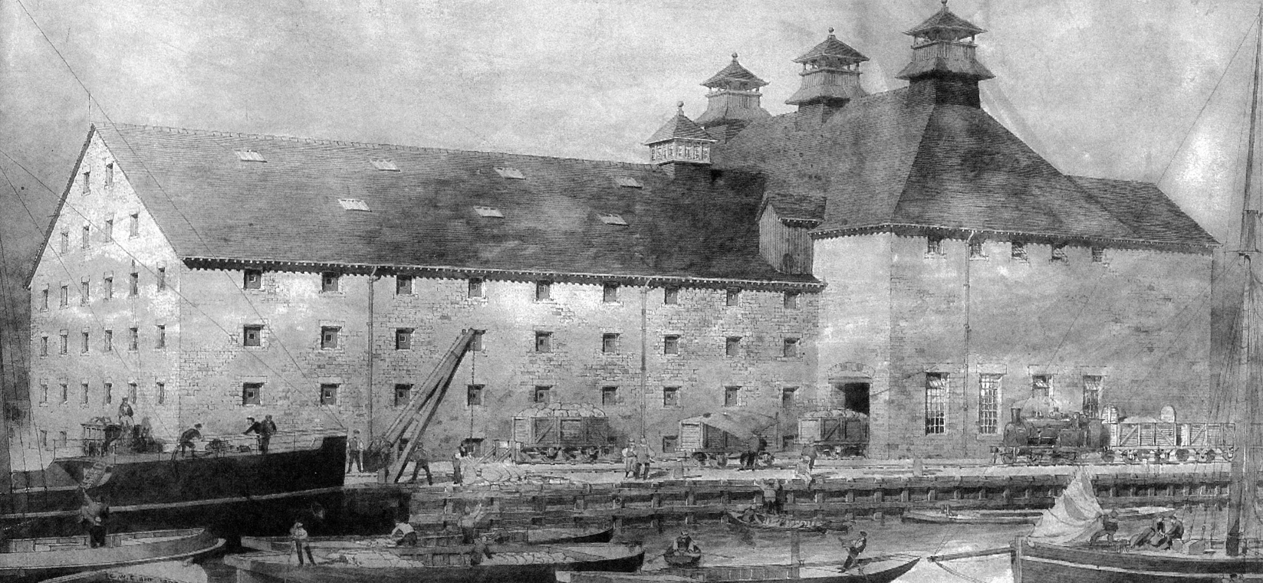

Slide 11
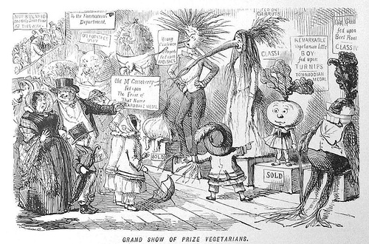

Slide 12
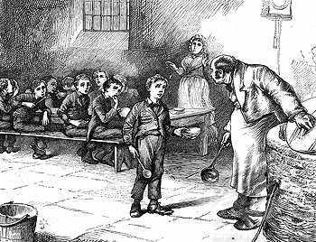
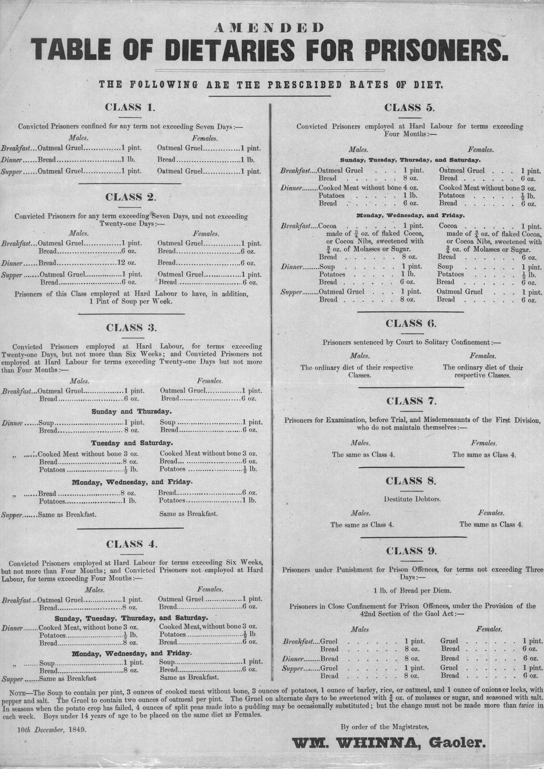
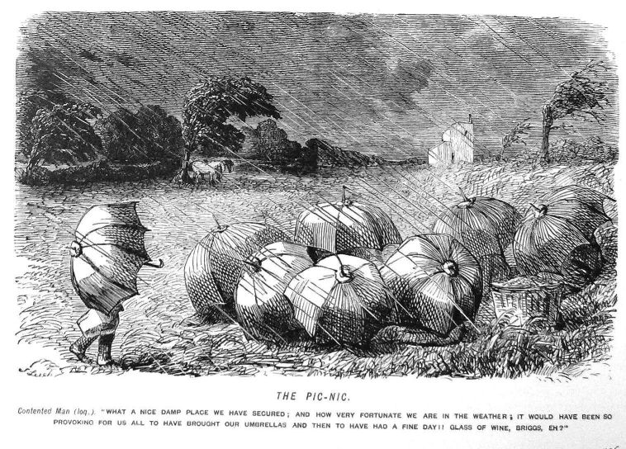

Slide 13
