Slide 1
Coal Mining in The North East

Slide 2
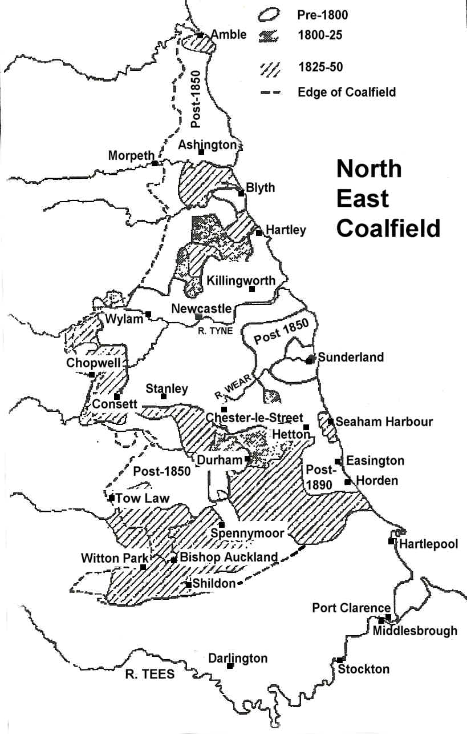

Slide 3
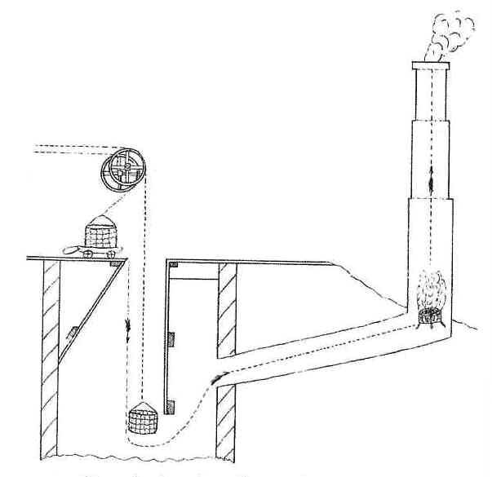
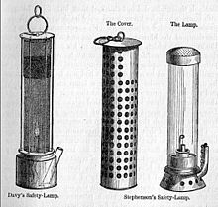
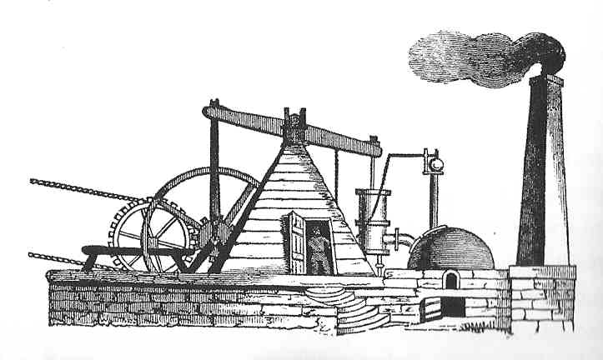
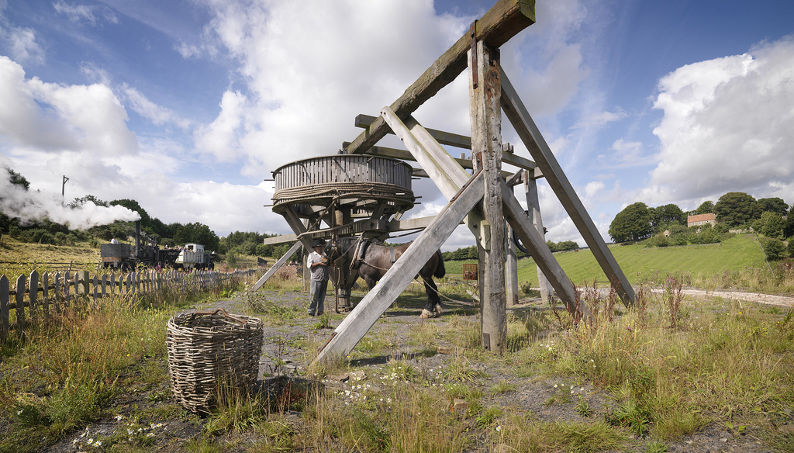

Slide 4
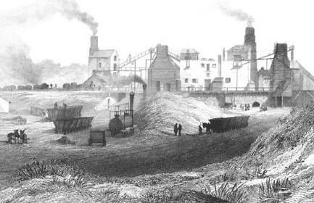
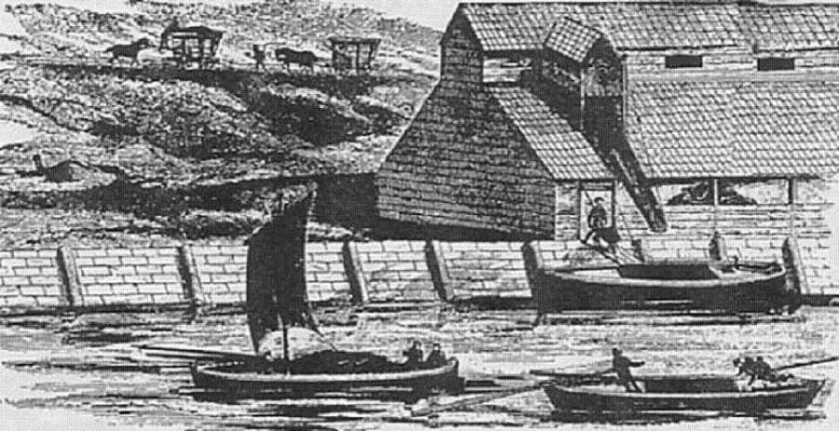
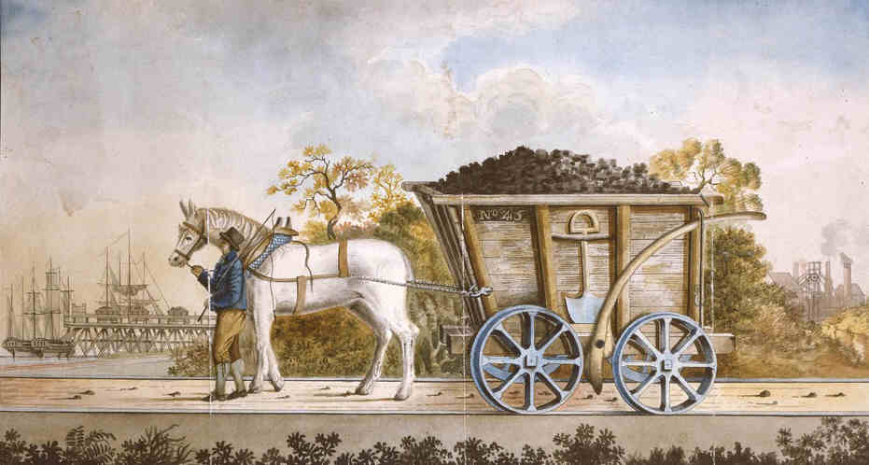
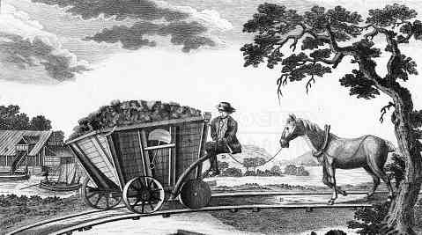
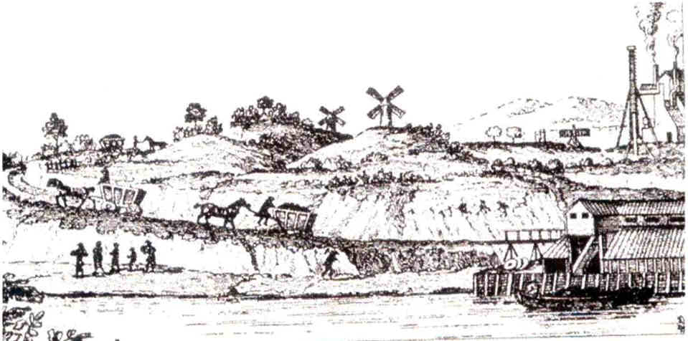

Slide 5
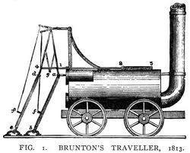
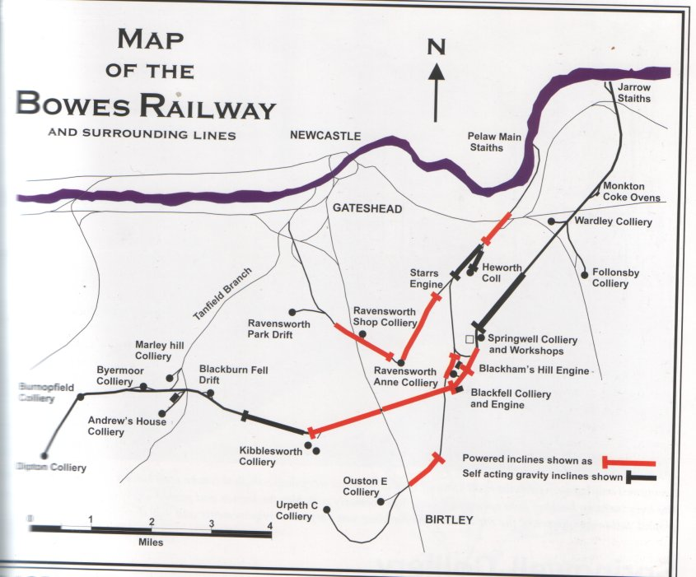
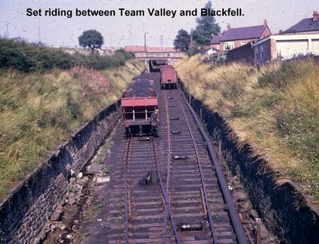
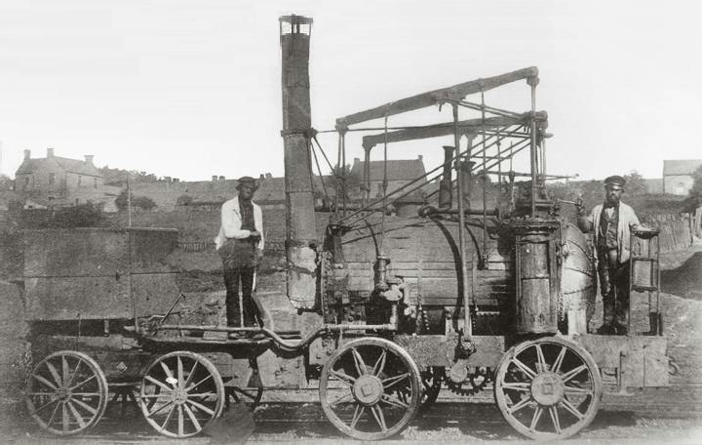

Slide 6
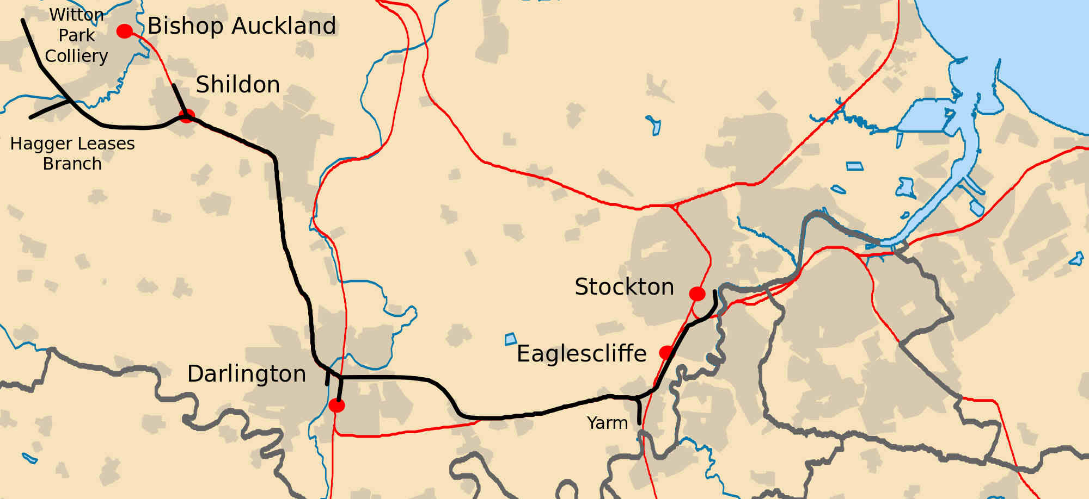
Cost of Haulage of Coal in 1815
1 horse for 4 miles on wooden waggonway 1s 3¼d
1 horse for 4 miles on iron rails 8½d
By steam locomotive for 4 miles 3¾d

Slide 7
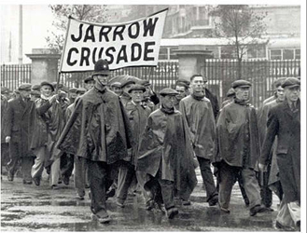
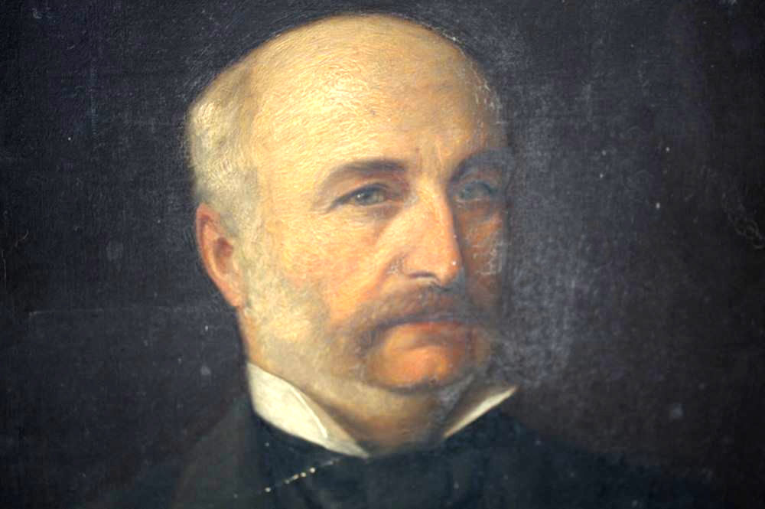
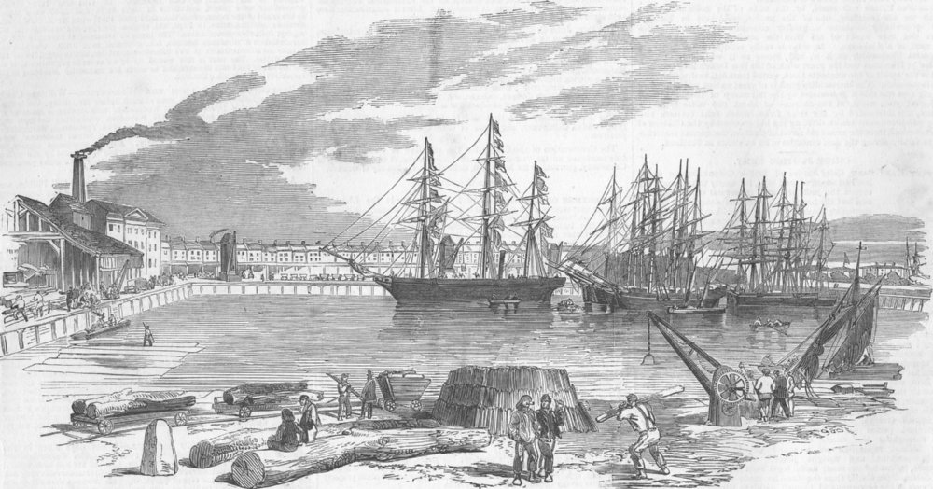

Slide 8
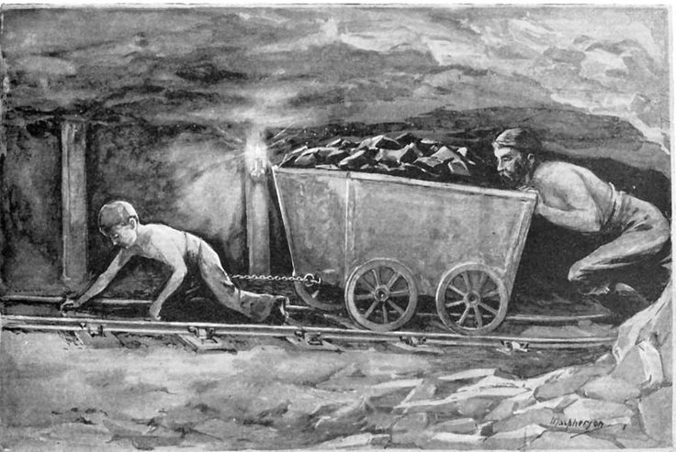
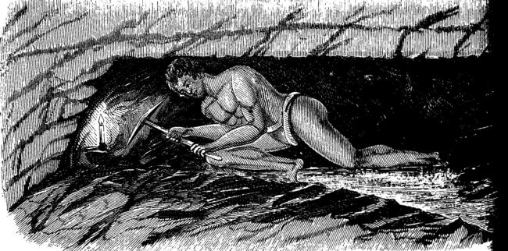
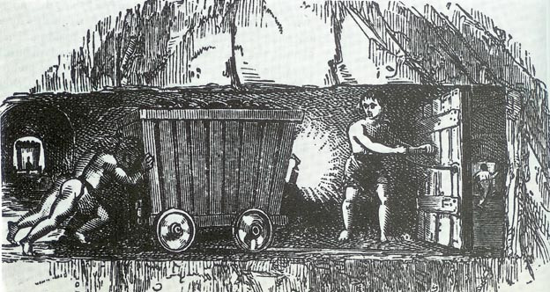

Slide 9
Weekly expenses of a miner’s family in Bishop Auckland in 1842
Man, wife and two children – 20s wages per week.
Expenditure:
1lb blasting powder 1s 0d
1lb candles for use in coal pit 10½d
Soap 7d
1½lb sugar 1s 1½d
2oz tea 6d
¼lb coffee 7d
21lbs bread 2s 0d
Yeast, salt, pepper 4d
7lb beef 4s 1d
Pint of milk per day 9¼d
¾lb butter 1s 0¾d
1 lb cheese 8d
Tobacco 8d
14s 11d

Slide 10
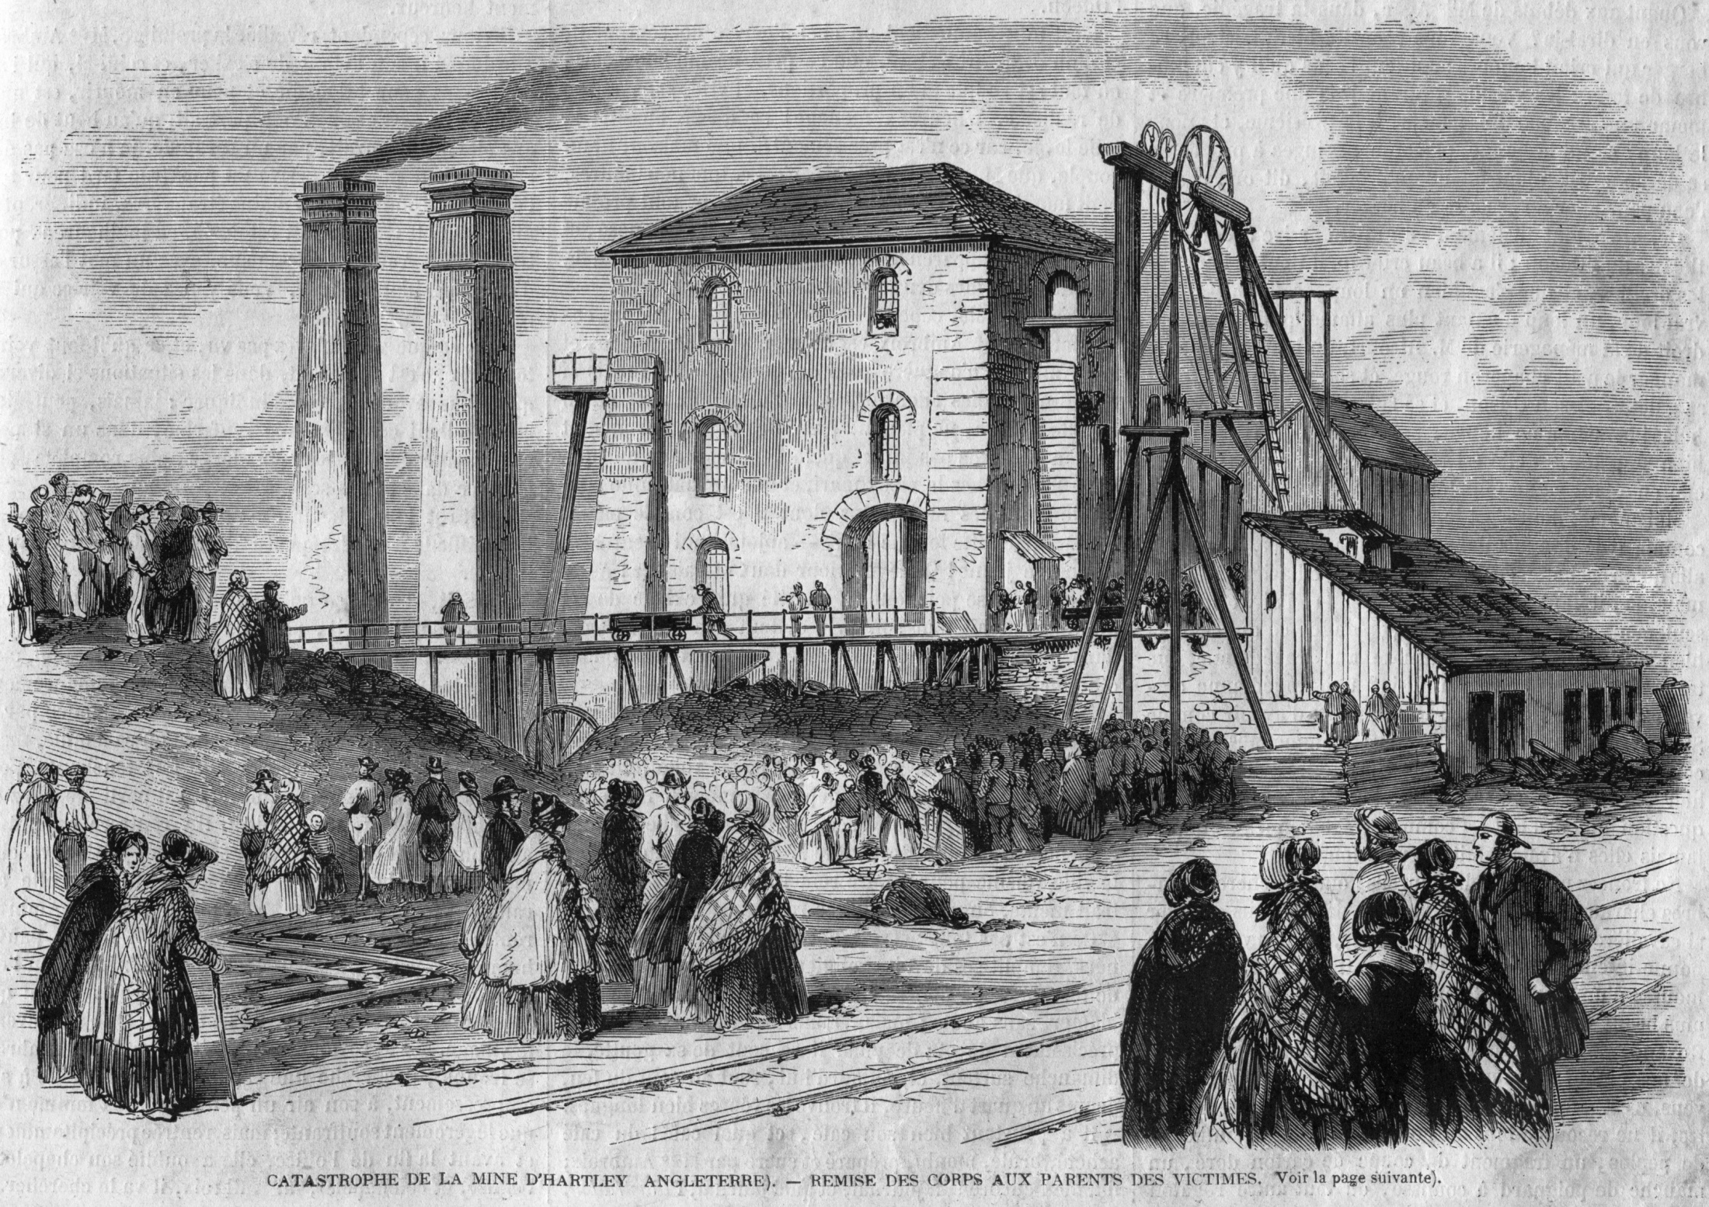

Slide 11
