Slide 1
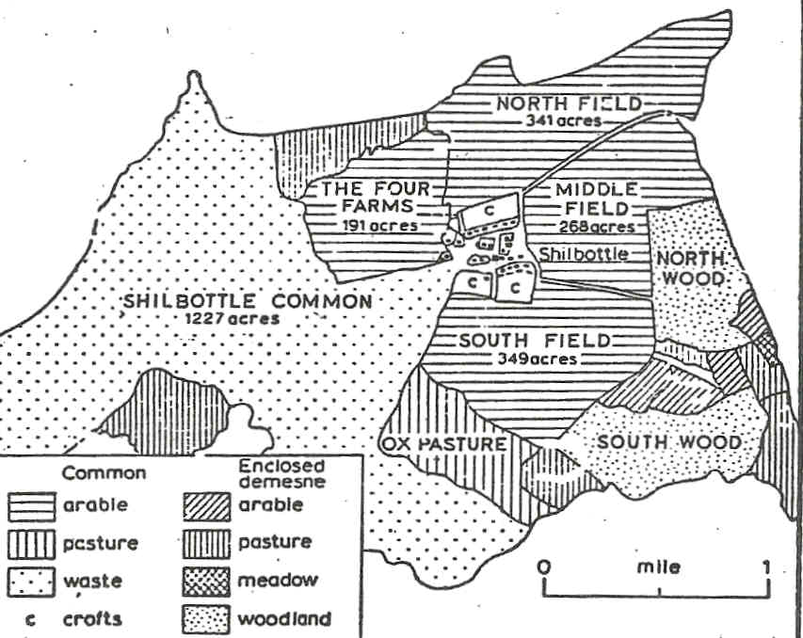
Shilbottle Township in the 17th century, before enclosure

Slide 2
LONG NEWTON
before Enclosure (1659)
North West Field 503 acres
East Field 408 acres
South Field 647 acres
West Fiel 372 acres
Gilbert Field 56 acres
Haver Close 6 acres
Ox Pasture 559 acres
South Moor 580 acres
West Moor 92 acres
Mill Hill 32 acres
East Burn Hill 11 acres
West Burn Hill 17 acres
The Batts 9 acres
LONG NEWTON
after Enclosure
Freehold Farms
John Fowler 247 acres
William Hobman 197 acres
Robert Thorpe 162 acres
Ralph Colling 158 acres
Thomas Fowler 85 acres
Lord of the Manor
Sir George Vanes divided 2,591 acres into 10 leasehold farms of varying size
Small Allotments 16 acres total

Slide 3
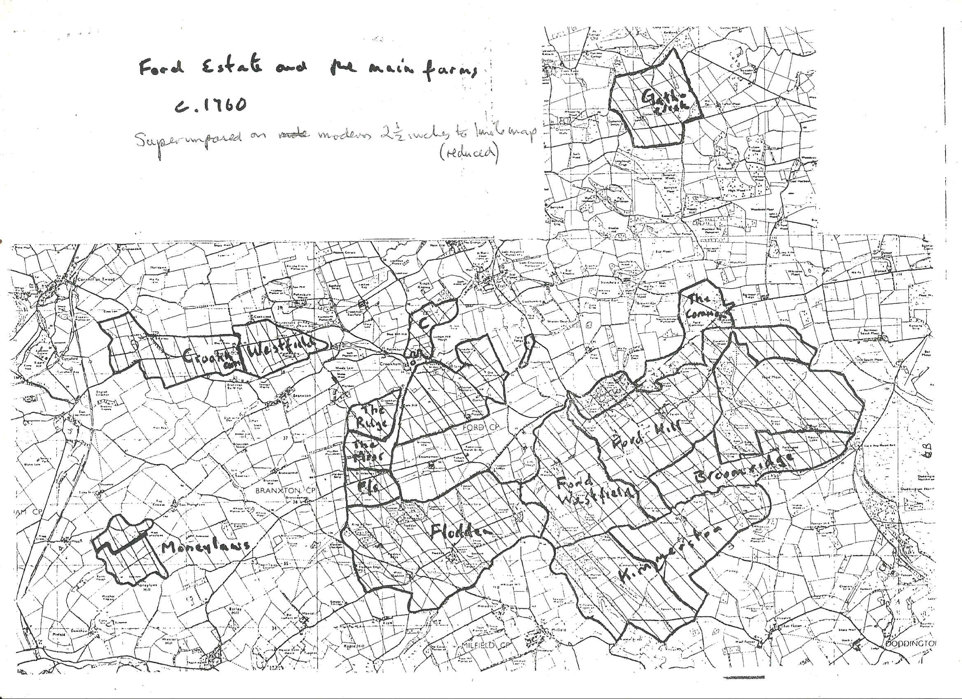
Plan of
The Delaval Estates at Ford
circa 1760, before Enclosure

Slide 4
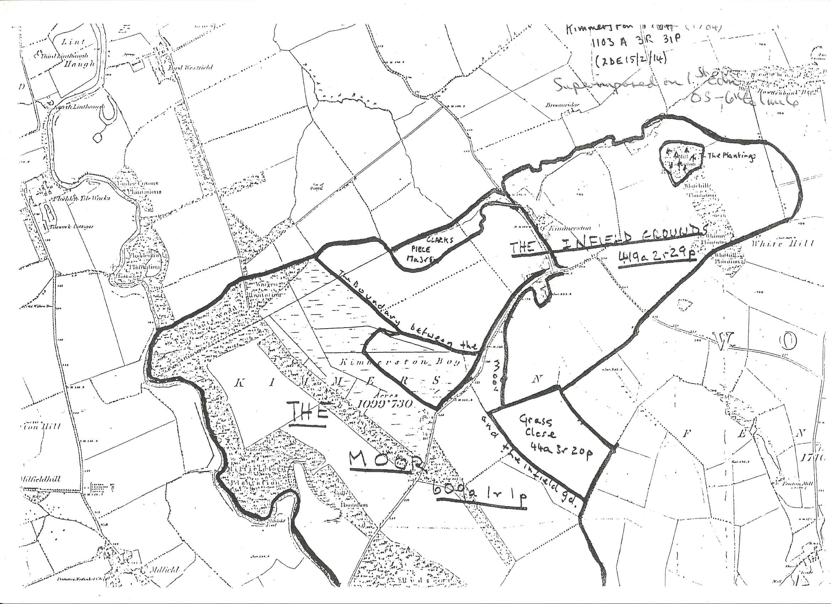
Plan of Kimmerston Farm, 1784

Slide 5
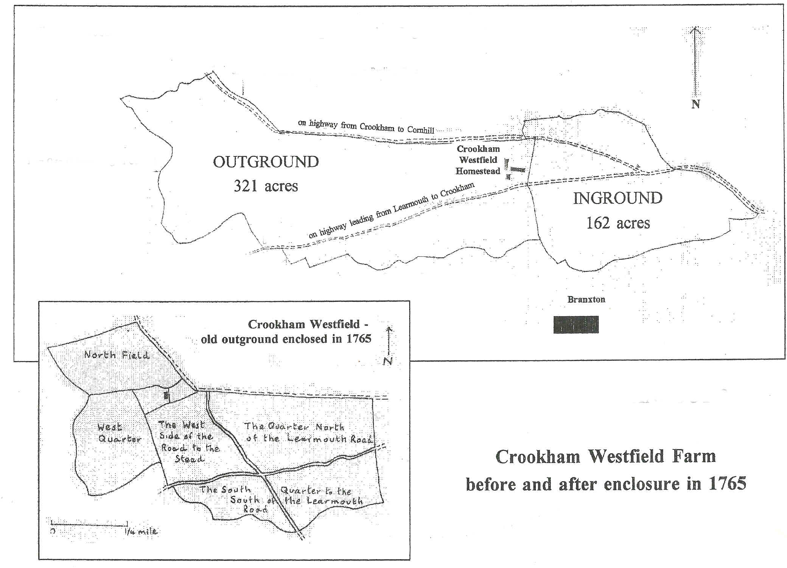

Slide 6
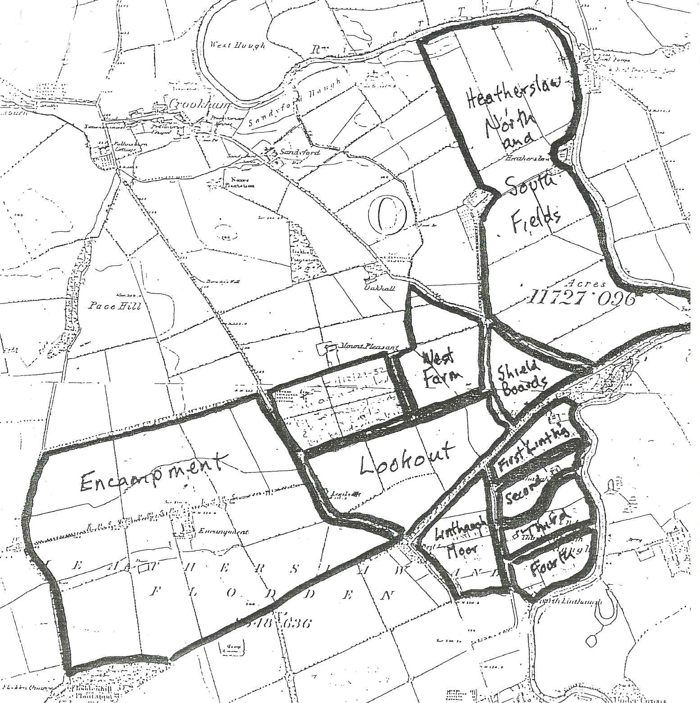
Plan of Encampment

Slide 7
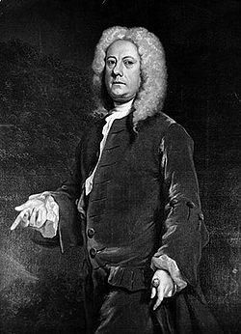
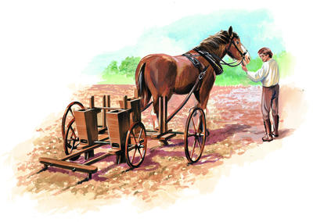
Jethro Tull’s Seed Drill

Slide 8
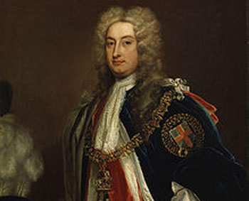
Viscount Townshend

Slide 9
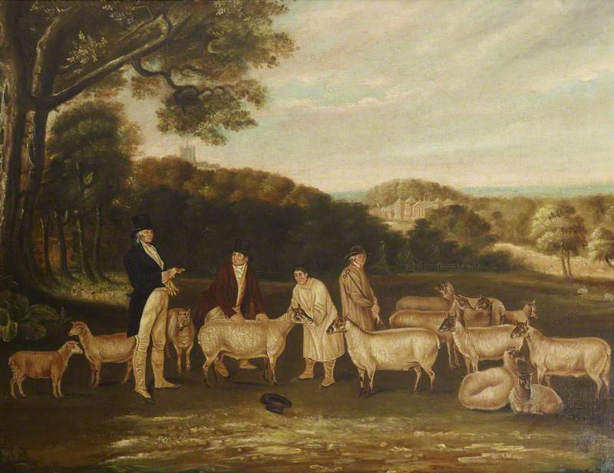
Thomas Coke
inspecting his Southdown Sheep

Slide 10
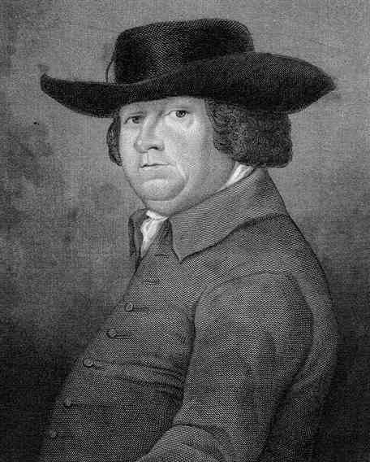
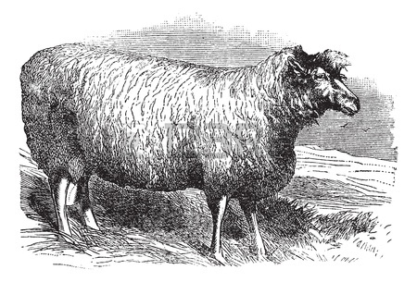
Robert Bakewell
and the New Leicester Sheep

Slide 11
Average weight of animals sold at Smithfield Market in London
1700 1800
Black cattle 166 kg 360 kg
Sheep 13 kg 36 kg
Calves 22 kg 66 kg
Lambs 8 kg 22 kg

Slide 12
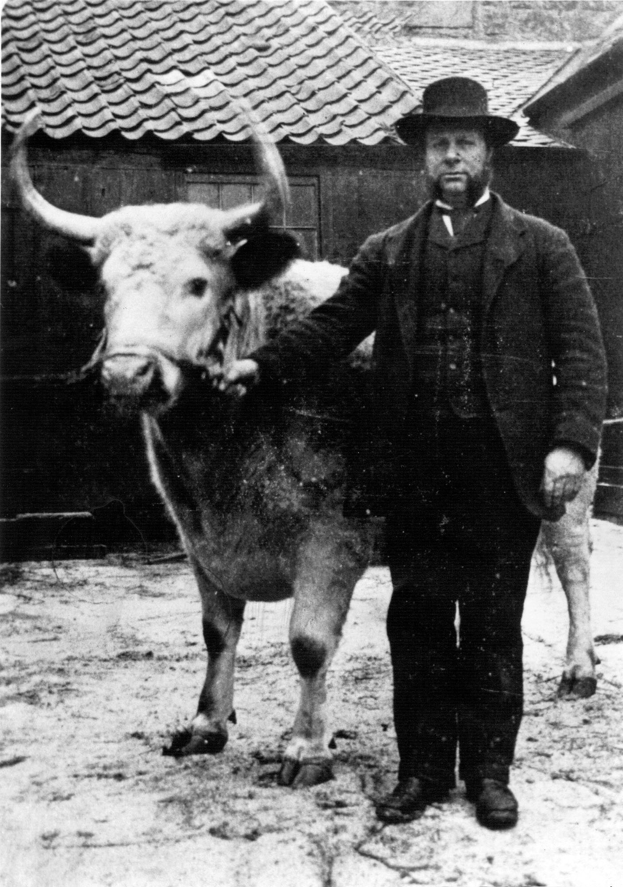

Slide 13
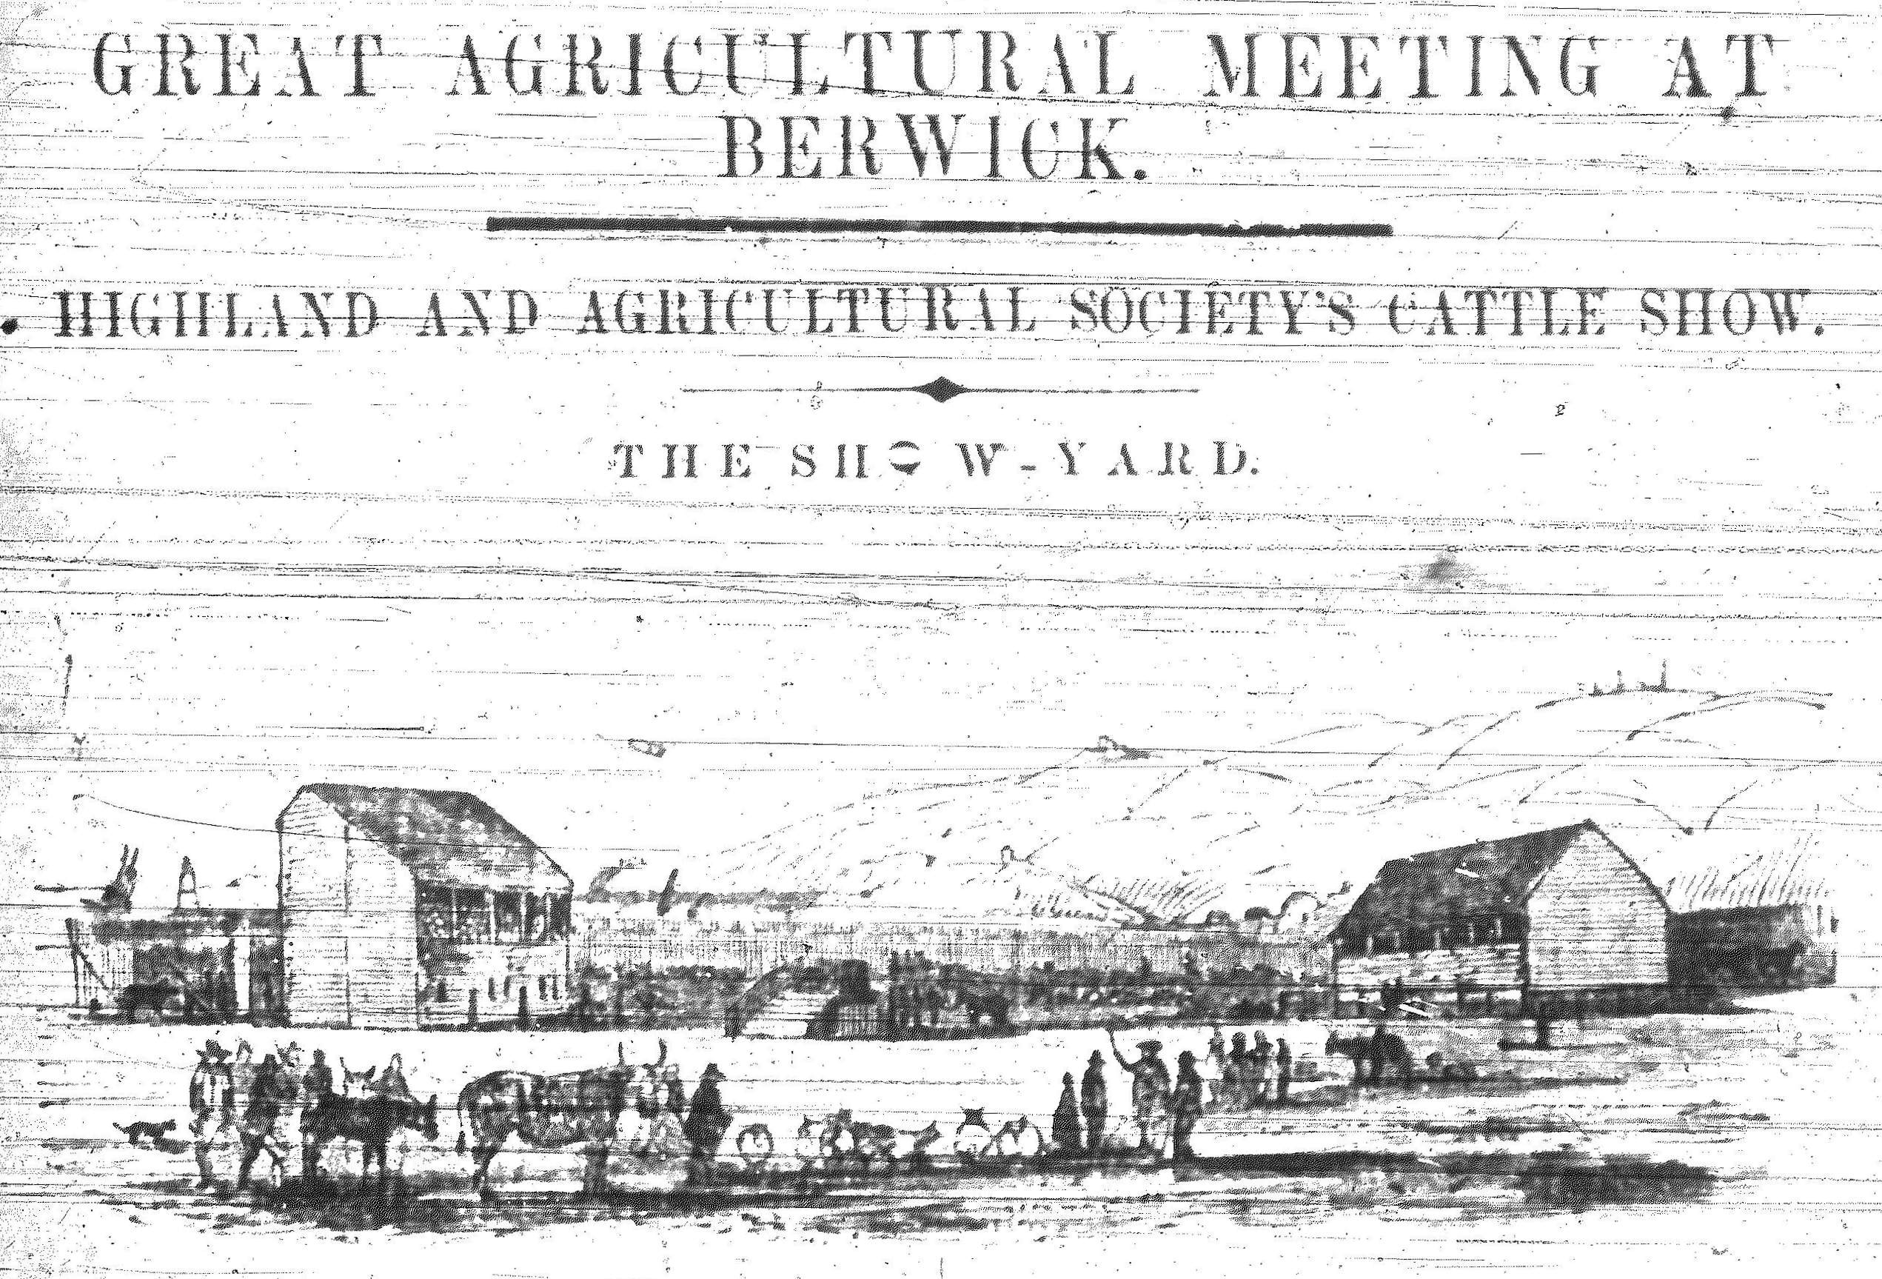

Slide 14
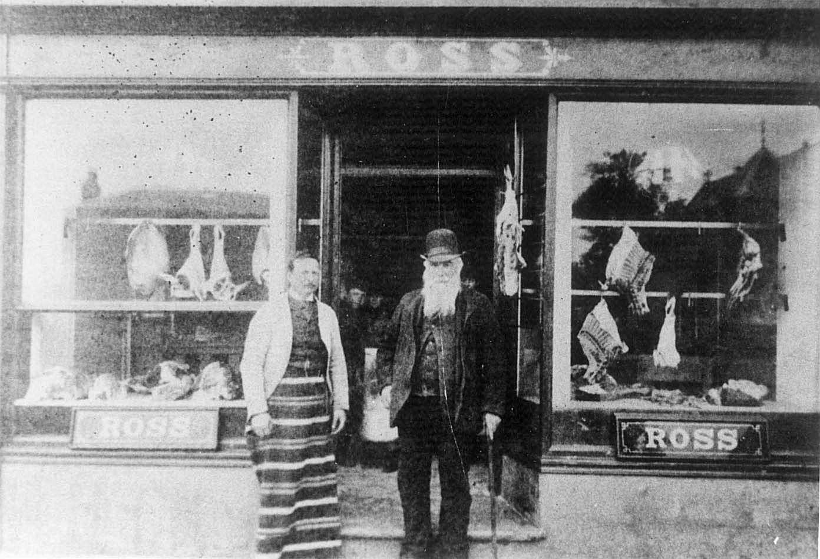

Slide 15
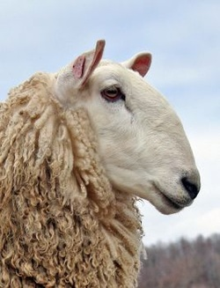

Slide 16
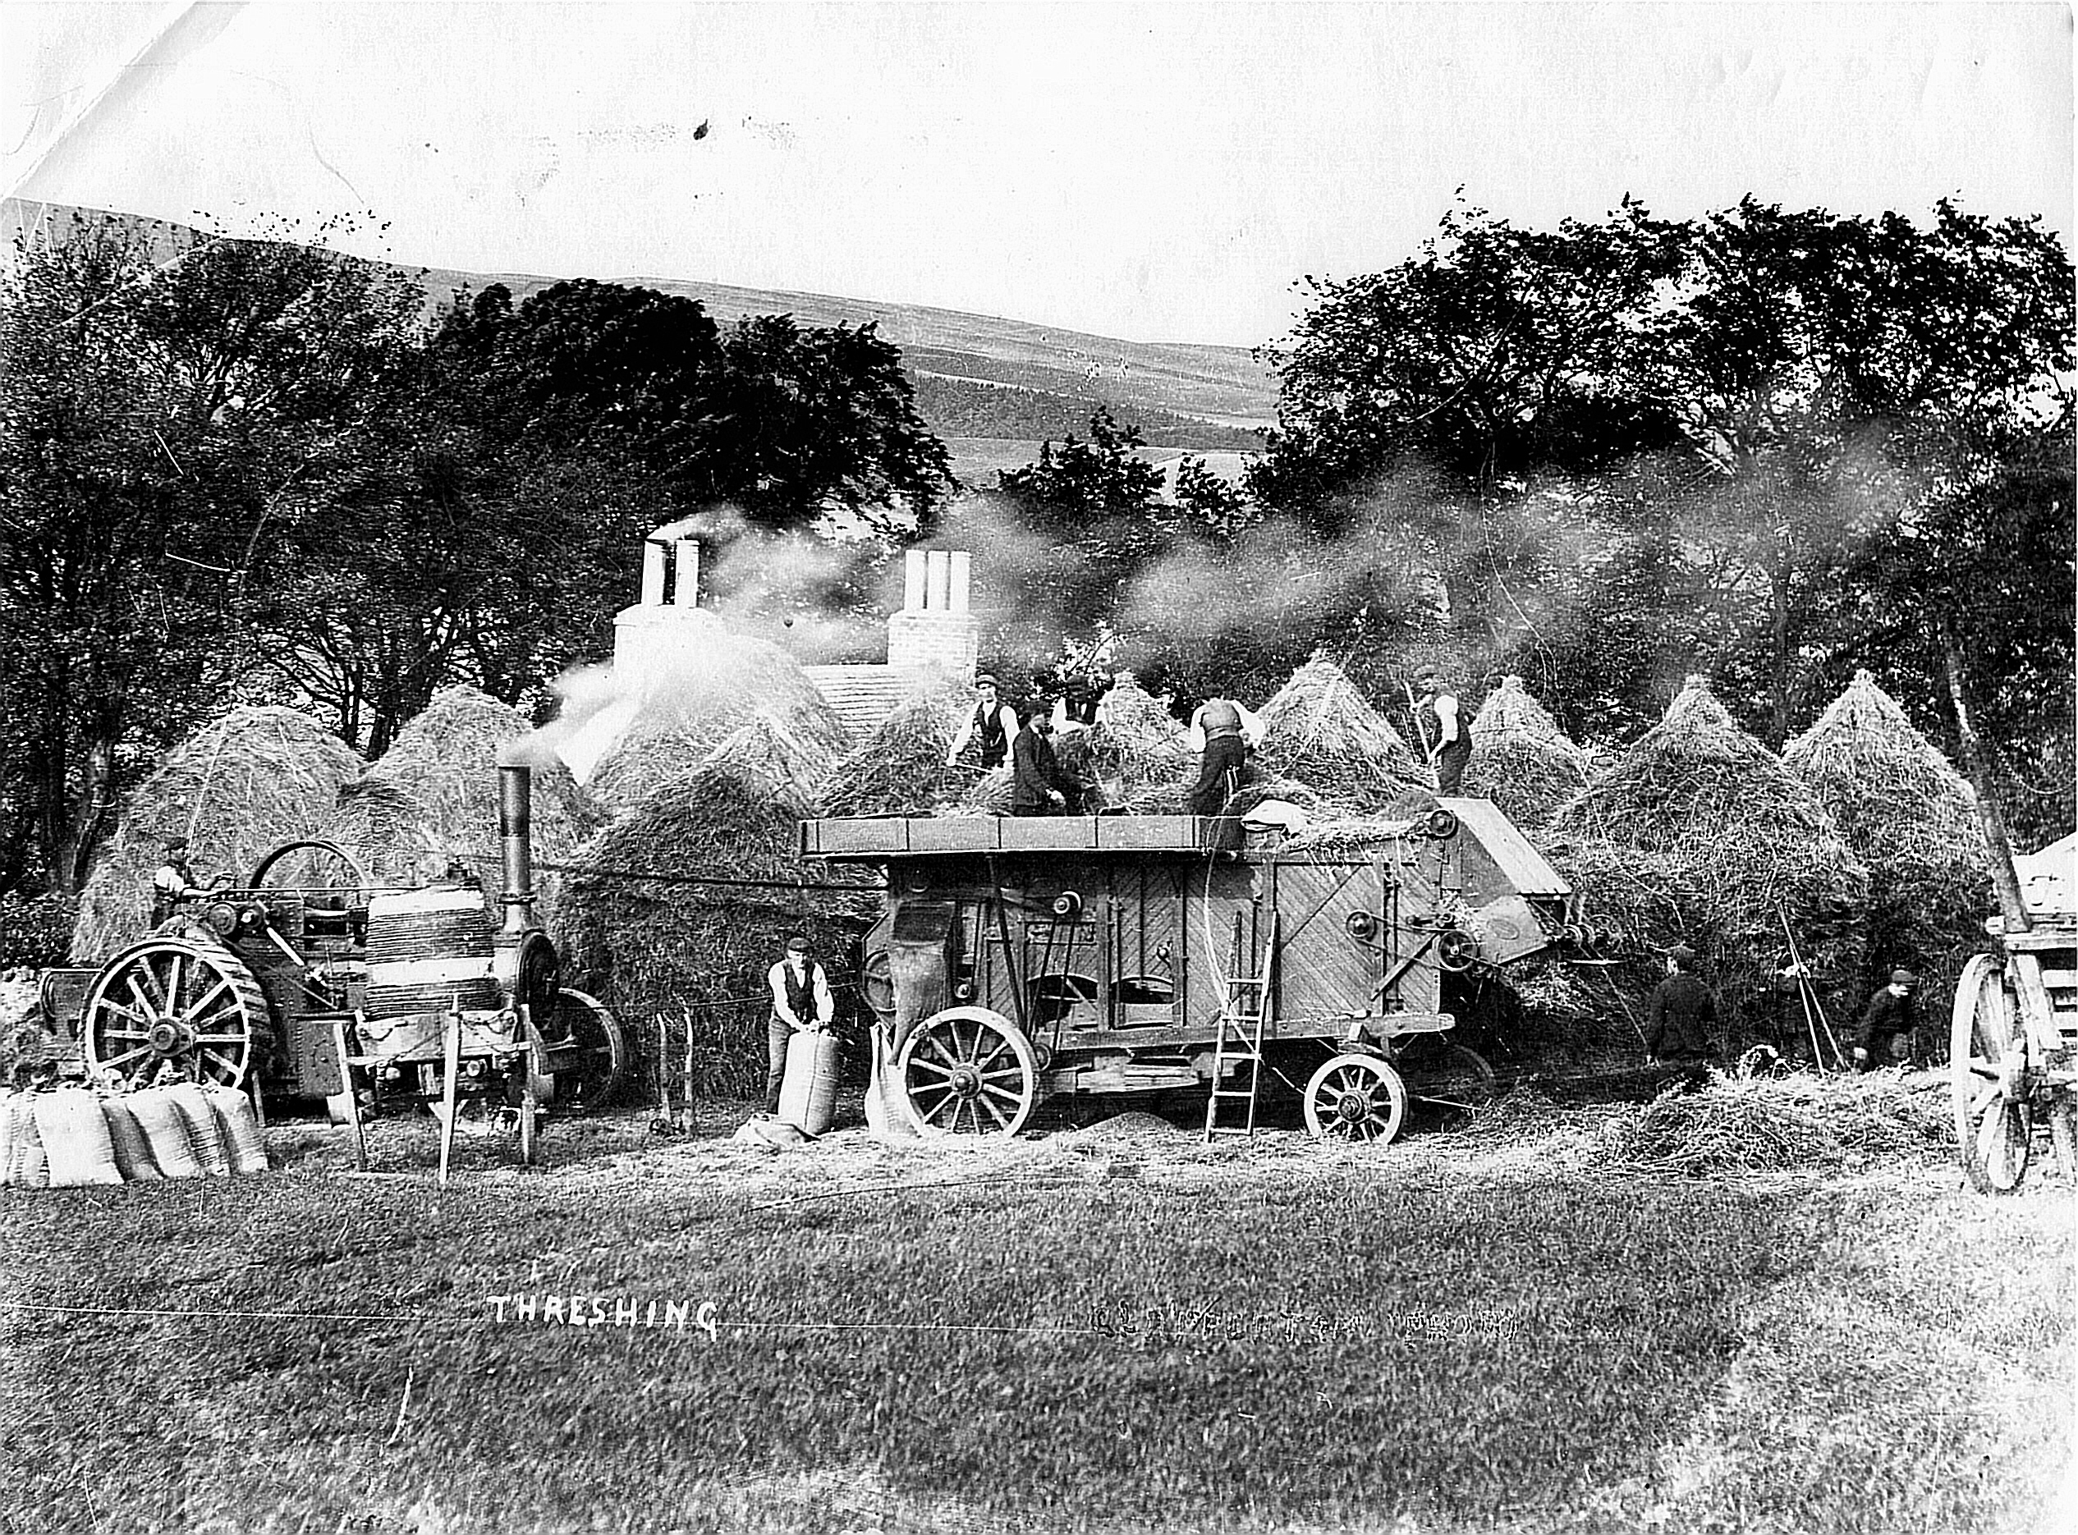
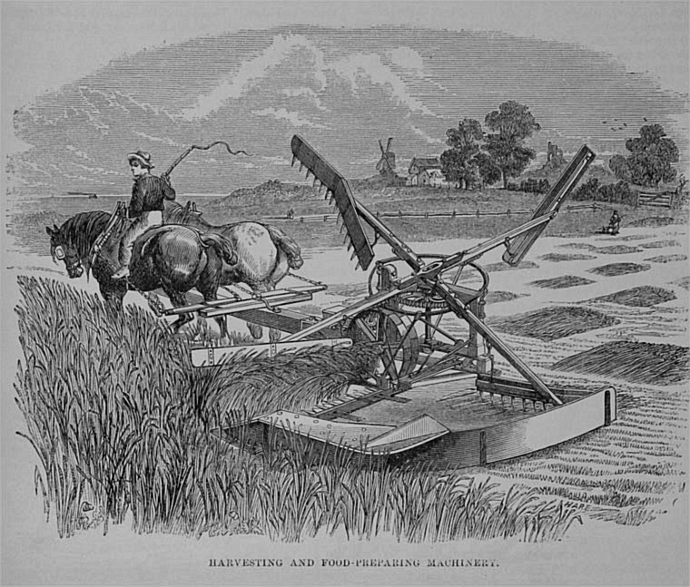
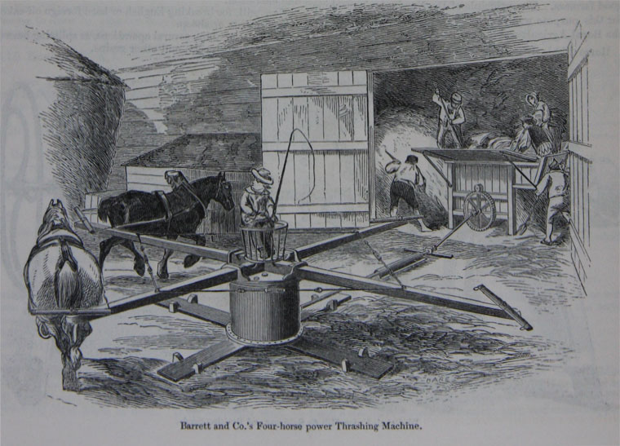

Slide 17
Hind’s Bond, 1794 (Bailey and Culley)
2 cows kept, or money in lieu at £3 each
3 bushels of wheat at 5s each
37 bushels of oats at 1s 6d each
12 bushels barley at 2s 6d each
12 bushels rye at 3s 4d each
2 cows kept, or money in lieu at £3 each
3 bushels of wheat at 5s each
37 bushels of oats at 1s 6d each
12 bushels barley at 2s 6d each
12 bushels rye at 3s 4d each
10 bushels peas at 3s 6d each
24 lbs cast wool at 6d a lb
1 bushel potatoes, planted
A pig tethered £2 4s 0d
Leading coals 5-6 cart loads £1 0s 0d
Total £18 11s 0d a year

Slide 18
Hind’s Bond, 1856-7
House rent free, coals led.
Cow on pasture in summer, kept in 17th November to 12th May.
Straw and 1 ton of hay in winter.
To be allowed to keep a pig shut up.
Wheat 6 new bolls.
Barley 4 old bolls.
Oats 6 old bolls.
Pease and beans 2 old bolls.
£4 stint money.
1000 yards of potato ground prepared for me in field.
To provide a sufficient woman worker at 10d a day in summer and 8d a day in winter, at 1/6d a day for harvest of 20 days.

Slide 19
