Slide 1
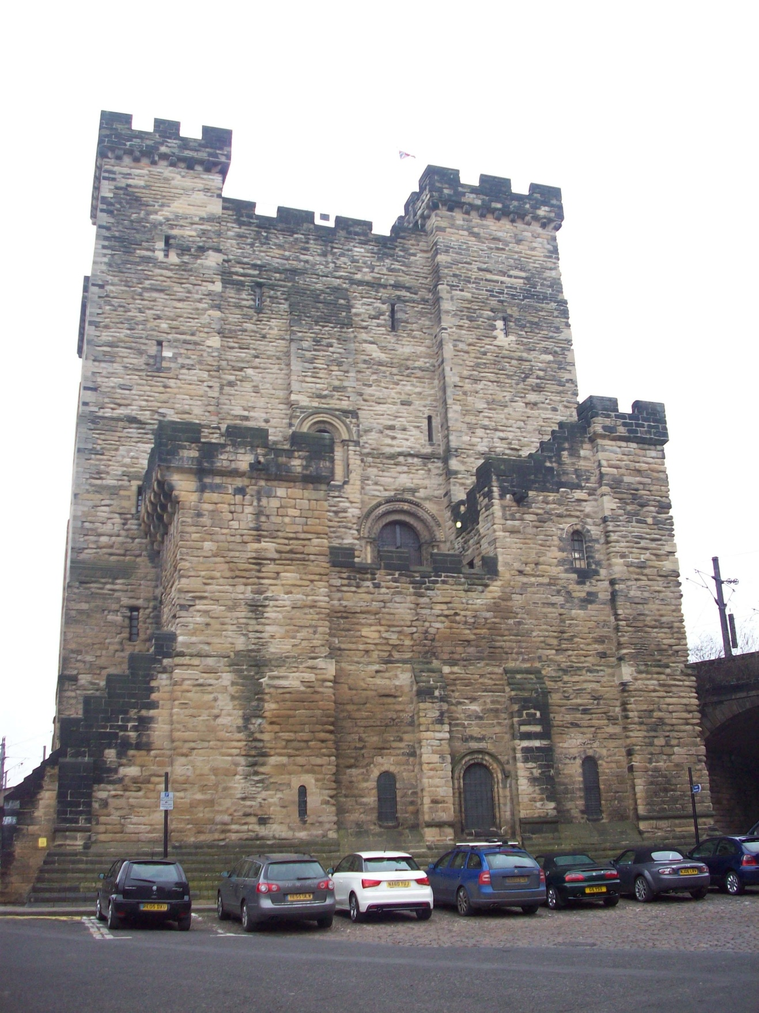
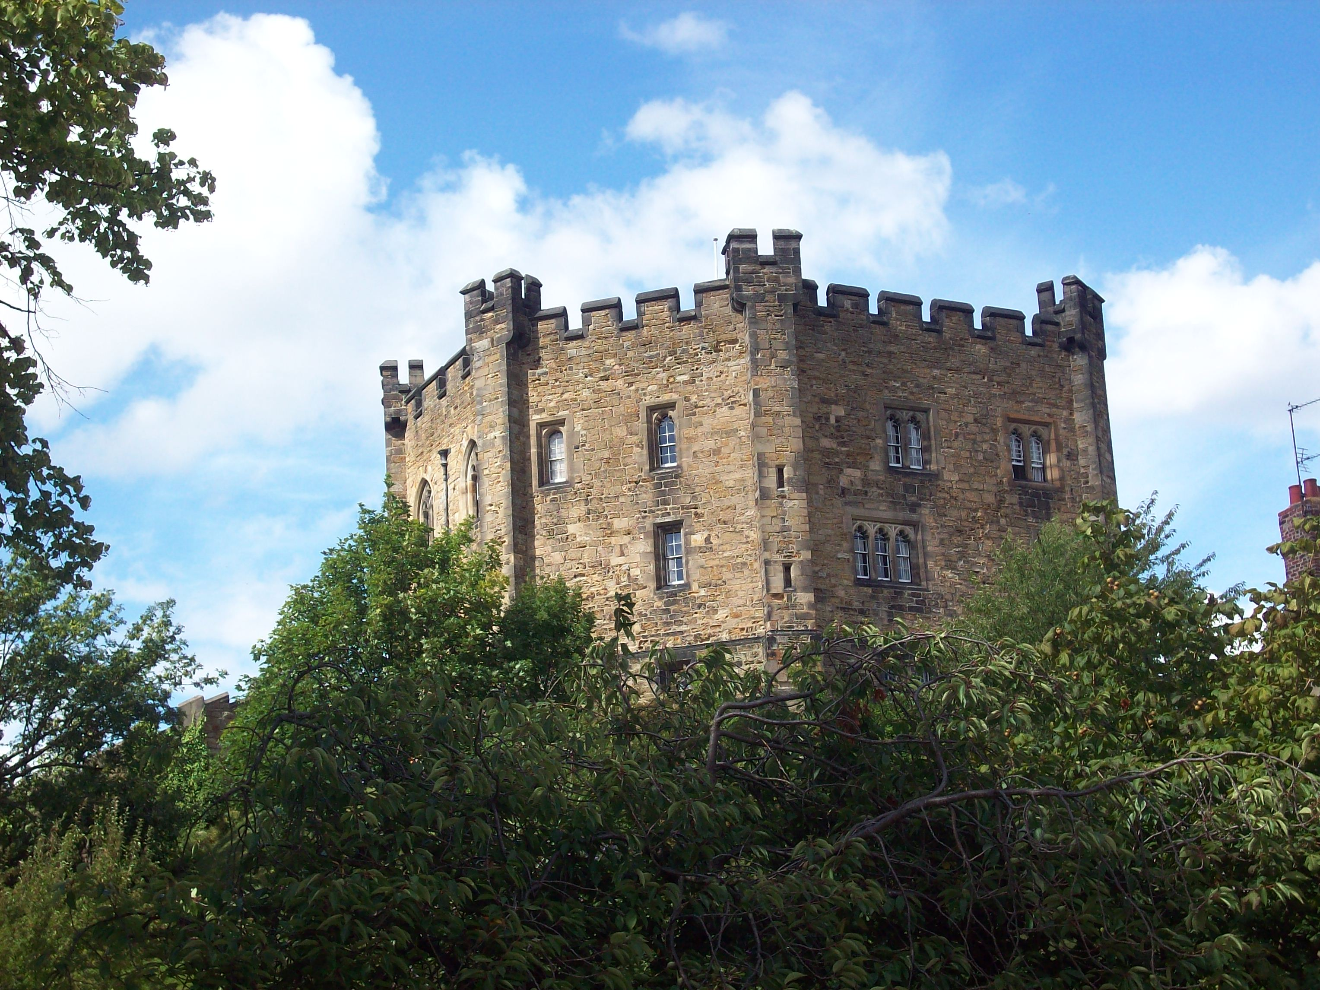
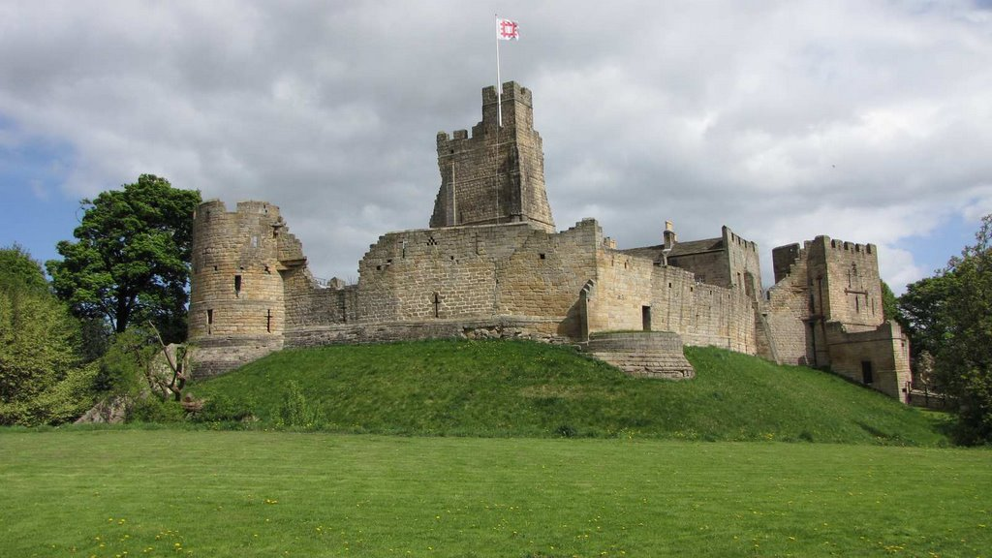
Defending the Border

Slide 2
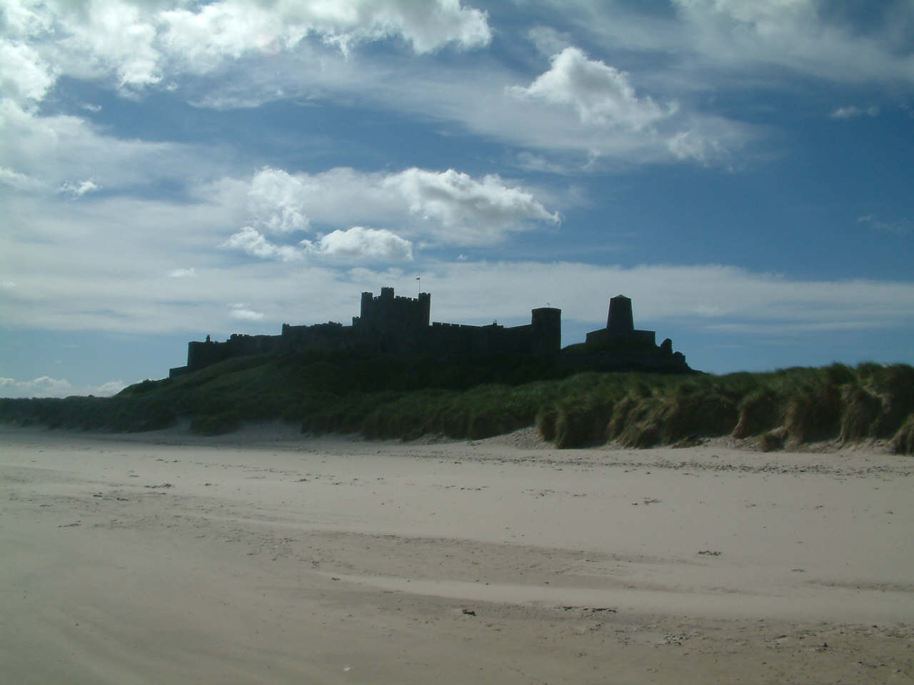
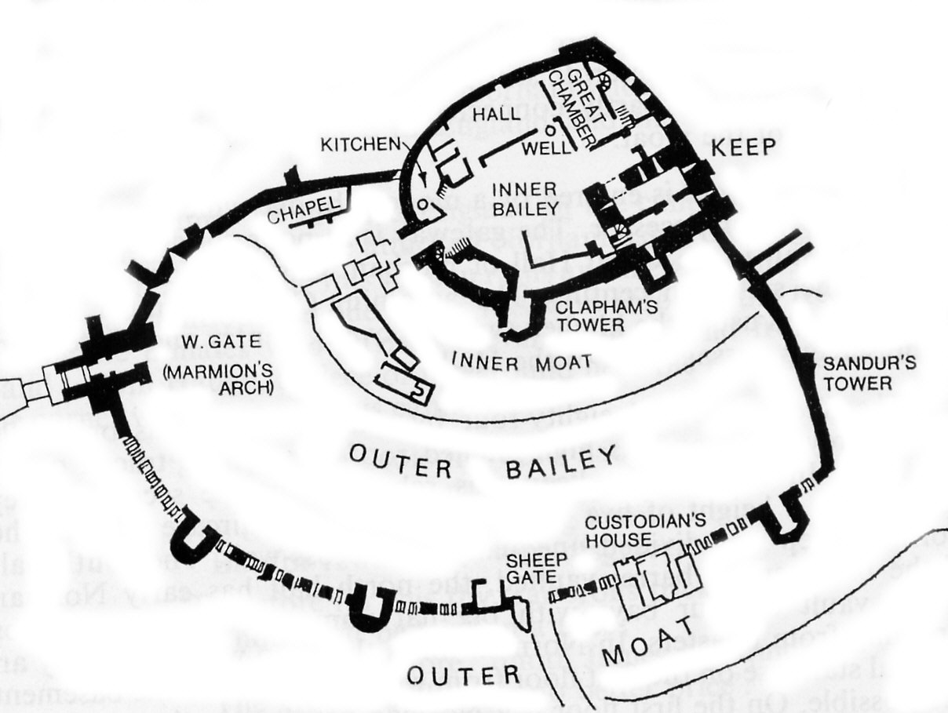
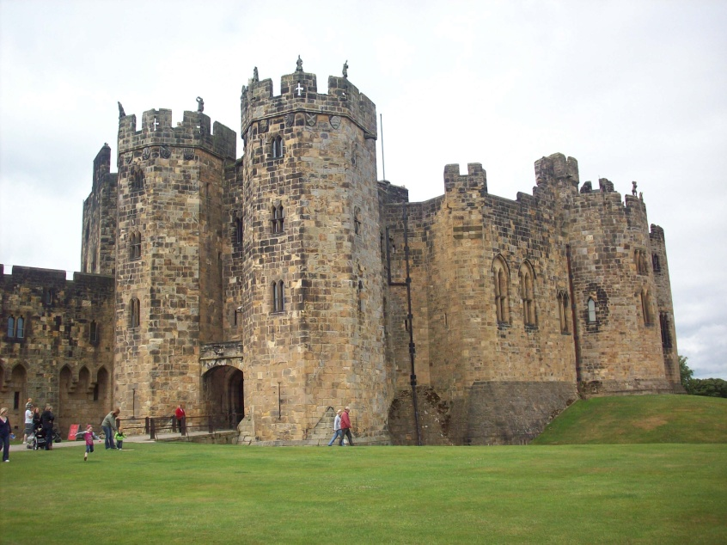
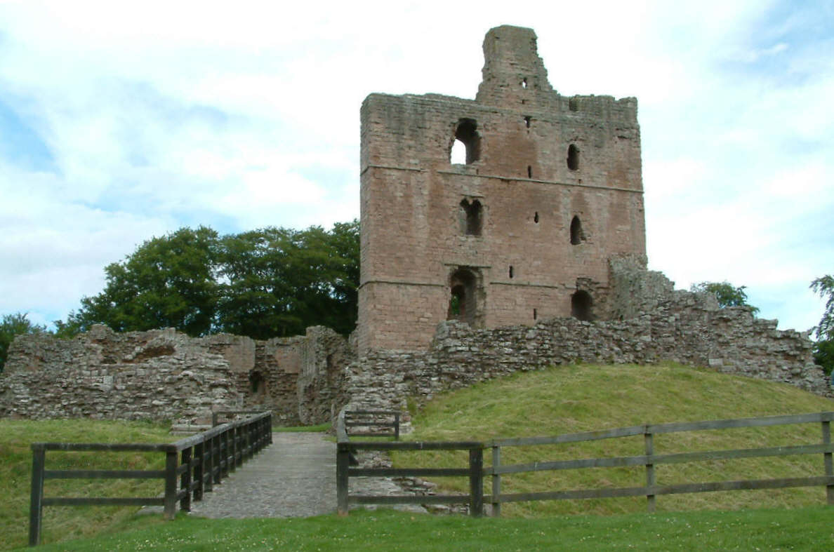
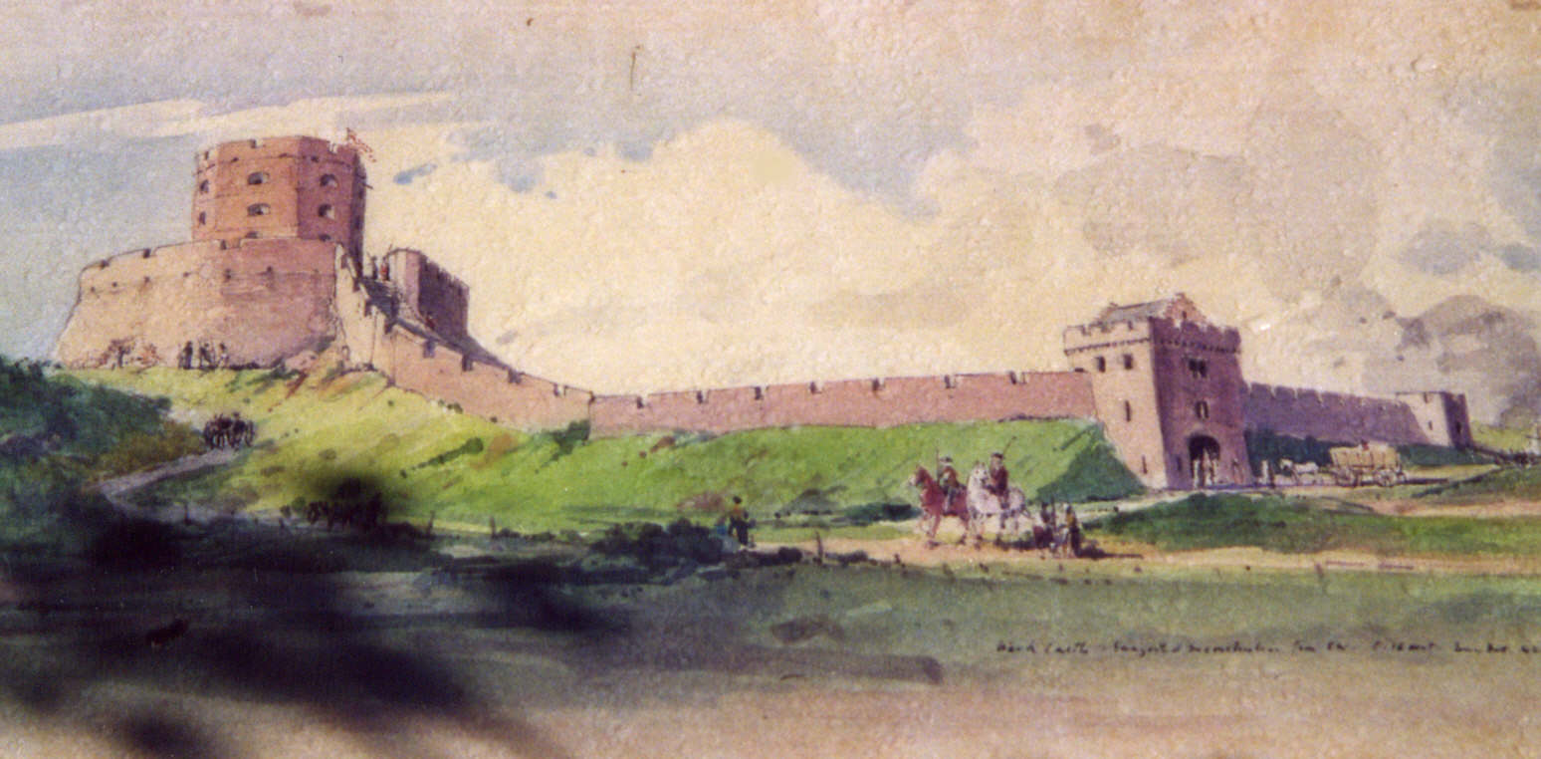
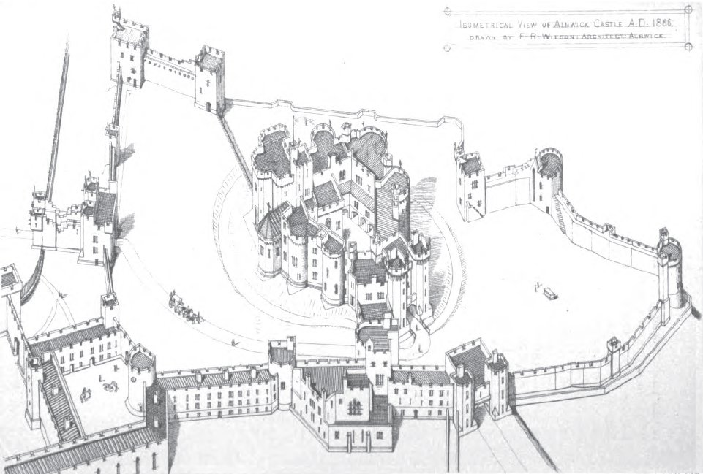

Slide 3
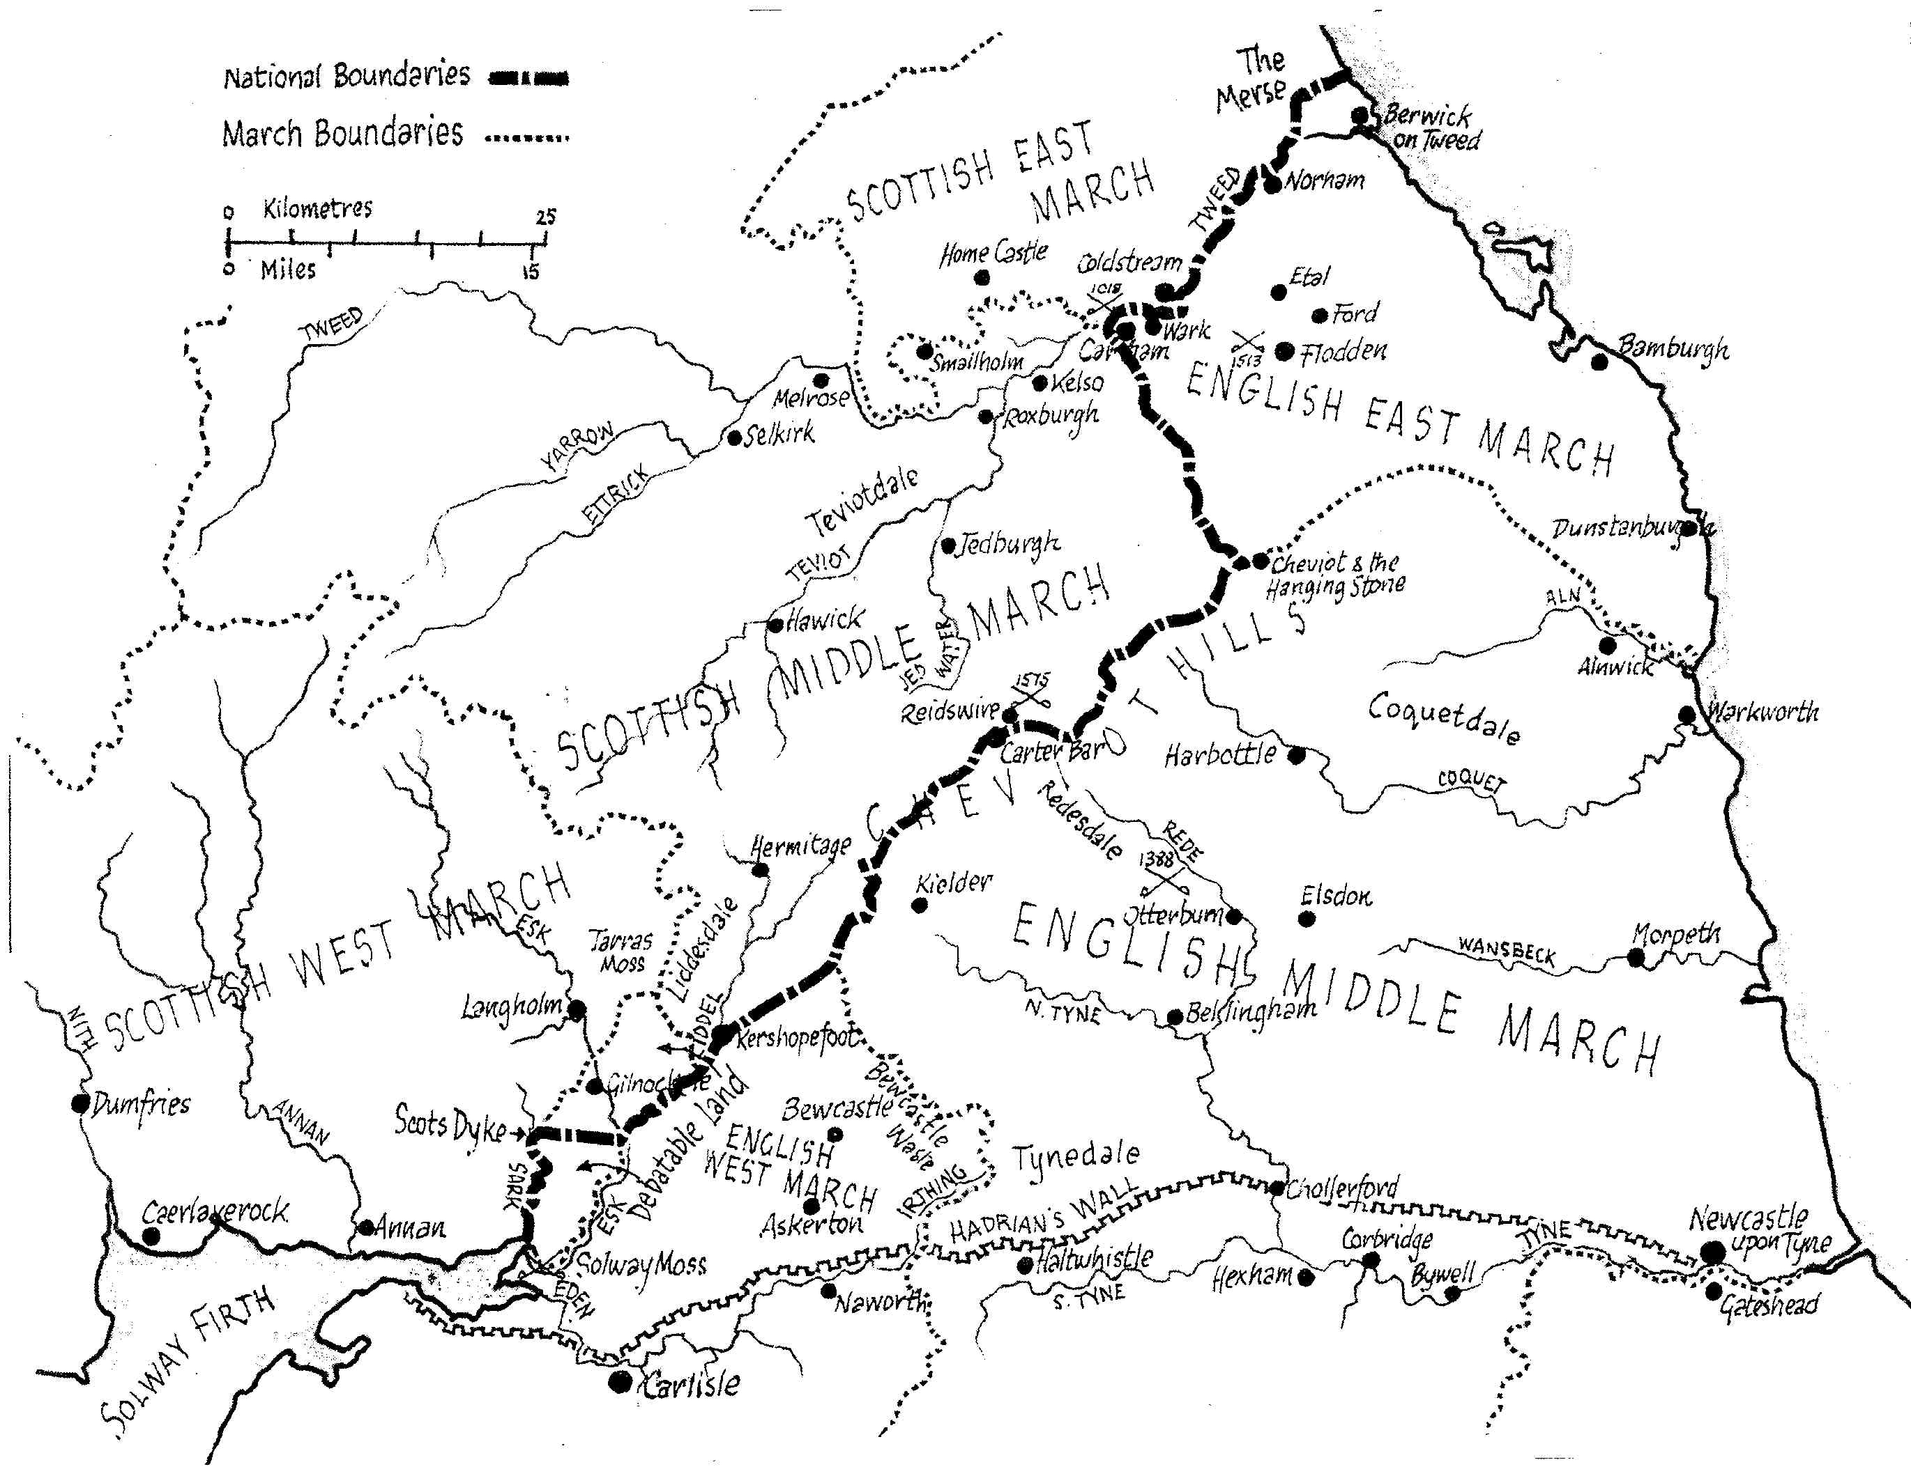

Slide 4
Holy Island Inventory for Michaelmas 1328 (excluding small tithes)
Tithe Corn of:
Fenham £2 13 4 formerly worth £20 0 0
Fenwick £3 0 0 £20 0 0
Buckton £1 6 8 £14 0 0
Beal £2 0 0 £17 6 8
Goswick 6 8 £20 0 0
Haggerston £1 0 0 £17 6 8
Scremerston £1 0 0 £16 0 0
Cheswick £3 6 8 £20 0 0
Low Linn 8 0 £8 0 0
Holburn 5 0 £8 0 0
Land Rents for:
Fenham £11 10 0 £19 9 6
Fenham Mill £4 0 0 £8 0 0
Holy Island 6 0 £3 0 0
Elwick £1 18 4 £2 5 0
Tweedmouth Nothing £4 16 0
Holburn Nothing £2 2 0
Lowick Nothing £1 10 0
Barmoor Nothing 6 6
Bowsden Nothing £1 10 0
Ancroft Nothing £2 0 0
Cheswick Nothing 10 0
Kyloe Nothing £2 0 0
Ord Nothing £1 0 0
Total; Income in 1328 £49 0s 8d formerly worth £209 2s 6d

Slide 5
Value of Ponteland Estate, 1325
Value in 1325 Formerly worth
Manor house 6d 10s 0d
Demesne arable 13s 0d £5 16s 9d
Demesne meadow £1 0s 0d £11 8s 0d
Park NIL 6s 8d

Slide 6
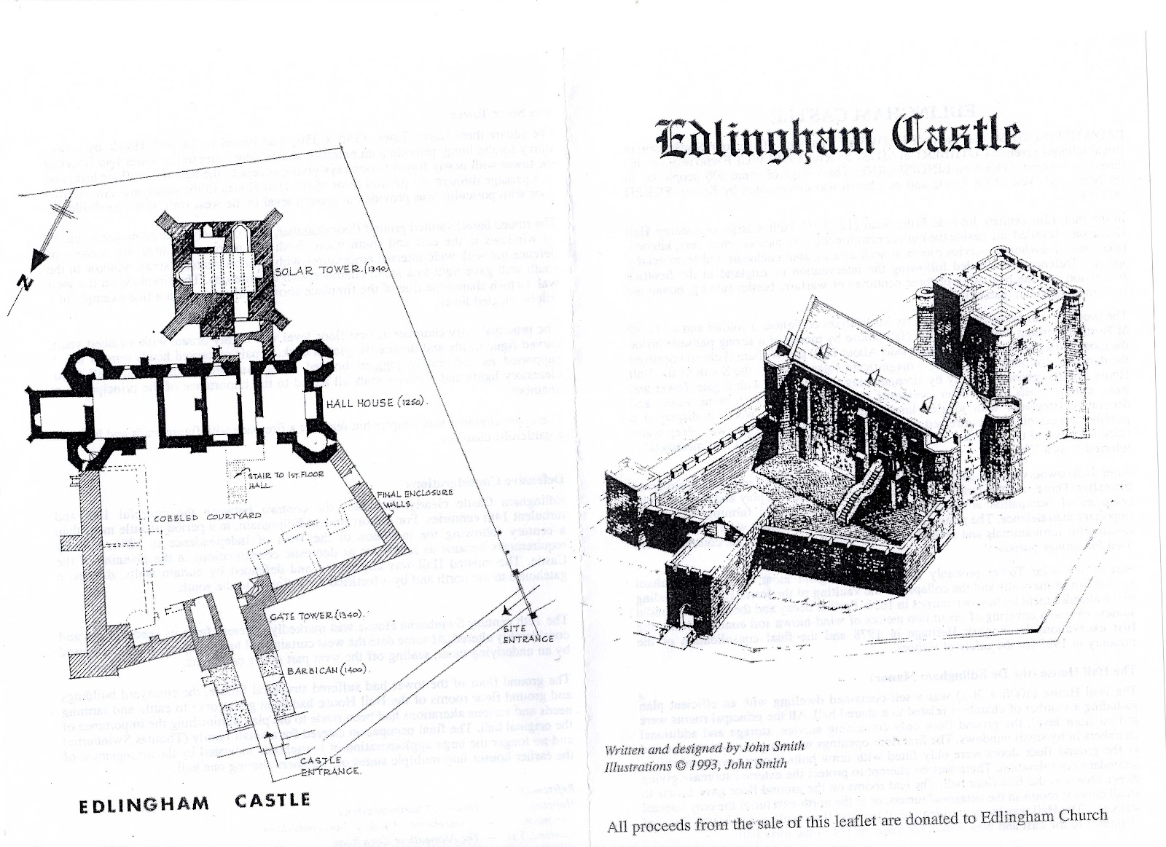
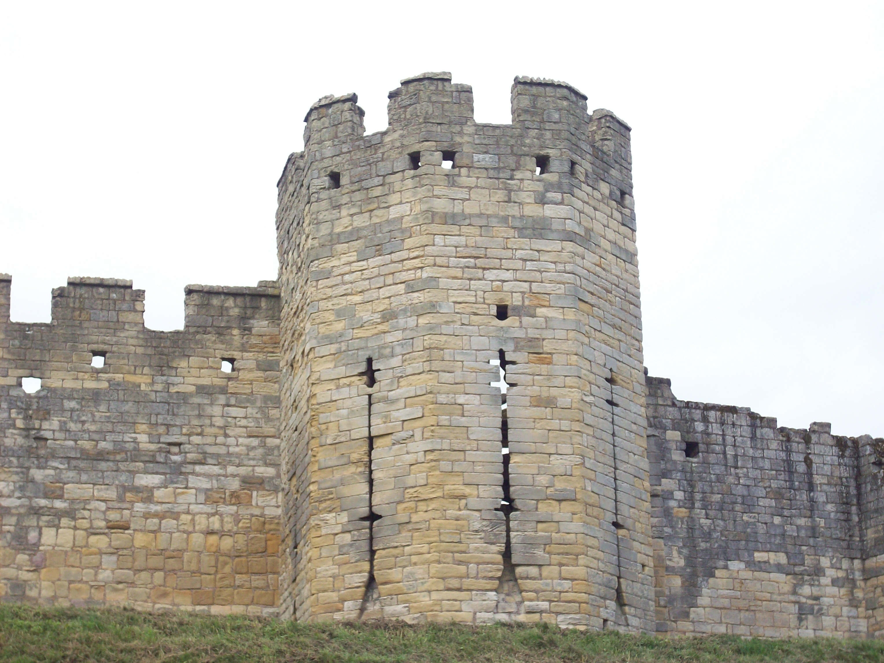
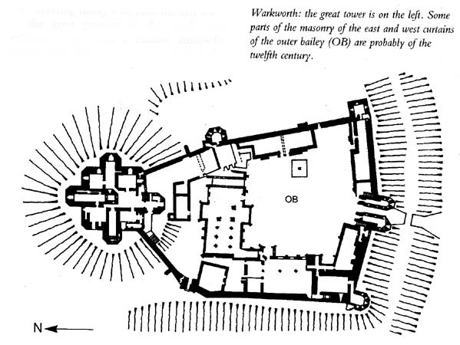
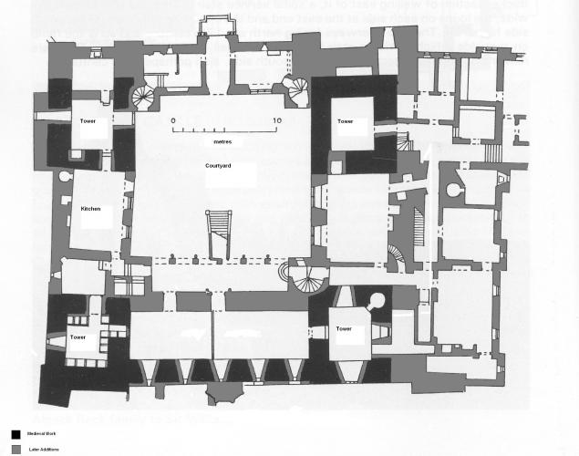
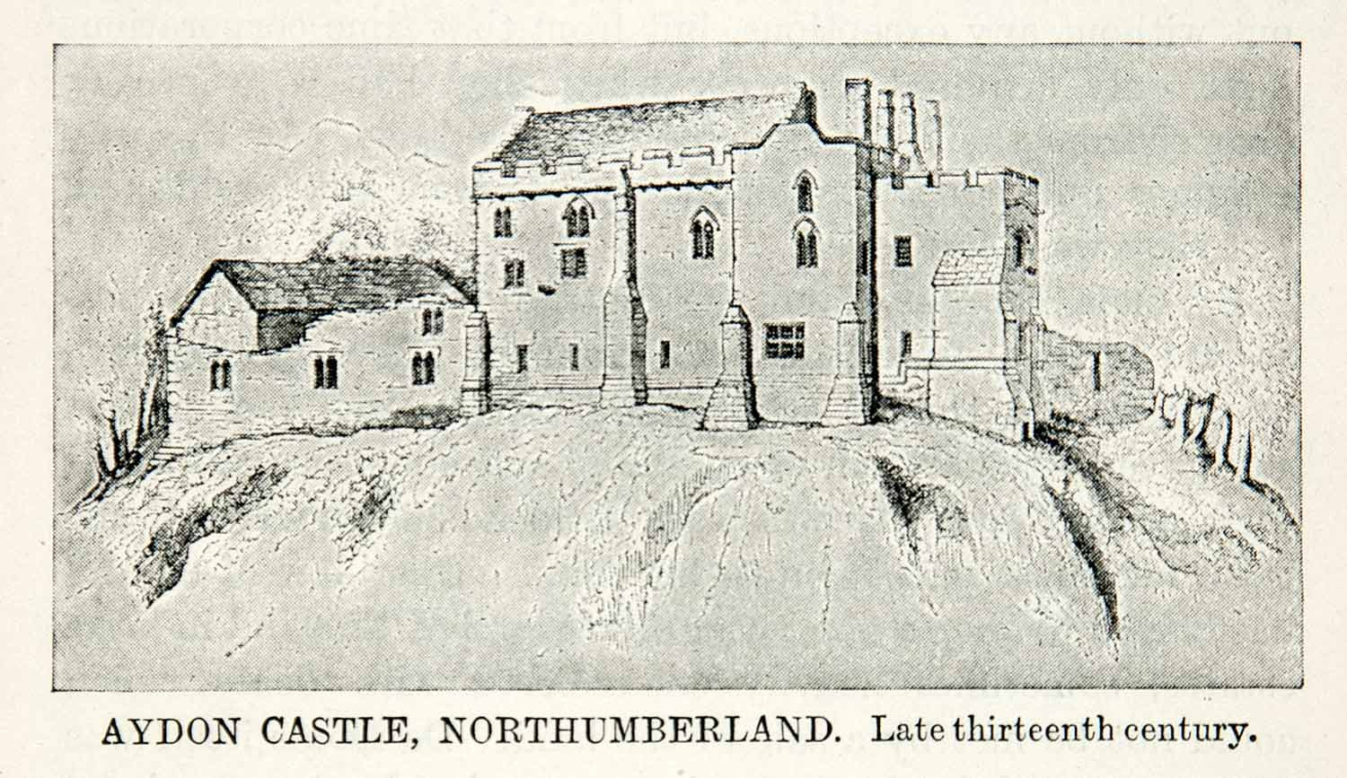

Slide 7
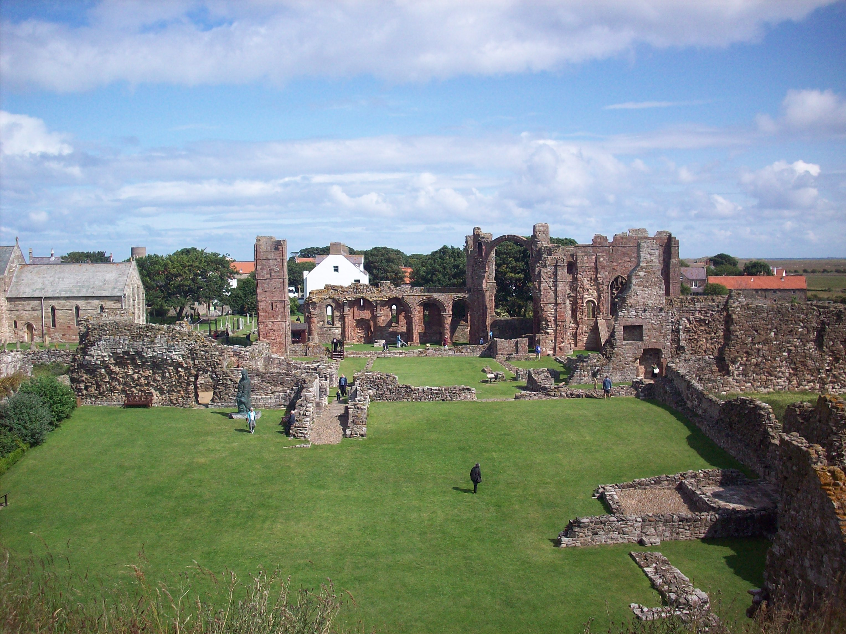
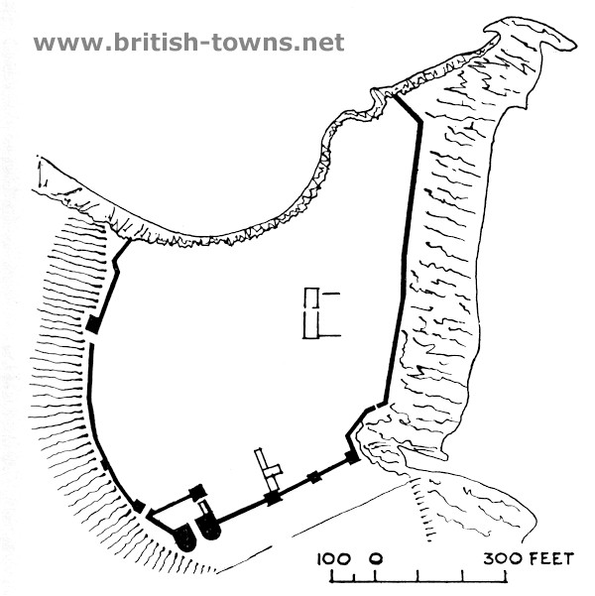
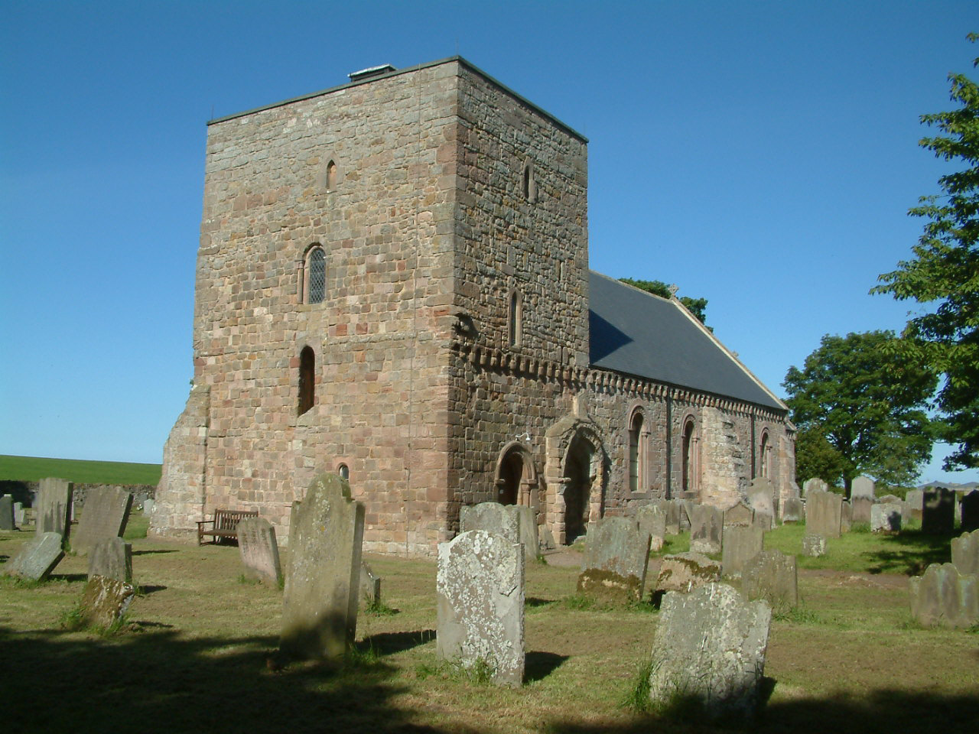
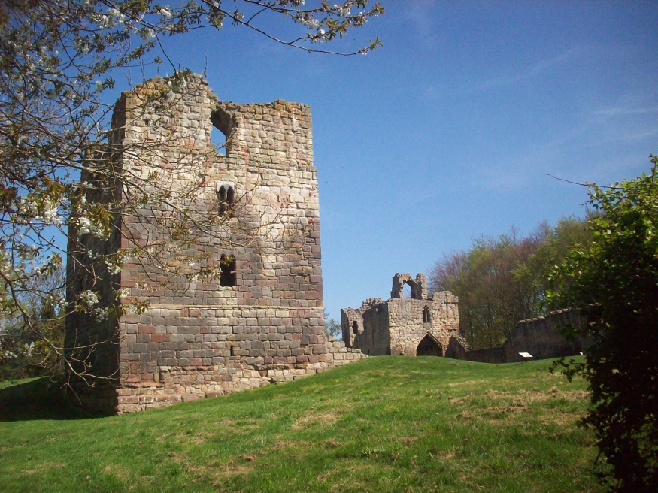
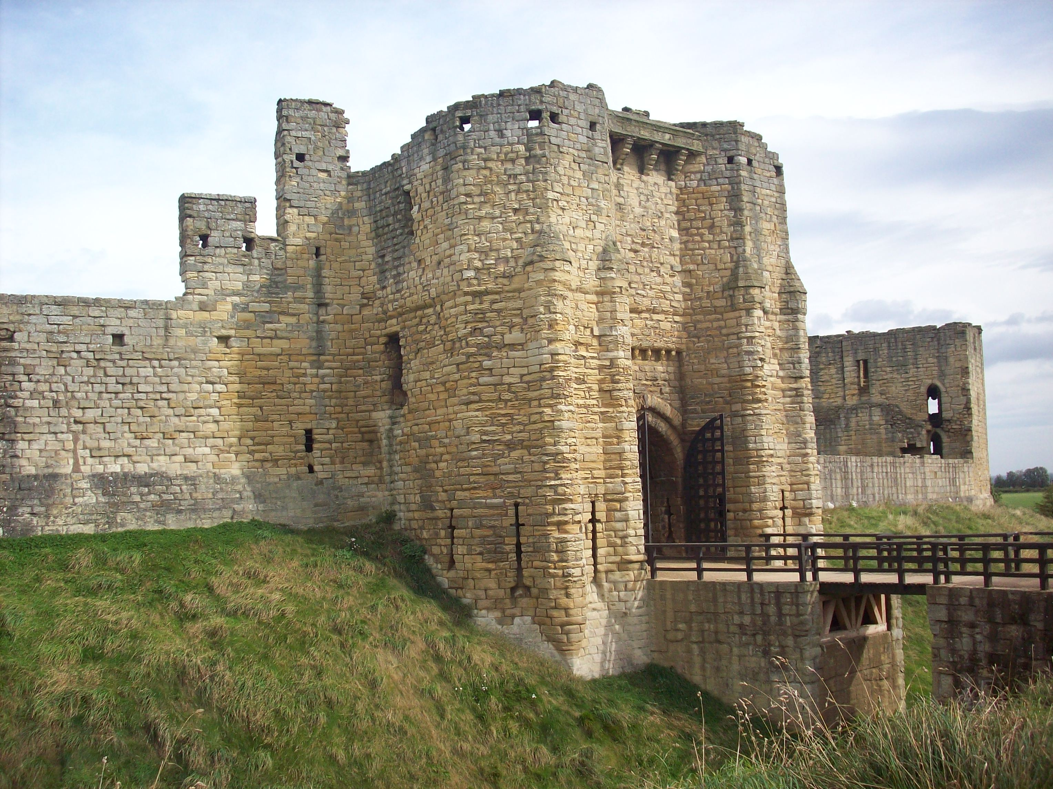
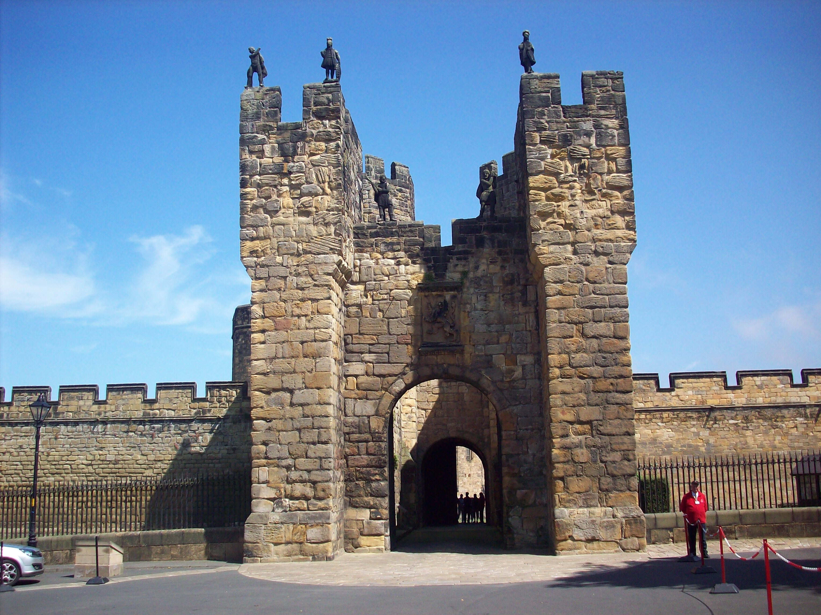
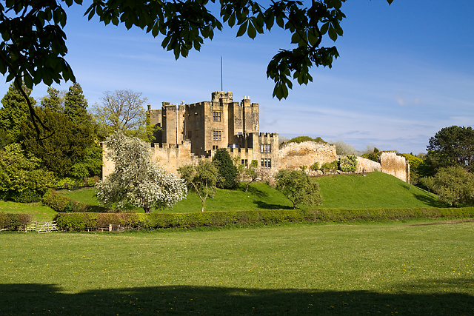
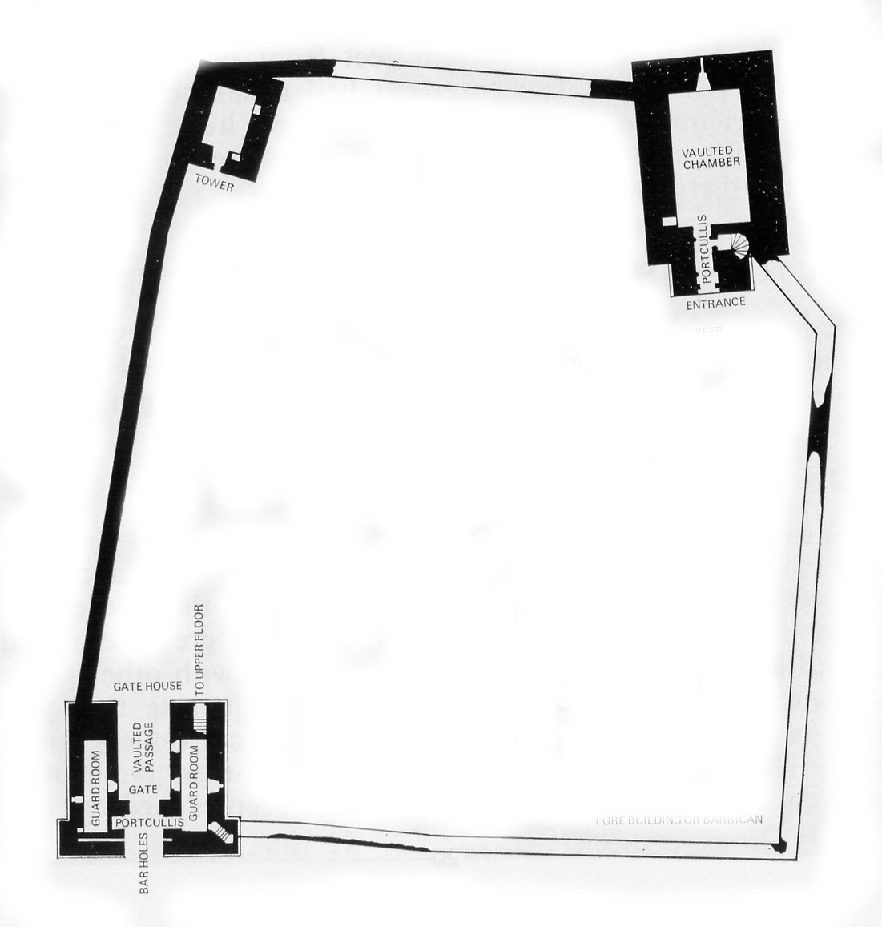
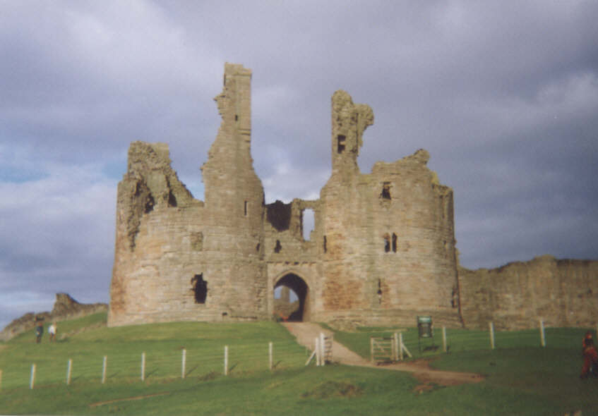
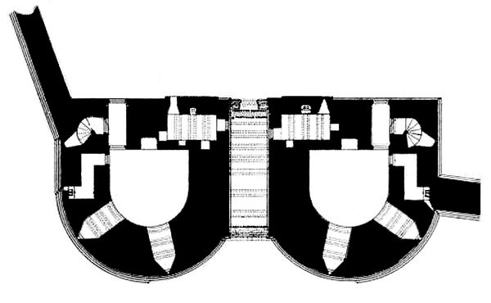

Slide 8
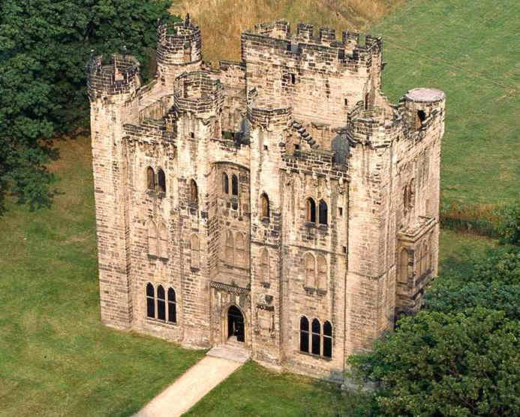
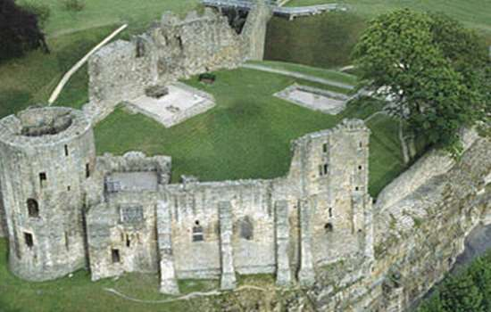
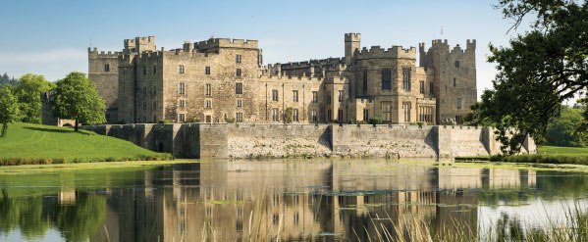

Slide 9
GROWTH AND LOSS OF THE PERCY FAMILY ESTATES
1067 William "Alsgernons" Percy given estates in north and west Yorkshire by King William I.
1087 William de Percy's holdings comprised Hambledon in Hampshire, 32 manors in Lincolnshire and 86 manors in Yorkshire, including Topcliffe, Whitby and Spofforth.
1138 William Percy granted Barony of Petworth, Sussex, for service at the Battle of The Standards (Northallerton).
1166 Percy estates valued at 36 Knights' Fees.
1309 Henry Percy II purchases the Barony of Alnwick from Bishop Antony Bek of Durham (trustee of the Vesci estate).
1332 Barony of Warkworth granted to Henry Percy by King Edward III, for service.
1333 Serjeanty of Beanley, forfeited by Patrick Earl of Dunbar and March, granted to Henry Percy by King Edward III.
1377 Henry Percy created Earl of Northumberland by Richard II.
1381 Baronies of Langley and Prudhoe, and Cockermouth in Cumbria, gained through marriage of Earl of Northumberland to Maud Lucy, widow of Gilbert de Umfraville and heiress to the Lucy and Umfraville estates.
1403 Barony of Mitford gained by marriage of 1st Earl's sons to the heiresses to the Earl of Angus.
1405 First Earl of Northumberland's estates forfeited for rebellion.
1416 2nd Earl of Northumberland regains estates, except Prudhoe and Beanley.
1441 2nd Earl regains Prudhoe.
1461 2nd Earl killed at Battle of Towton; Percy estates forfeited to the Crown.
1471 Titles and estates restored to the 4th Earl.
1484 Poynings family estates in Somerset, Dorset, Surrey, Sussex, Norfolk and Suffolk gained on the death of Eleanor, widow of 3rd Earl of Northumberland.
1535 Earl of Northumberland's estates pass to the Crown on the death of 6th Earl, without direct heir.
1557 Percy family regains titles and estates of Earls of Northumberland.

Slide 10
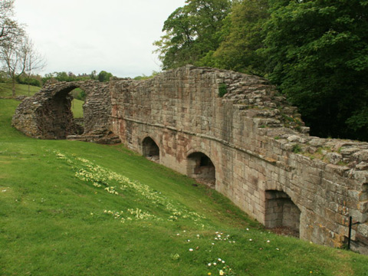
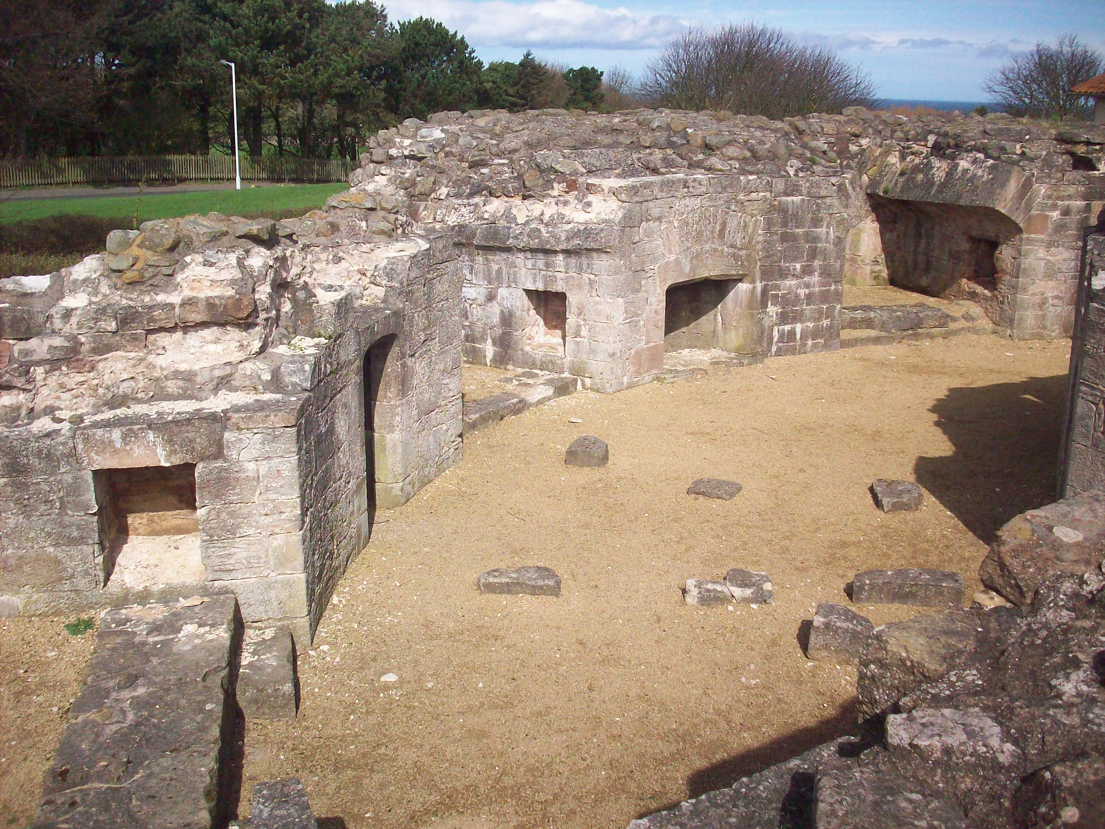
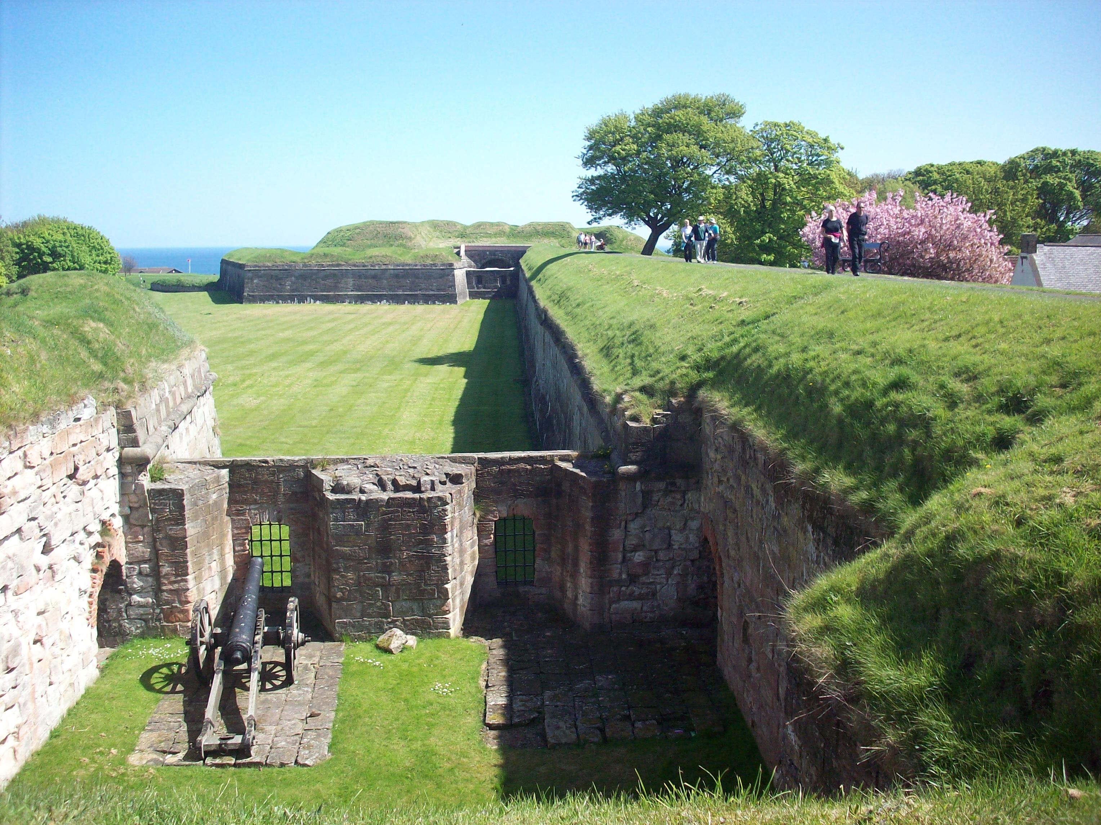
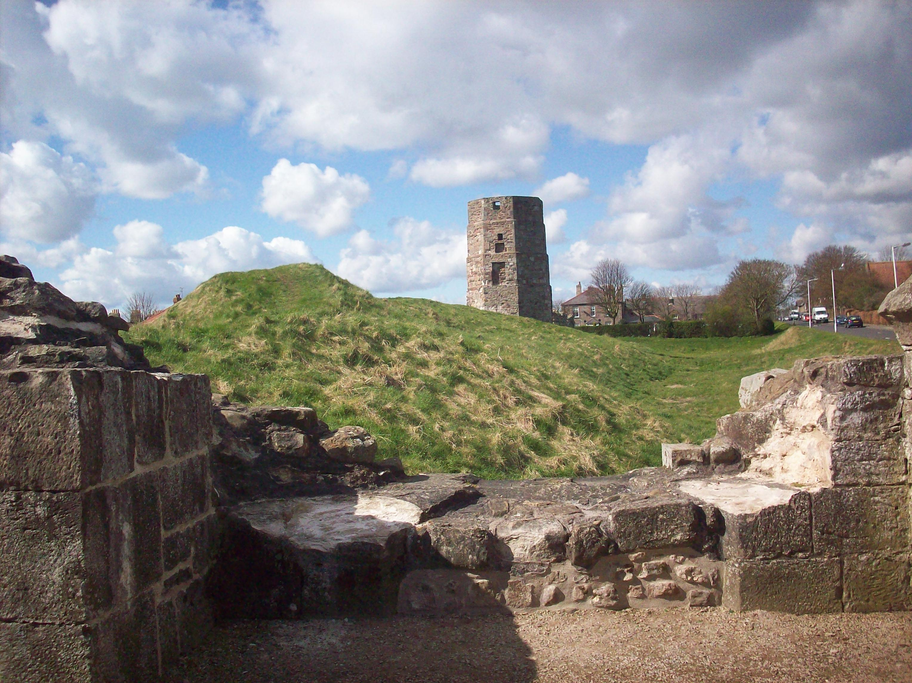
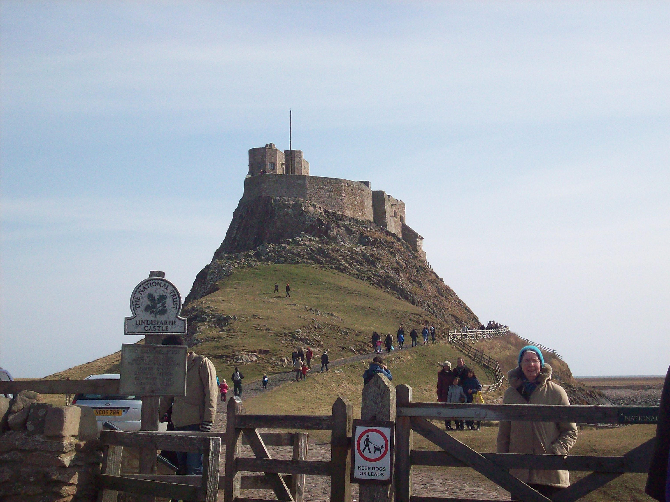

Slide 11
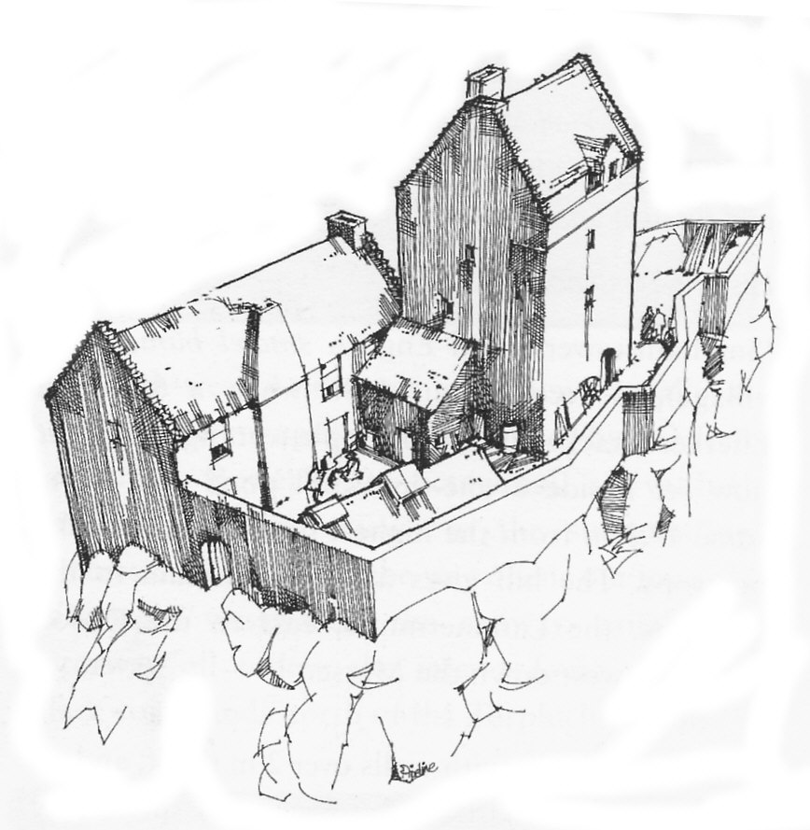
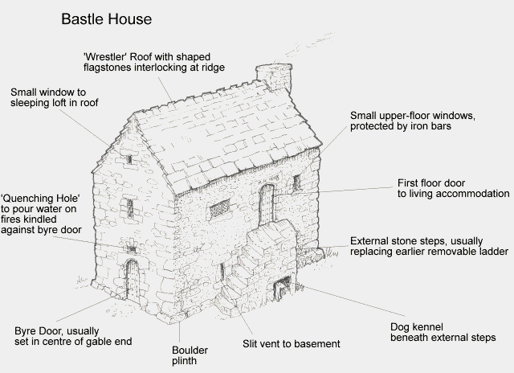
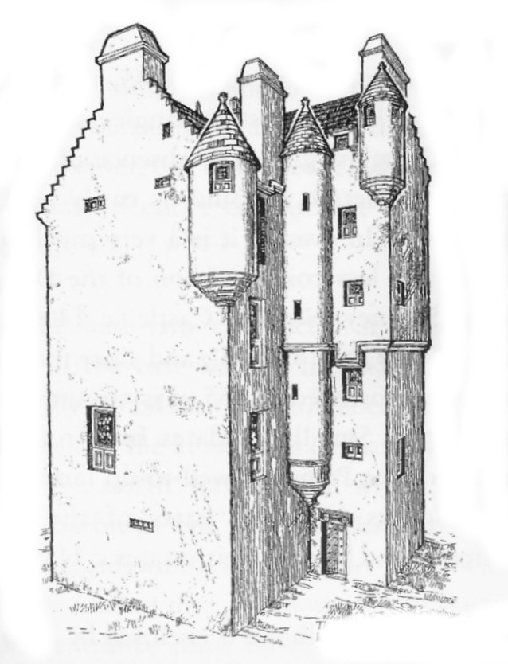
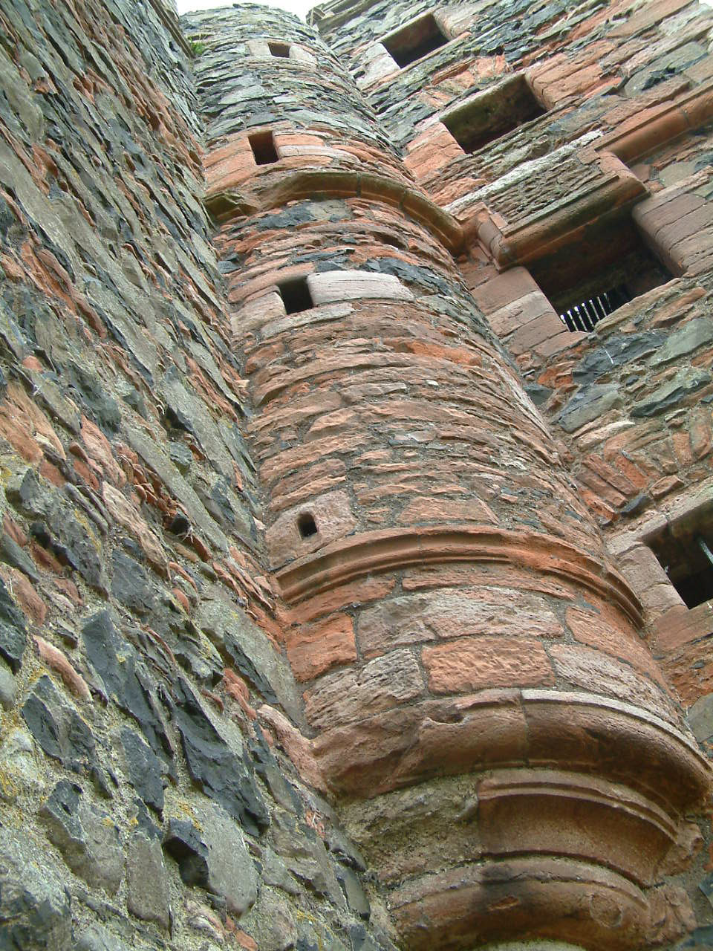
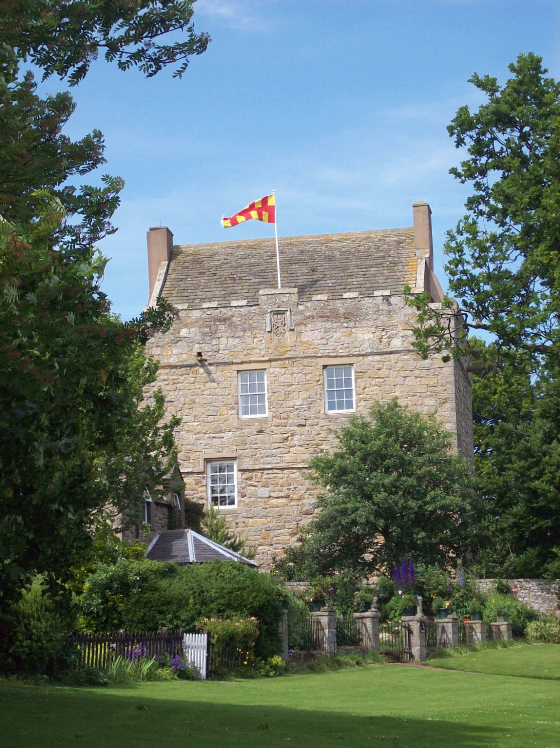
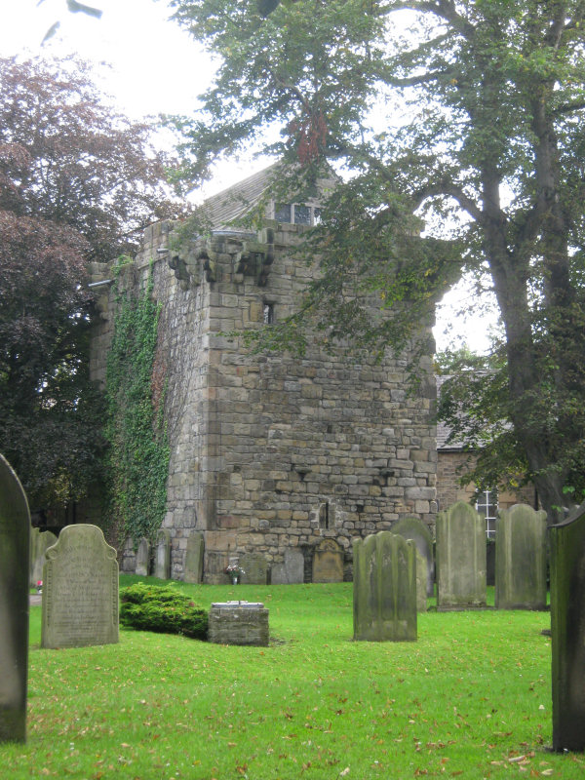
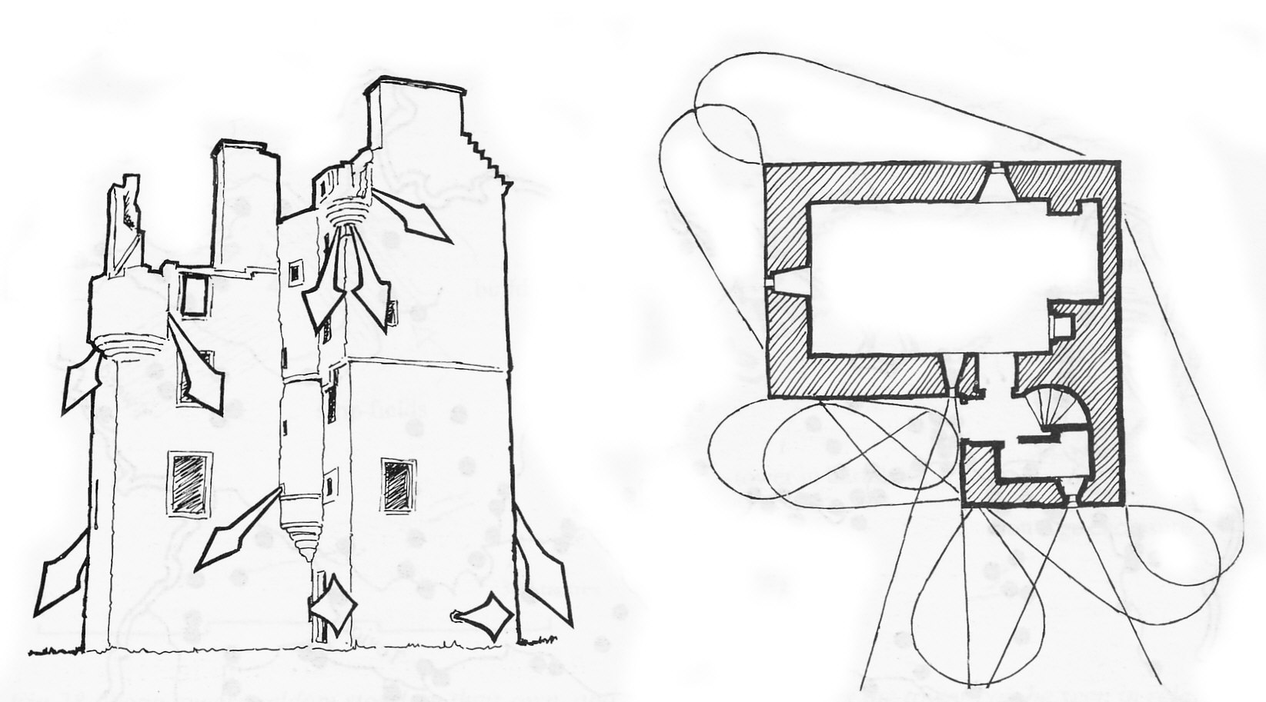

Slide 12
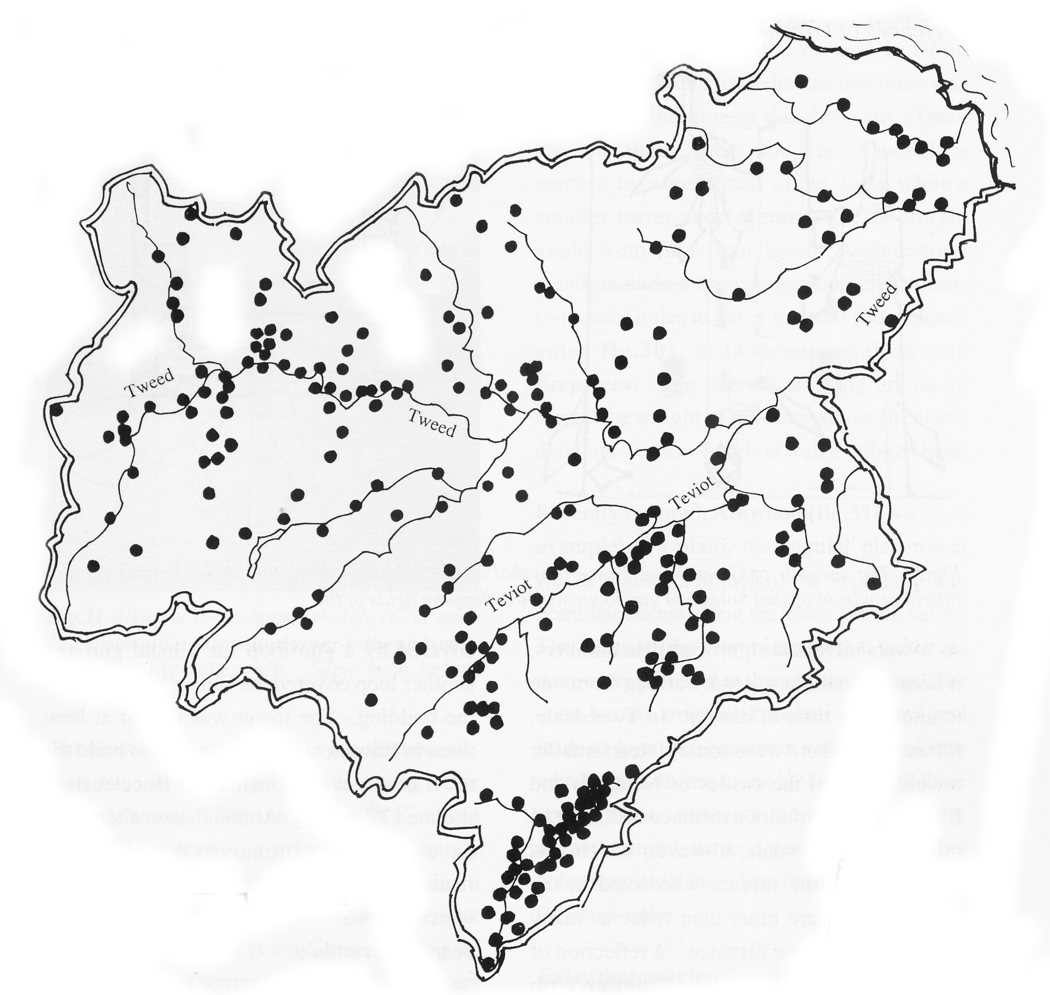
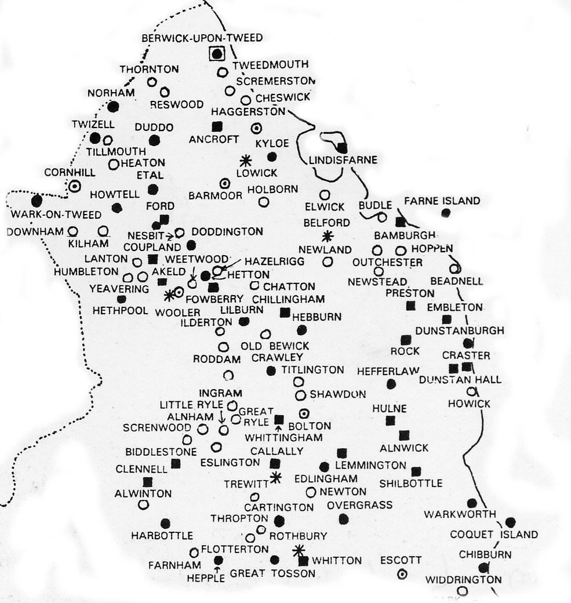
Northumberland Towers, circa 1500
Border Towers, circa 1500

