Slide 1
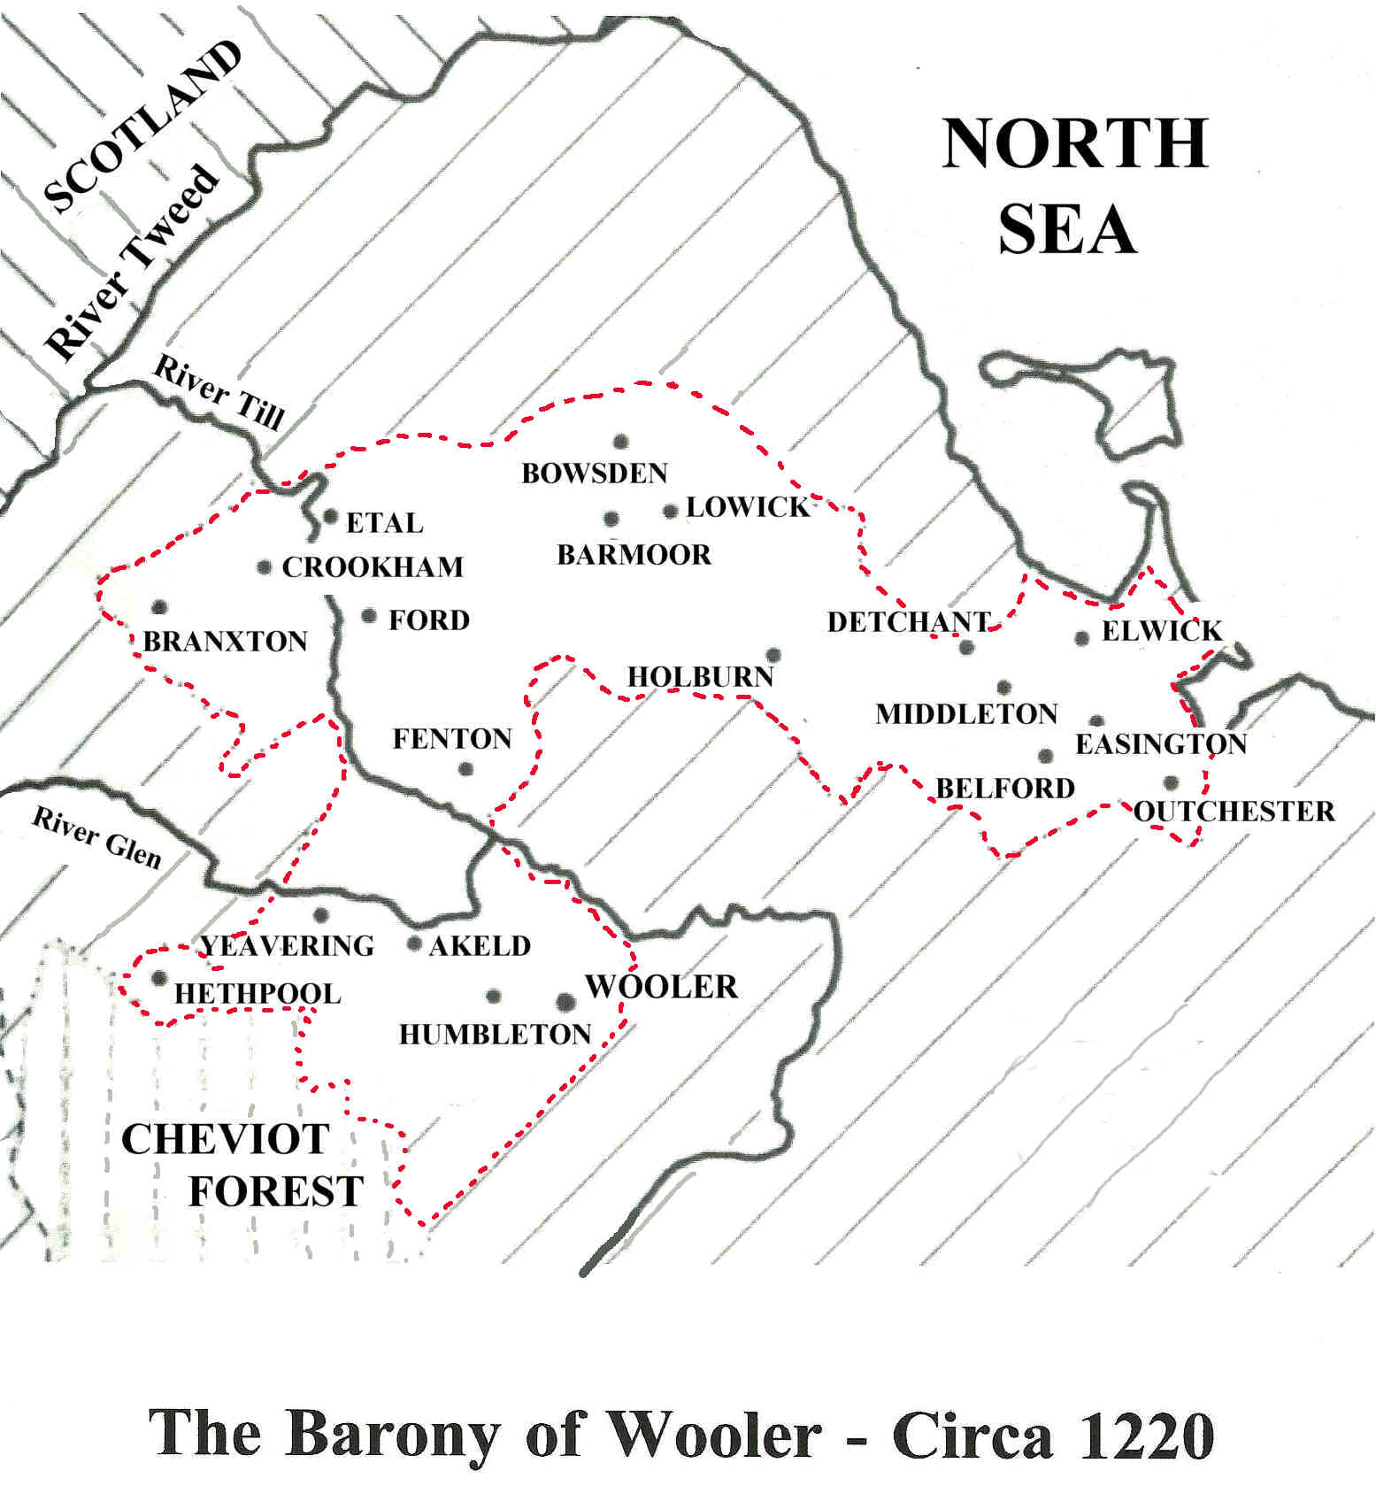

Slide 2
THE GOODS AND CHATTELS OF THOMAS PAGE, NEIF
Holder of 48 acres at Harton in 1378
3 oxen worth £1 16s 8d;
1 horse worth 16s. 0d;
3 cows worth 11s 4d;
1 heifer worth 4s 0d;
4 boars worth £1 16s 0d;
1 sow worth 4s 0d; 2 pigs worth 4s 9d;
3 piglets worth 3s 3d;
2 iron bound carts worth 16s 0d;
1 plough worth harness worth 5s 0d;
1 iron stove worth 8s 0d;
1 “plumbum” worth 8s 0d;
1 winnowing fan and 4 sacks worth 3s 04;
2 oil lamps and 1 ewer worth 3s 0d;
Wheat, barley, oats and peas worth £6 13s 4d

Slide 3
BONDLAND TENANCIES AT SHADFORTH (also SHERBURN and CASSOP)
From the Bishop of Durham's "Boldon Book" – 1183
For each bondland of 30 acres, these rents and works are owed:
Work 3 days a week throughout the year, except 7 days at Easter, 7 days at Whitsun and 13 days at Christmas.
Do 4 boons in autumn with the whole household, except the housewife.
Reap 3 roods of oats.
Plough and harrow 3 roods of oat stubble.
Plough and harrow 2 acres.
Mow 1 day at Houghton-le-Spring.
Build a booth at St Cuthbert's Fair, 1 for every 3 tenants.
½ chalder of Scotoats.
2 hens at Christmas.
10 eggs at Easter.
5 loads of wood.
2s 6d Scotpenny.
1s 4d Cartingpenny (also known as averpenny)
17s 0d Cornage (communal rent paid for the right to pasture cattle)
1 cow in milk (Metrith) (communal rent ).

Slide 4
BONDLAND TENANCIES AT SHADFORTH, Quarringtonshire. 1381
18 Bondlands, each consisting of 1 steading and 30 acres (2 bovates of 15 acres)
2 bondlands each: Robert Allinson, William Allinson, William Robinson and Thomas Huetson
1½ bondlands each: Joan Biddick, John Greveson, John Ludworth and Ralph Johnson
1 bondland each: Thomas Pearson, William Smith, Thomas of Sherburn and William Wardon
For each bondland the following rents and works are owed:
Scotpennies at the Feast of the Purification of the Blessed Virgin Mary 1s 7d
Maltpennies at Michaelmas 1s 3d
Averpennies at the Feasts of St Cuthbert in March, St John the Baptist and St Cuthbert in September 1s 0d
Woodloadpennies at the Feast of St John the Baptist 8d
6 bushels Scotoats at the Feast of the Purification
2 hens at Christmas
10 eggs at Easter
Week work = 3 days a week except the weeks of Easter and Whitsun and the fortnight of Christmas 16s 0d
Autumn work = 4 boon days at the harvest with all the household except his housewife 1s 0d
Michaelmas ploughing = 2 acres 1s 4d
Oat reaping = 3 roods (¾ acre) 6d
In addition, every bondland shall contribute to two communal rents:
Metrith 6s 0d
Cornage £1 5s 6d
The bond tenants also pay:
Common oven 2s 0d
Common forge (the common forge is now a cottage) -
Beer toll 2s 8d
Pinder's office 6s 8d

Slide 5
SHADFORTH in Quarringtonshire (Bishop of Durham) - 1381
Free Tenants
Sir Ralph Eure - 1 steading and 7½ acres 10d + "foreign" service and episcopal errands.
Isabel Boner - 1 steading and 7½ acres 10d
The heirs of John Freeman - 1 steading and 15 acres 1s 8d
Bond Tenants - 18 Bondlands each consisting of 1 steading and 30 acres (=2 bovates of 15 acres)
2 bondlands each: Robert Allinson, William Allinson, William Robinson and Thomas Huetson
1½ bondlands each: Joan Biddick, John Greveson, John Ludworth and Ralph Johnson
1 bondland each: Thomas Pearson, William Smith, Thomas of Sherburn and William Wardon
Cottagers
Robert Taylor = 1 cottage and 1 acre 4s 11d*
Margaret Hall = 1 cottage (formerly the common forge) 3s 9d*
* These rents include 9d for Michaelmas works
Exchequer Land
Robert Allinson = 2 tofts (should pay 6s 0d) 5s 0d
William Allinson = ½ acre 6d
Tenants = 3 acres 2s 6d
Tenants = 1 steading 3s 6d
Tenants = 43 acres £2 3s 0d
Tenants - 6 acres 6s 0d
Tenants - 3 acres 3s 0d
Tenants = 1 acre 1s 0d

Slide 6
BINGFIELD in the Estate of The Priory of Hexham, 1379
Manor, including several houses, a chapel, four gardens containing 2 acres, a tithe barn, 234 acres of demesne arable, 16 acres 3 roods demesne meadow and 16 acres detached pasture - The whole Grange of Bingfield held by Lease between Robert Colstan, William of Lethem and William Taylor of Errington for a term of 12 years, paying annually £6 for the first 3 years, £7 6s 8d for the second 3 years and £8 for the following 6 years.
53 acres in the Waste - leased to Walter Beaumont for £8
Sheep Farm with a garden of 4 acres - held by the Prior and Convent of Hexham
12 Husbandlands each comprising 24 acres of arable and meadow - each shall carry timber and grind-stones to the mill and shall repair its walls and roof at his own expense, and shall scour the mill pond and race whenever necessary. And they shall grind their corn at the lord's mill.
William of Lethem 1 husbandland 11s 6d + 1s Multure
John Lamb 2 husbandlands £1 13s 0½d + 6d Multure
John Thompson 1 husbandland 16s 10½d + 2s 6d Multure
William of Lethem 1 husbandland 16s 10½d + 2s Multure
Adam Kemp 1 husbandland 14s 4d
Walter of Sandhoe, neif 2 husbandlands £1 14s 6d + 1s Multure
William Hall 1 husbandland 17s 0d + 2s 6d Multure
John Oxherd/William Trout 2 husbandlands £1 2s 6d
John Thompson 1 husbandland 16s 0d + 1s Multure
12 Cottages - each owes the same service to the mill as the husbandmen; Rents for a cottage with 6 acres = 4s 7½d
Water-mill - held by John Oxherd for 10s 0d
Brew House - held by Robert Colstan for 2s 0d
Grottington Farm - held by Thomas Harrison for a term of 3 years, paying £2 for the first year and £2 10s 0d annually for the two succeeding years

Slide 7
BURGHS IN NORTH EAST ENGLAND
BURGHS IN NORTHUMBERLAND (18)
Norham; Wooler; Warenmouth; Bamburgh; Alnwick; Canongate; Alnmouth; Warkworth; Newbiggin; Rothbury; Felton; Morpeth; Mitford; Harbottle; Haydon Bridge; Newbrough; Corbridge; North Shields; Newcastle;
BURGHS IN DURHAM (9)
Gateshead; Sunderland; Durham; Gilesgate; Elvet; Crossgate; Bishop Auckland; Darlington; Stockton
BURGHS IN THE WAPENTAKE OF SADBERGE (2)
Barnard Castle and Hartlepool

Slide 8
GROWTH AND LOSS OF THE PERCY FAMILY ESTATES
1067 William "Alsgernons" Percy given estates in north and west Yorkshire by King William I.
1087 William de Percy's holdings comprised Hambledon in Hampshire, 32 manors in Lincolnshire and 86 manors in Yorkshire, including Topcliffe, Whitby and Spofforth.
1138 William Percy granted Barony of Petworth in Sussex, for service at the Battle of The Standards (Northallerton).
1166 Percy estates valued at 36 Knights' Fees.
1309 Henry Percy II purchases the Barony of Alnwick from Bishop Antony Bek of Durham (trustee of the Vesci estate).
1332 Barony of Warkworth granted to Henry Percy for service to King Edward III.
1333 Serjeanty of Beanley, forfeited by Patrick Earl of Dunbar and March, granted to Henry Percy by King Edward III.
1377 Henry Percy created Earl of Northumberland by Richard II.
1381 Baronies of Langley and Prudhoe, and Cockermouth in Cumbria, gained through marriage of the 1st Earl of Northumberland to Maud Lucy, widow of Gilbert de Umfraville and heiress to the Lucy and Umfraville estates.
1403 Barony of Mitford gained by marriage of the 1st Earl's sons to the heiresses to the Earl of Angus.
1405 First Earl of Northumberland's estates forfeited for rebellion.
1416 2nd Earl of Northumberland regains estates, except Prudhoe and Beanley.
1441 2nd Earl regains Prudhoe.
1461 2nd Earl killed at Battle of Towton; Percy estates forfeited to the Crown.
1471 Titles and estates restored to the 4th Earl.
1484 Poynings family estates in Somerset, Dorset, Surrey, Sussex, Norfolk and Suffolk are gained on the death of Eleanor, widow of 3rd Earl of Northumberland.
1535 Earl of Northumberland's estates pass to the Crown on the death of 6th Earl without a direct heir.
1557 Percy family regains the title and estates of the Earl of Northumberland.

