Slide 1
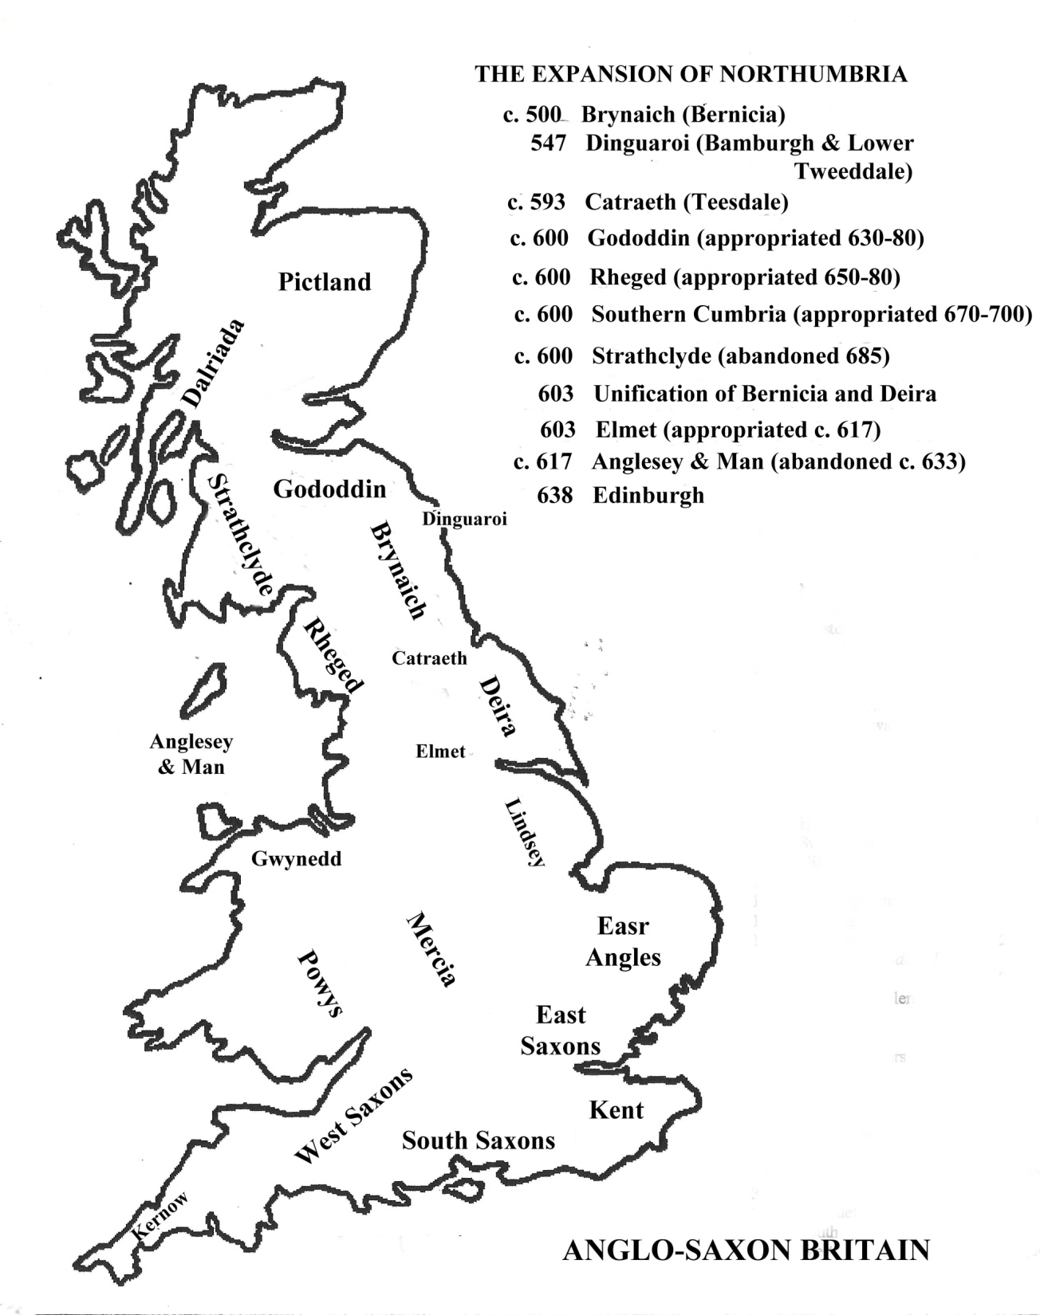

Slide 2
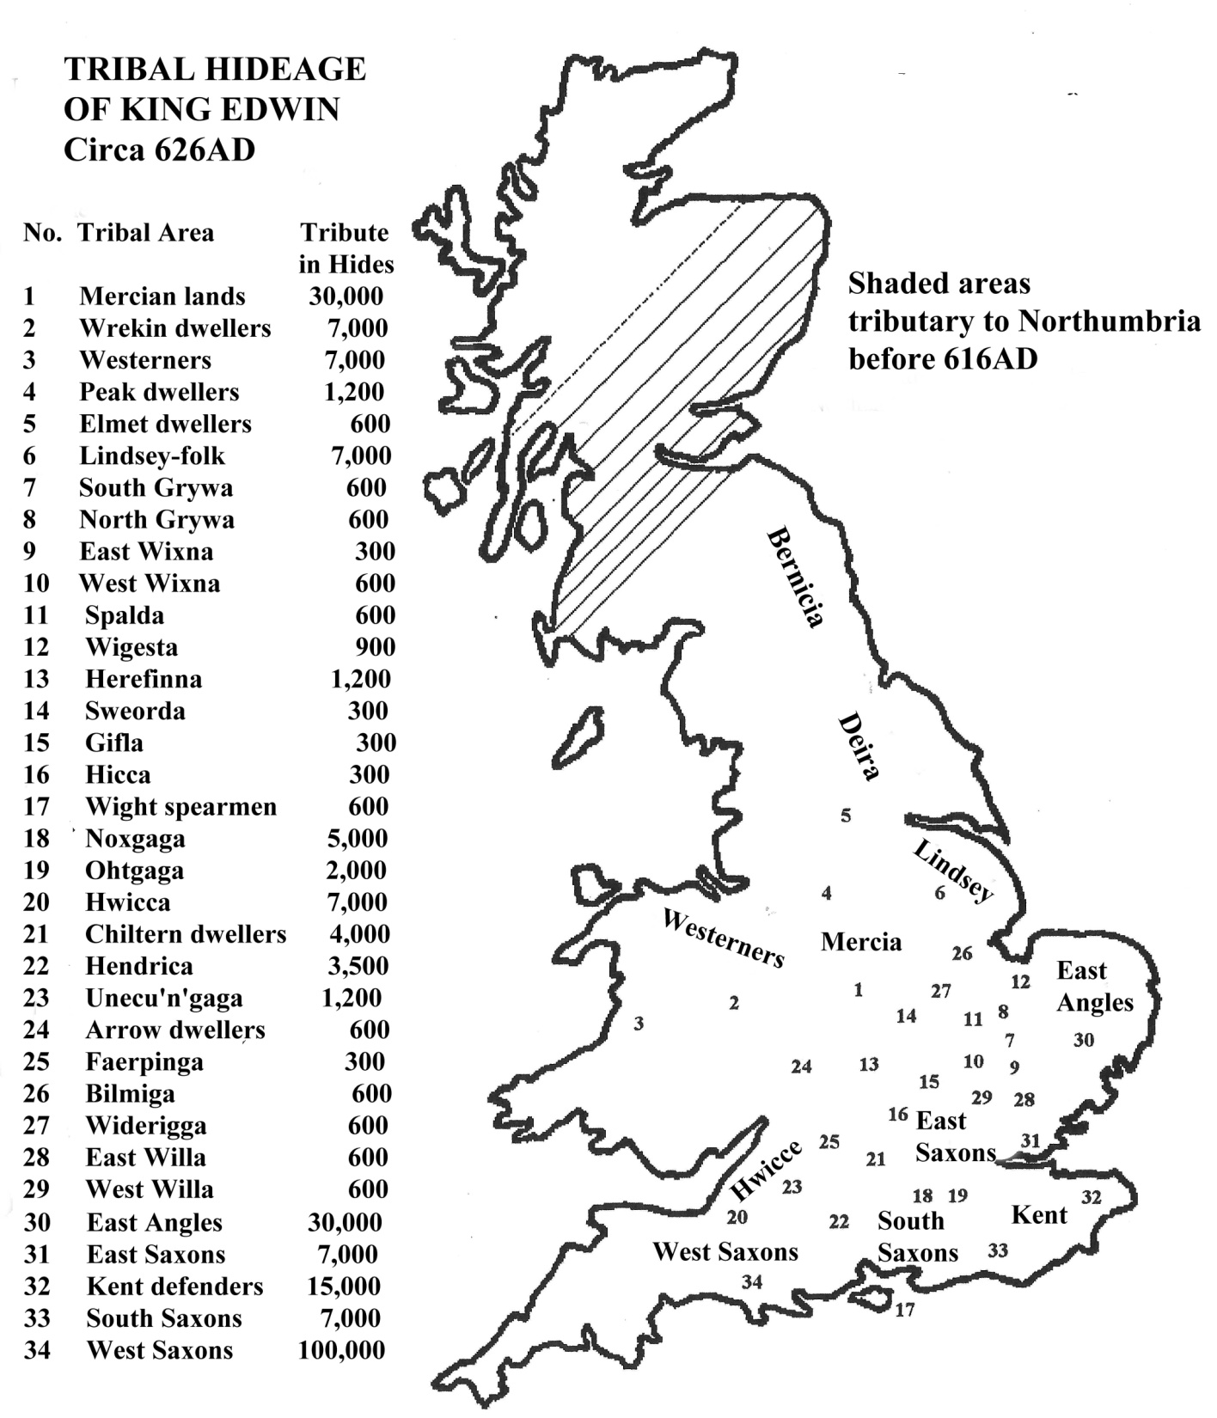

Slide 3
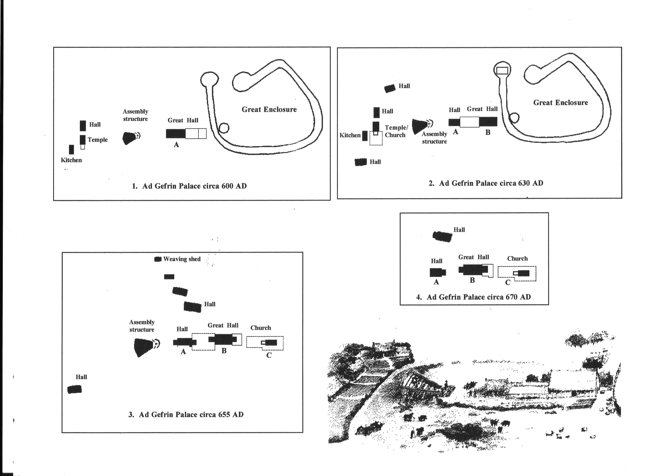

Slide 4
547-559 | Ida | Founder of the Bernicia royal house
559-589 | Ælla | Founder of the Deiran royal house
Northumbrian Kings
593 to 616 | Æthelfrith | United Bernicia with Deira; Killed in Battle
616 to 12/14 October 632 | Edwin | Killed in Battle by Penda of Mercia; Saint Edwin
late 632 to 633 | Eanfrith | King of Bernicia; Murdered by Penda, King of Mercia
late 632 to summer 633 | Osric | King of Deira; Killed by Cadwalla at York
633 to 5 August 642 | Oswald | Killed by Penda, King of Mercia; Saint Oswald
late 642 to 644 | Oswiu | King of Northumbria
644 to 651 | Oswiu | King of Bernicia
644 to 651 | Oswine | King of Deira; Murdered at Gilling on orders of Oswiu
651 to 15 Feb 670 | Oswiu | King of united Northumbria
Feb 670 to 20 May 685 | Ecgfrith | Killed in battle against the Picts
May 685 to 14 Dec 704 | Aldfrith
late Dec 704 to early 705 | Eadwulf | Usurper
705 to 716 | Osred I | Murdered
716 to 718 | Coenred
718 to 29 May 729 | Osric | Adopted Ceolwulf as his heir
729 to 731 | Ceolwulf | Deposed; Saint Ceolwulf
731 to 737 | Ceolwulf | Restored; abdicated to become a monk
737 to 758 | Eadberht | Abdicated to become a monk
758 to 759 | Oswulf | Murdered by his servants at Corbridge
759 to 765 | Æthelwald Moll | Deposed
765 to 774 | Alhred | Deposed and exiled
774 to 779 | Æthelthred I | Deposed; The Butcher King”
779 to 23 Sept 788 | Ælfwald I | Murdered near Chesters on Hadrian’s Wall
788 to 790 | Osred II | Deposed and exiled on the Isle of Man
790 to 18 April 796 | Æthelthred I | Restored; ”The Butcher King”
796 | Osbald | Exiled to Pictland after a reign of 27 days
14 May 796 to 806/8 | Eardwulf | Deposed
806/8 to 808/10 | Ælfwald II
808 to 810 | Eardwulf | Restored
810 to 841 | Eanred
840/1 to 844 | Æthelthred II | Deposed
844 | Rædwulf | Usurper
844 to c. 848/9 | Æthelthred II | Restored
c. 848/9 to 862/3 | Osberht | Deposed
862/3 to 23 March 867 | Ælle II | Usurper; Killed by the Danes with Osberht
867 to 21 March 867 | Osberht | Restored. Killed by the Danes with the usurper Aelle
867 to 872 | Ecgberht I | Puppet king of the Danes
Subject to Norse Kingdom | of York
872 to 972
Northumbria subject to the | King of the English
927 to 939 ^{[2]} | Æthelstan of Wessex | King of the English

Slide 5
547-559 IDA Founder of the Bernicia royal house
559-589 AELLA Founder of the Deiran royal house
Northumbrian Kings
593-616 Ethelfrith United Bernicia with Deira; Killed in Battle
616-632 Edwin Killed in Battle by Penda of Mercia; Saint Edwin
632-633 Eanfrith King of Bernicia; Murdered by Penda of Mercia
632-633 Osric King of Deira; Killed by Cadwalla at York
633-642 Oswald Killed by Penda of Mercia; Saint Oswald
642-644 Oswy King of Northumbria
644-651 Oswy King of Bernicia
644-651 Oswin King of Deira; Murdered on orders of Oswy
651-670 Oswy King of united Northumbria
670-685 Egfrith Killed in battle against the Picts
685-704 Aldfrith

Slide 6
685-704 Aldfrith
704-705 Eadwulf Usurper
705-716 Osred I Murdered
716 -718 Coenred
718 -729 Osric Adopted Ceolwulf as his heir
729 -731 Ceolwulf Deposed
731-737 Ceolwulf Restored; abdicated to become a monk; Saint Ceolwulf
737-758 Eadbert Abdicated to become a monk
758 -759 Oswulf Murdered by his servants at Corbridge
759-765 Ethelwald Moll Deposed
765-774 Alhred Deposed and exiled
774-779 Ethelthred I Deposed; “The Butcher King”
779 -788 Elfwald I Murdered near Chesters on Hadrian’s Wall
788-790 Osred II Deposed and exiled on the Isle of Man
790-796 Ethelthred I Restored; ”The Butcher King”
796 Osbald Exiled to Pictland after a reign of 27 days

Slide 7
Viking Period
796 Osbald Exiled to Pictland after a reign of 27 days
796-806/8 Eardwulf Deposed
806/8-808/10 Elfwald II
808-810 Eardwulf Restored
810-840 Eanred
840-844 Ethelthred II Deposed
844 Redwulf Usurper
844-848/9 Ethelthred II Restored
848/9-862/3 Osbert Deposed
862/3-867 Aelle II Usurper; Killed by the Danes with Osbert
867 Osbert Restored; Killed by the Danes with Aelle
867-872 Egbert I Puppet king of the Danes
Northumbria subject to the Norse Kingdom of York
872-972
Northumbria subject to the King of the English
927-939 Athelstan of Wessex King of the English

