Slide 1
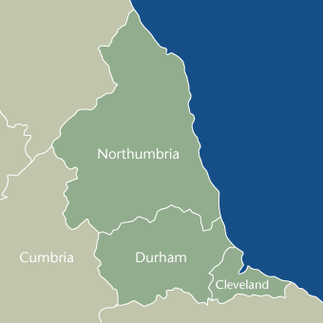
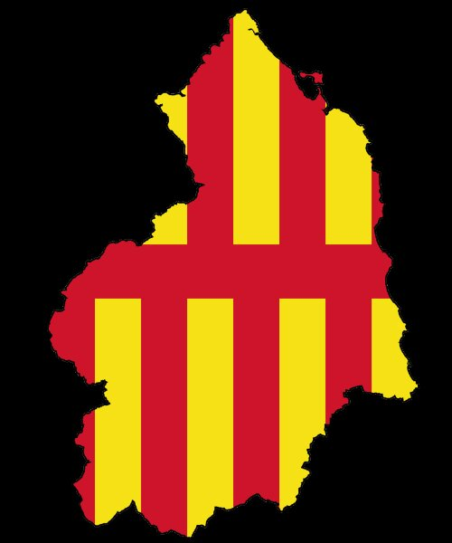
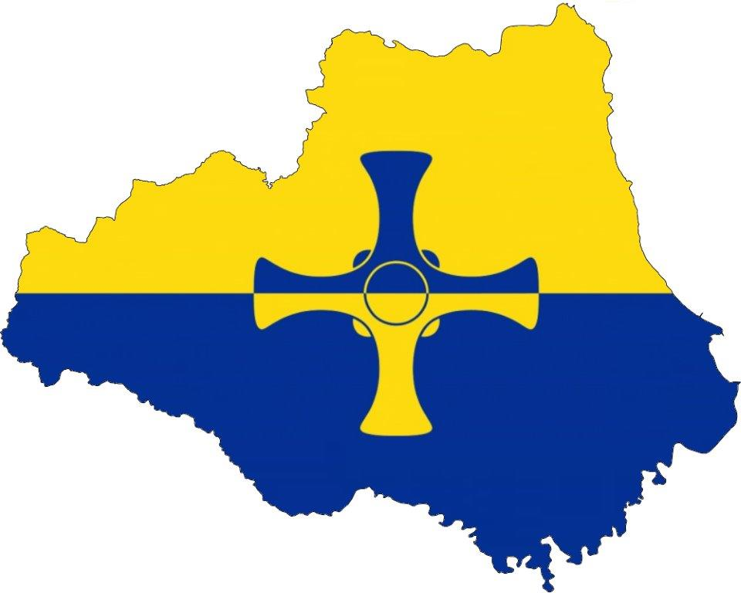
900 Years
of the
History of
North East England

Slide 2
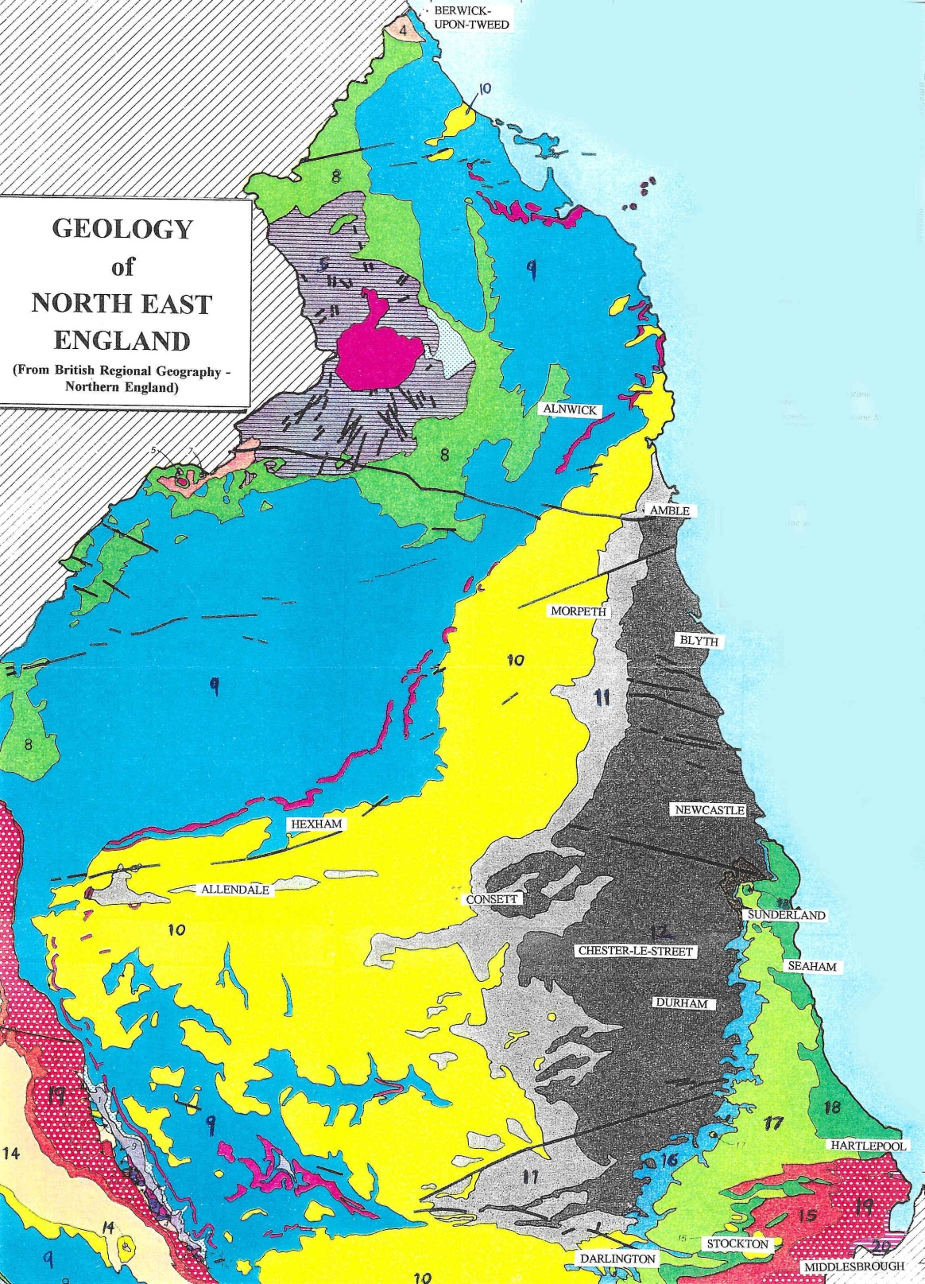
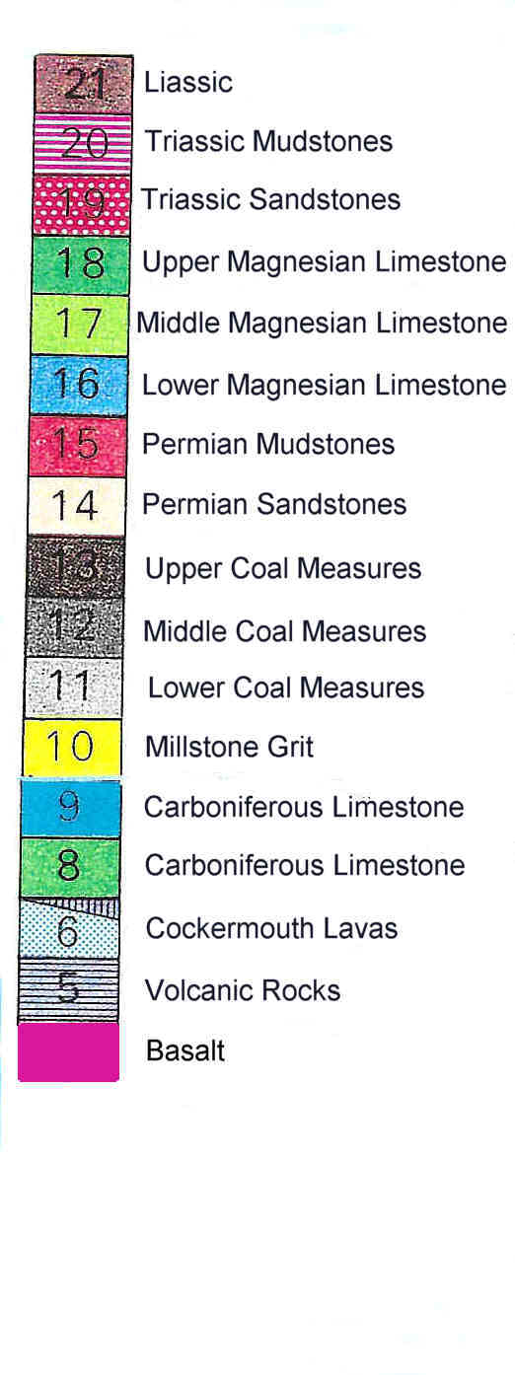

Slide 3
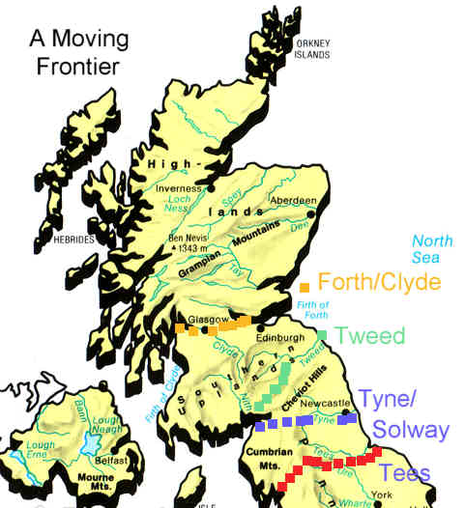
A Moving Border

Slide 4
POPULATION TRENDS
12th/13th centuries Rising population throughout the North East
1347 National population approximately 5,000,000
mid-14th to late-15th centuries Drastic reduction in the North East population
1377 National population approximately 2,500,000
16th century Population in the North East rises slowly
mid-17th to mid-18th centuries 60% increase in North East population*
1801-1851 Population in the North East increases by 120%
1831-1841 Migration into North East at its highest proportion (8%)
1840s Highest influx of migrants into County Durham
1850-90s Highest influx of migrants into south-east Northumberland
1851-71 North East population increases by 54%, about double the national rate of growth
* More rapid increase in Newcastle and Durham than in Northumberland. The population in the upland areas of the North East declined by up to 50%.

Slide 5
ESTIMATED POPULATION
Northumberland England
        and Durham and Wales
1595 120,000 4,500,000
1665 142,000 5,000,000
1735 225,000 6,000,000
1801 317,000 10,500,000
1851 695,000 20,186,000
1891 1,323,000 35,473,000

Slide 6
COMPARISON PERCENTAGE INCREASE IN POPULATION
Northumberland Durham England & Wales
1801 168,000 149,000 10,500,000
1811 183,000 (9%) 165,000 (16%) (14.3%)
1821 213,000 (16%) 194,000 (16.8%) (18.1%)
1831 237,000 (11.5%) 239,000 (22.7%) (15.8%)
1841 266,000 (12.3%) 308,000 (27.7%) (14.5%)
1851 304,000 (14.3%) 391,000 (26.3%) (12.7%)
1861 343,000 (13.6%) 509,000 (29.3%) (11.9%)
1871 387,000 (12.7%) 685,000 (34.1%) (13.2%)
1881 434,000 (12.2%) 867,000 (26.3%) (14.4%)
1891 506,000 (16.7%) 1,017,000 (17%) (11.7%)
603,000 (19.2%) 1,187,000 (14.6%) (12.2%)

Slide 7
An Example of declining population in a rural township
1801 Population of Wooler 1,679
1851 Population of Wooler 1,911
1891 Population of Wooler 1,301
Percentage of population living in size groups of settlements in the North East
Under 2,000 2-20,000 20-50,000 50,000+
1821 61.6% 22.1% 16.3% -
1851 49.6% 26.0% 3.3% 21.1%
1881 31.1% 23.6% 15.0% 30.2%
1911 25.2% 23.9% 9.2% 41.6%

Slide 8
INDUSTRY AND POPULATION CHANGE
In Lead Mining Districts:
1811 1821 1851 1891
Allendale 3,084 - 6,383 3,009
Newbiggin 396 69 69 54
(near Blanchland)
In a newly-won coalfield area (East Durham):
Population of Hetton-le-Hole 264
1821 Population of East Durham 4,920
1822 Hetton Colliery Co. sinks the first shaft through the East Durham Magnesian Cap.
1831 Population of Hetton-le-Hole 5,900
1851 Population of East Durham 42,091*
* Only 17% of the East Durham population had been born in township where they were living. Of the remainder, 54% were born elsewhere in Durham, 16% in South Northumberland, 7.4% in Cumbria,

Slide 9
INWARD MIGRATION
1842 Opening of the Weardale Iron Co. Works at Tow Law
1840s Height of the Irish Potato Famine
1851 10% of Tow Law population was born in Ireland

Slide 10
EFFECTS OF HARBOUR AND COLLIERY RAIL LINKS
AMBLE
1821 Population of Amble 197
1837 Act of Parliament to improve Amble Harbour
1841 Population of Amble 724
1861 Population of Amble 1,275
1821-41 270% increase in population of Amble
1821-41 25% increase in population of Northumberland
HARTLEPOOL
1831 Population of Hartlepool 1,330
1831 Hartlepool Dock & Railway Co. link with collieries in South-West Durham
1841 Population of Hartlepool 5,256

