Slide 1
The English Household & Family
1500-1800
Session One
Community and Kinship

Slide 2
Some Significant Events 1509 - 1603
1509 Accession of Henry VIII
1529 Act ordering inventories of personal goods of deceased persons
1533/4 The Church in England breaks with the Pope in Rome
1535 Survey of ecclesiastical property leads to dissolution of the monasteries
1536 Pilgrimage of Grace
1538 Parish Registers to be kept, recording births, marriages and burials
1547 Accession of Edward VI
1549 First Book of Common Prayer
1552 Licensing Act for alehouses
1553 Accession of Mary I
1558 Accession of Elizabeth I
1559 Act of Uniformity - compulsory attendance at parish church; teachers to be licensed
1563 Parishes made responsible for Poor Relief
1586/7 Disastrous harvests
1594-6 Disastrous harvests
1597 Poor Law Act - appointment of Parish Overseers of the Poor; Parish Rates introduced
1603 Accession of James VI/I – Union of The Crowns

Slide 3
Some Significant Events 1625 - 1801
1625 Accession of Charles I
1642 Outbreak of The Civil Wars
1649 Execution of Charles I
1653 Civil Marriage Act - all marriages to take place before a Justice of the Peace (abolished 1660)
1654 Oliver Cromwell made Lord Protector of the Commonwealth
1658 Richard Cromwell made Lord Protector
1660 Accession of Charles II
1662 Act of Settlement - parish or birth or long-term residence made responsible for poor relief
1685 Accession of James II
1688 Accession of William III and Mary II
1689 (Religious) Toleration Act
1692 Property Tax (Land Tax) introduced
1702 Accession of Anne
1714 Accession of George I
1727 Accession of George II
1753 Lord Hardwicke's Marriage Act
1760 Accession of George III
1799 Income Tax introduced (as a temporary measure during the Wars with Revolutionary France!)
1801 First National Census

Slide 4
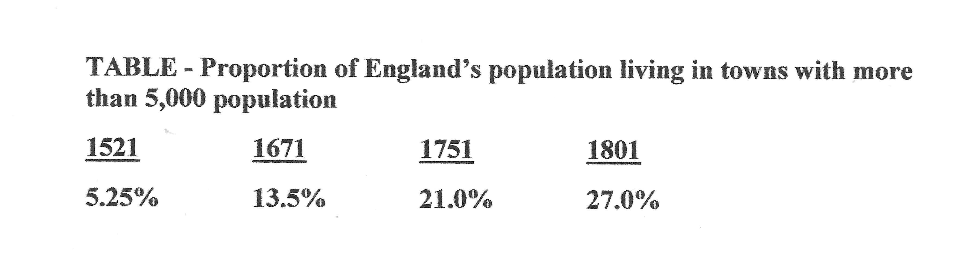
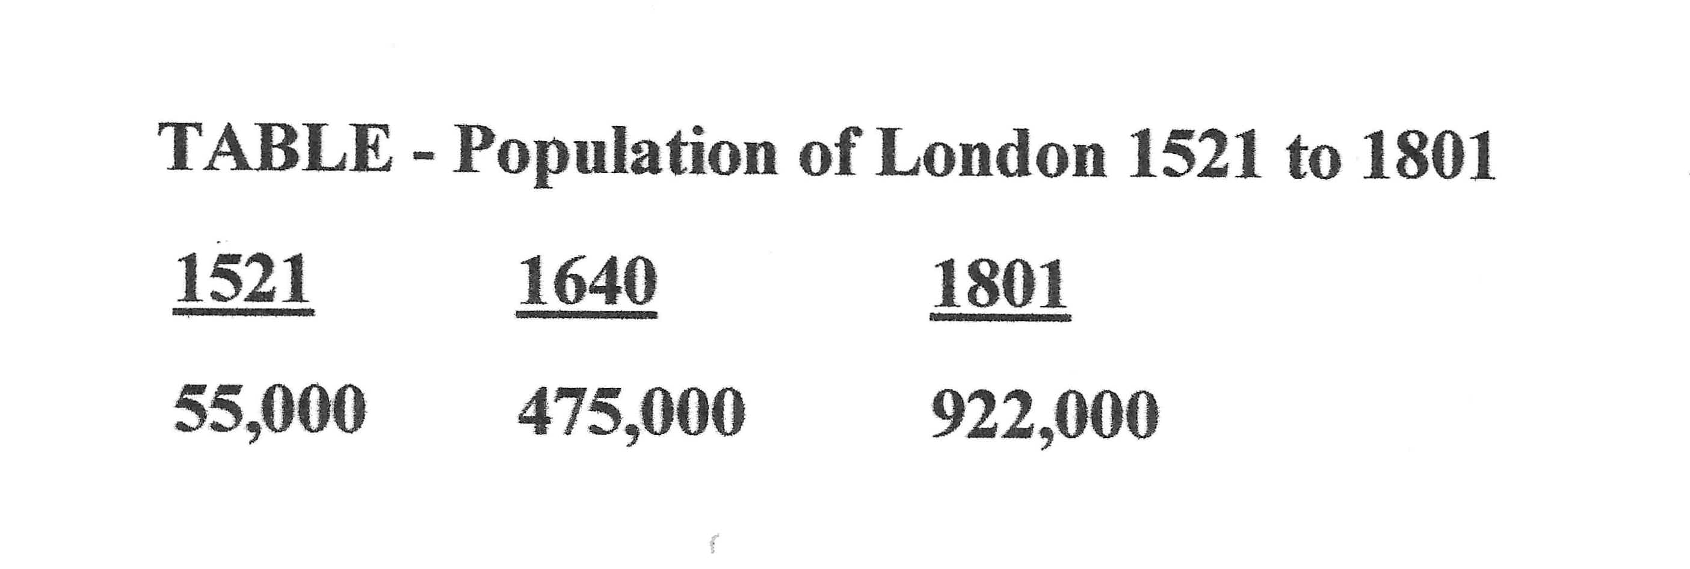
DEMOGRAPHIC CHANGE

Slide 5
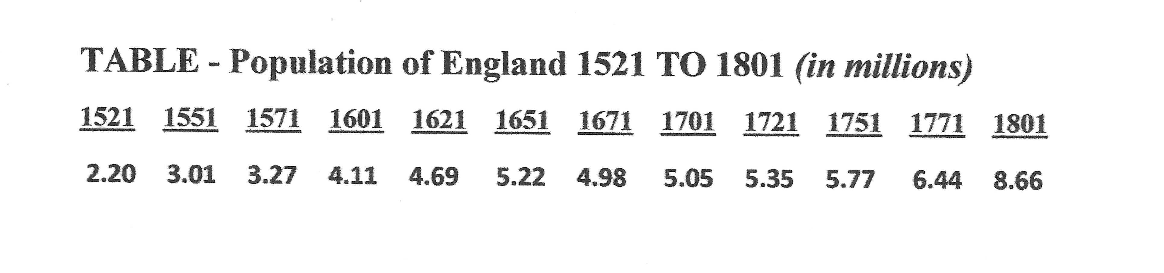
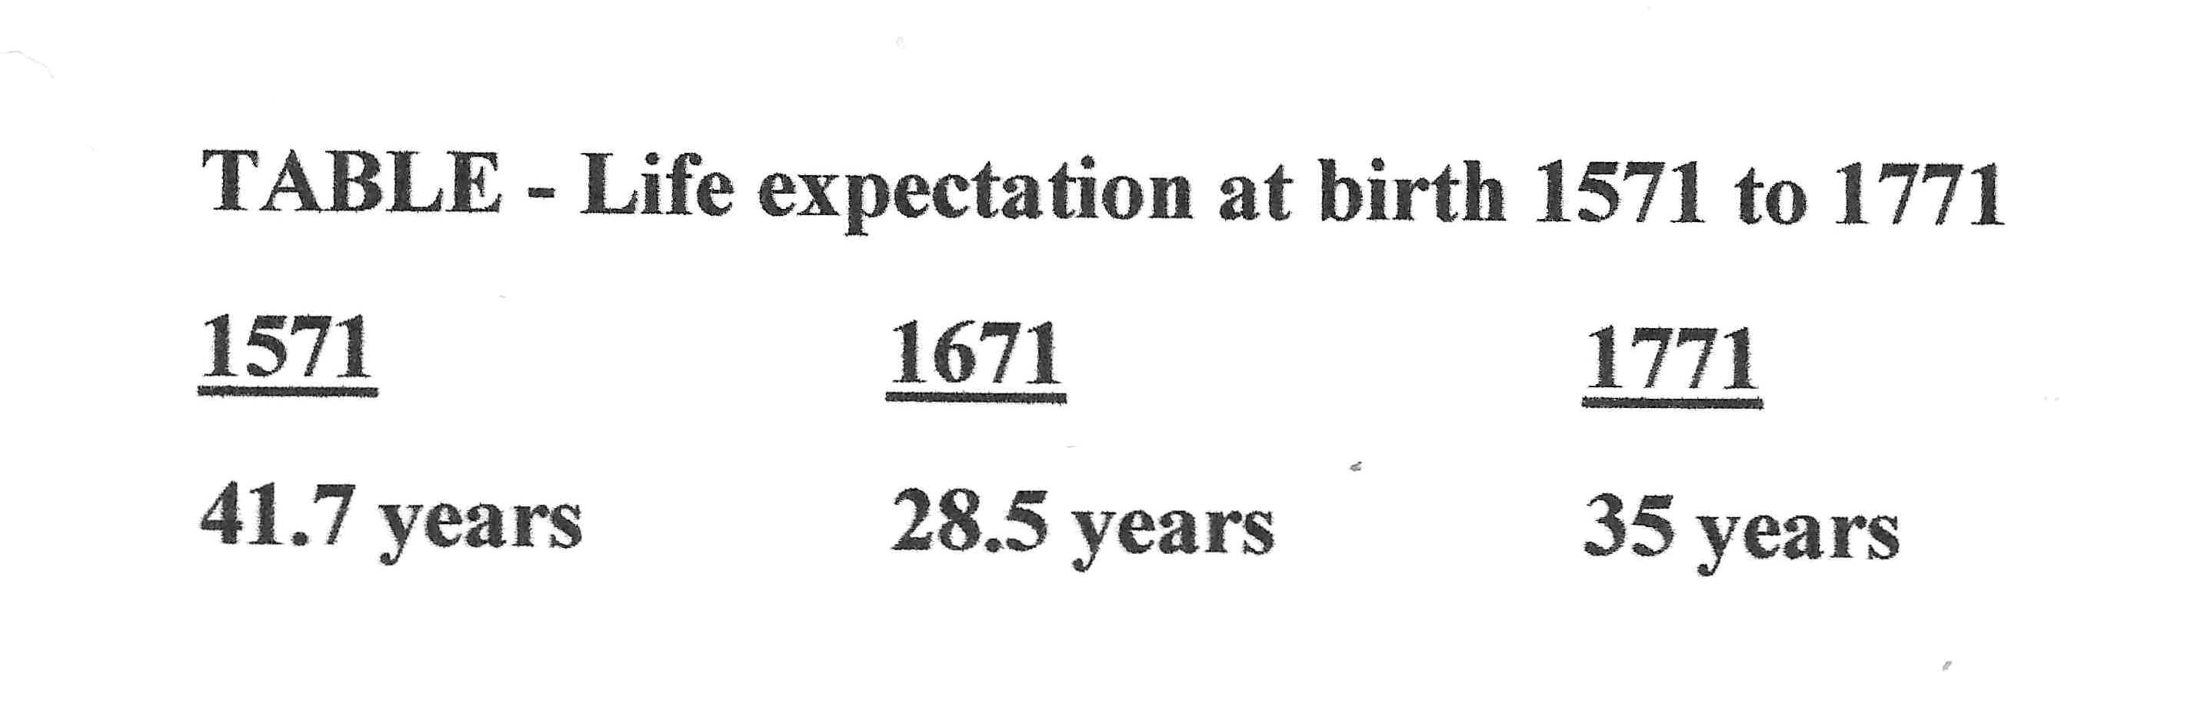
DEMOGRAPHIC CHANGE

Slide 6
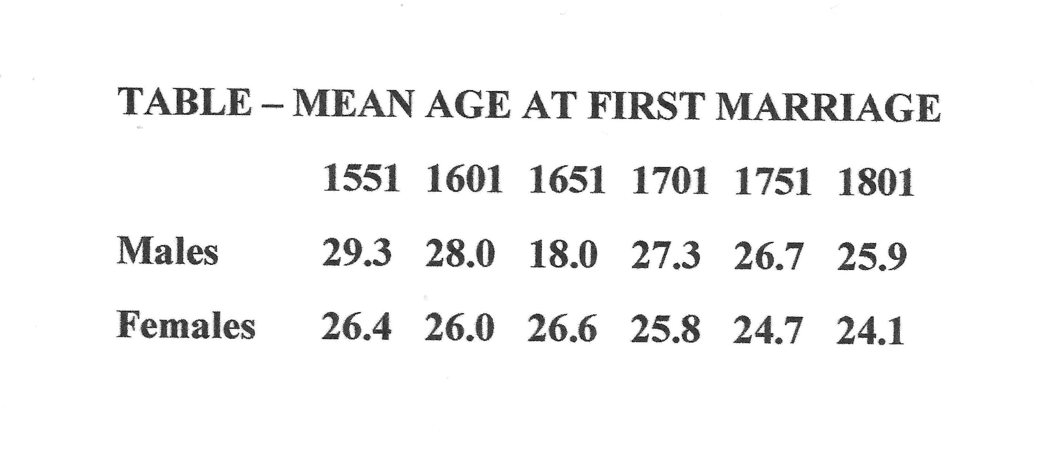

Slide 7
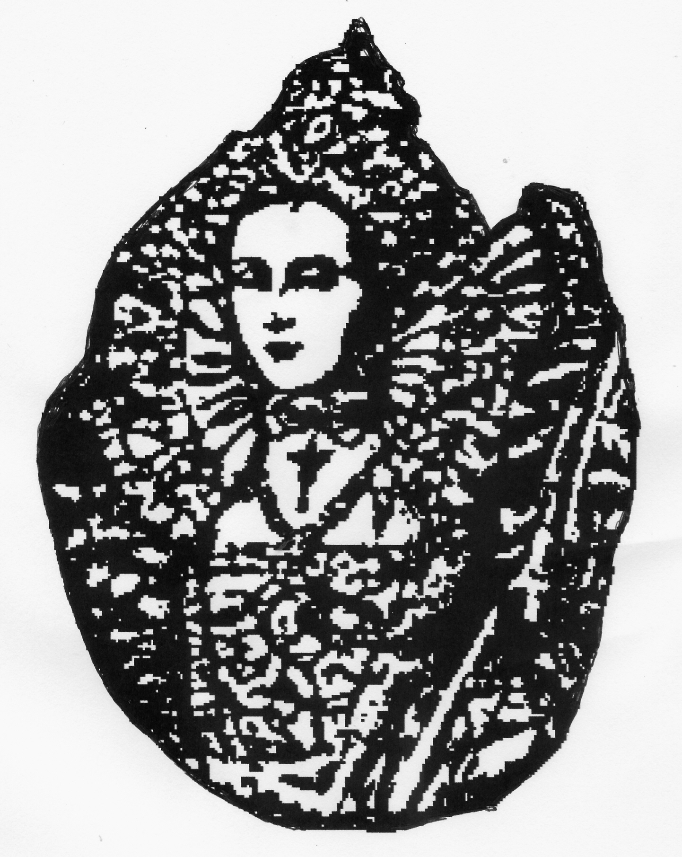
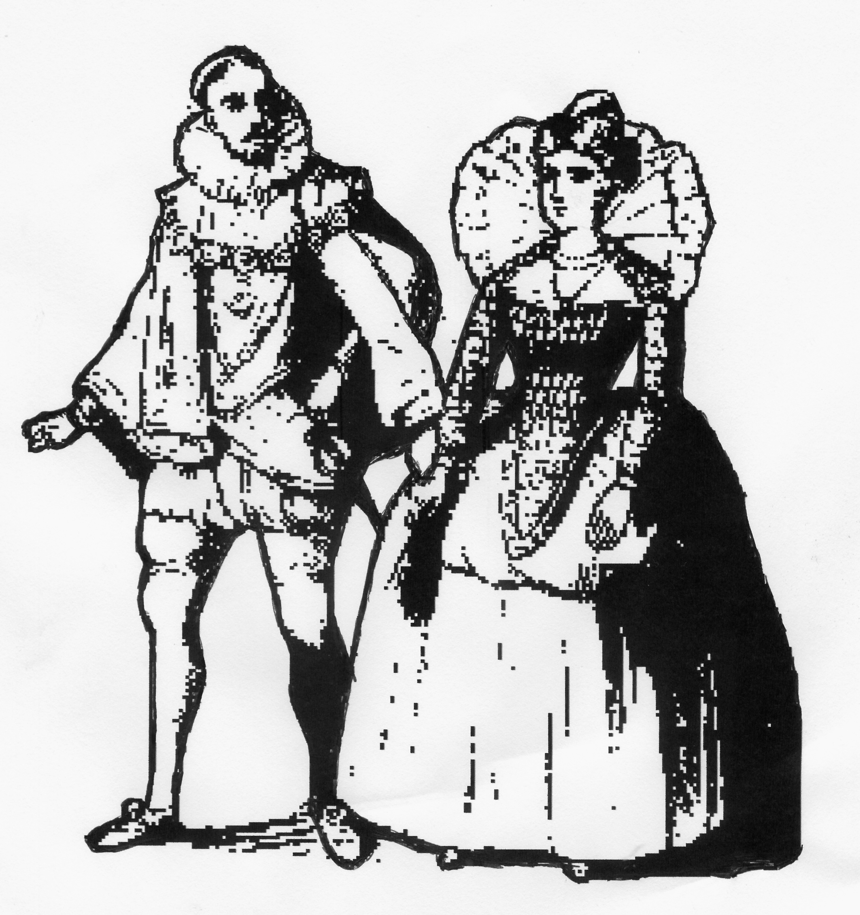
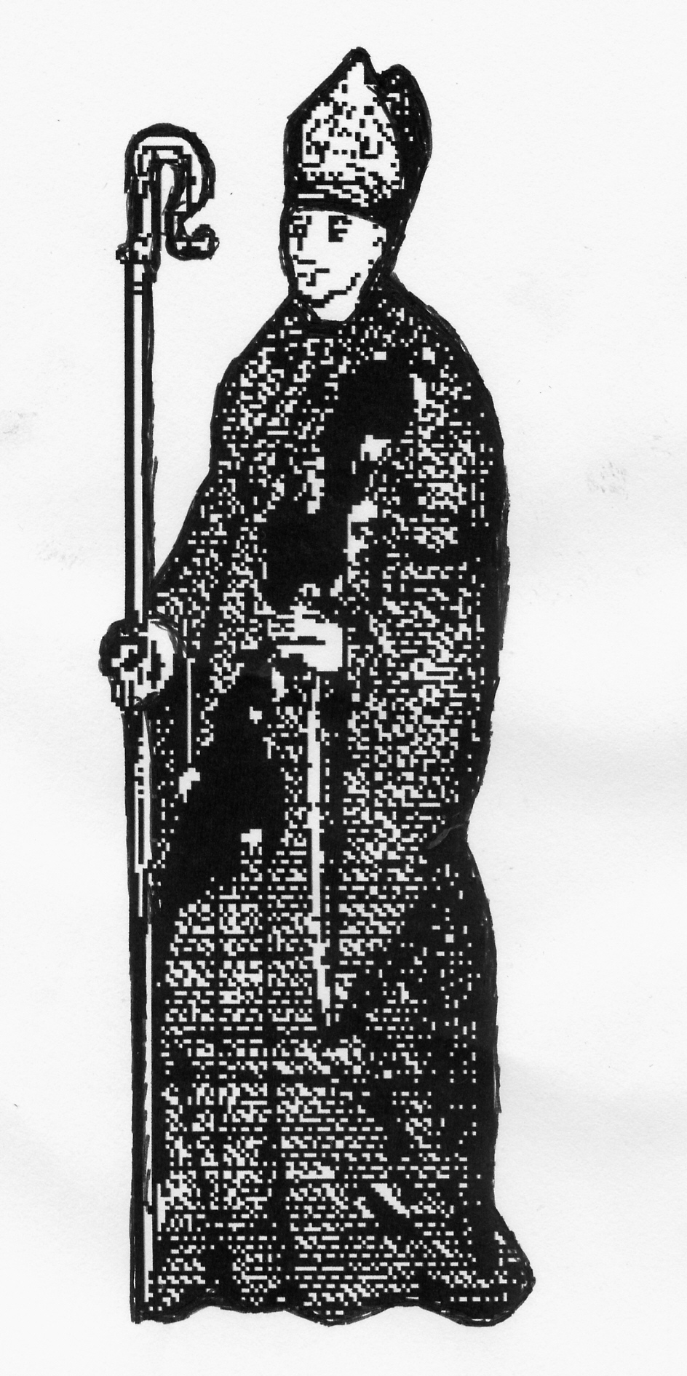
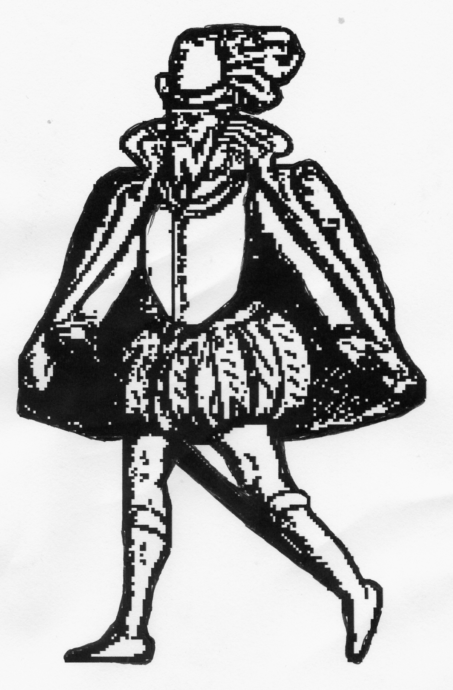
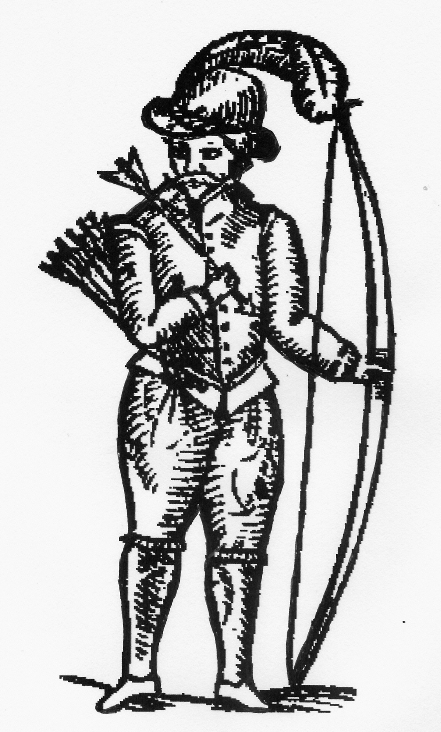
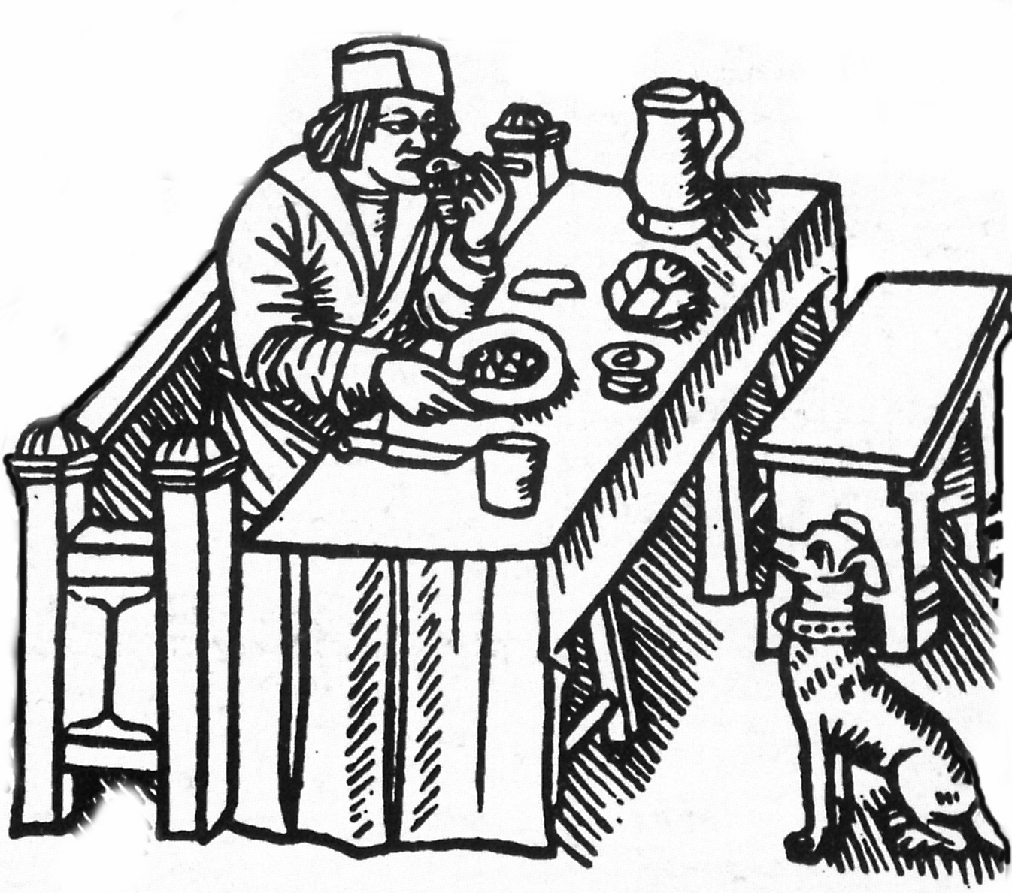
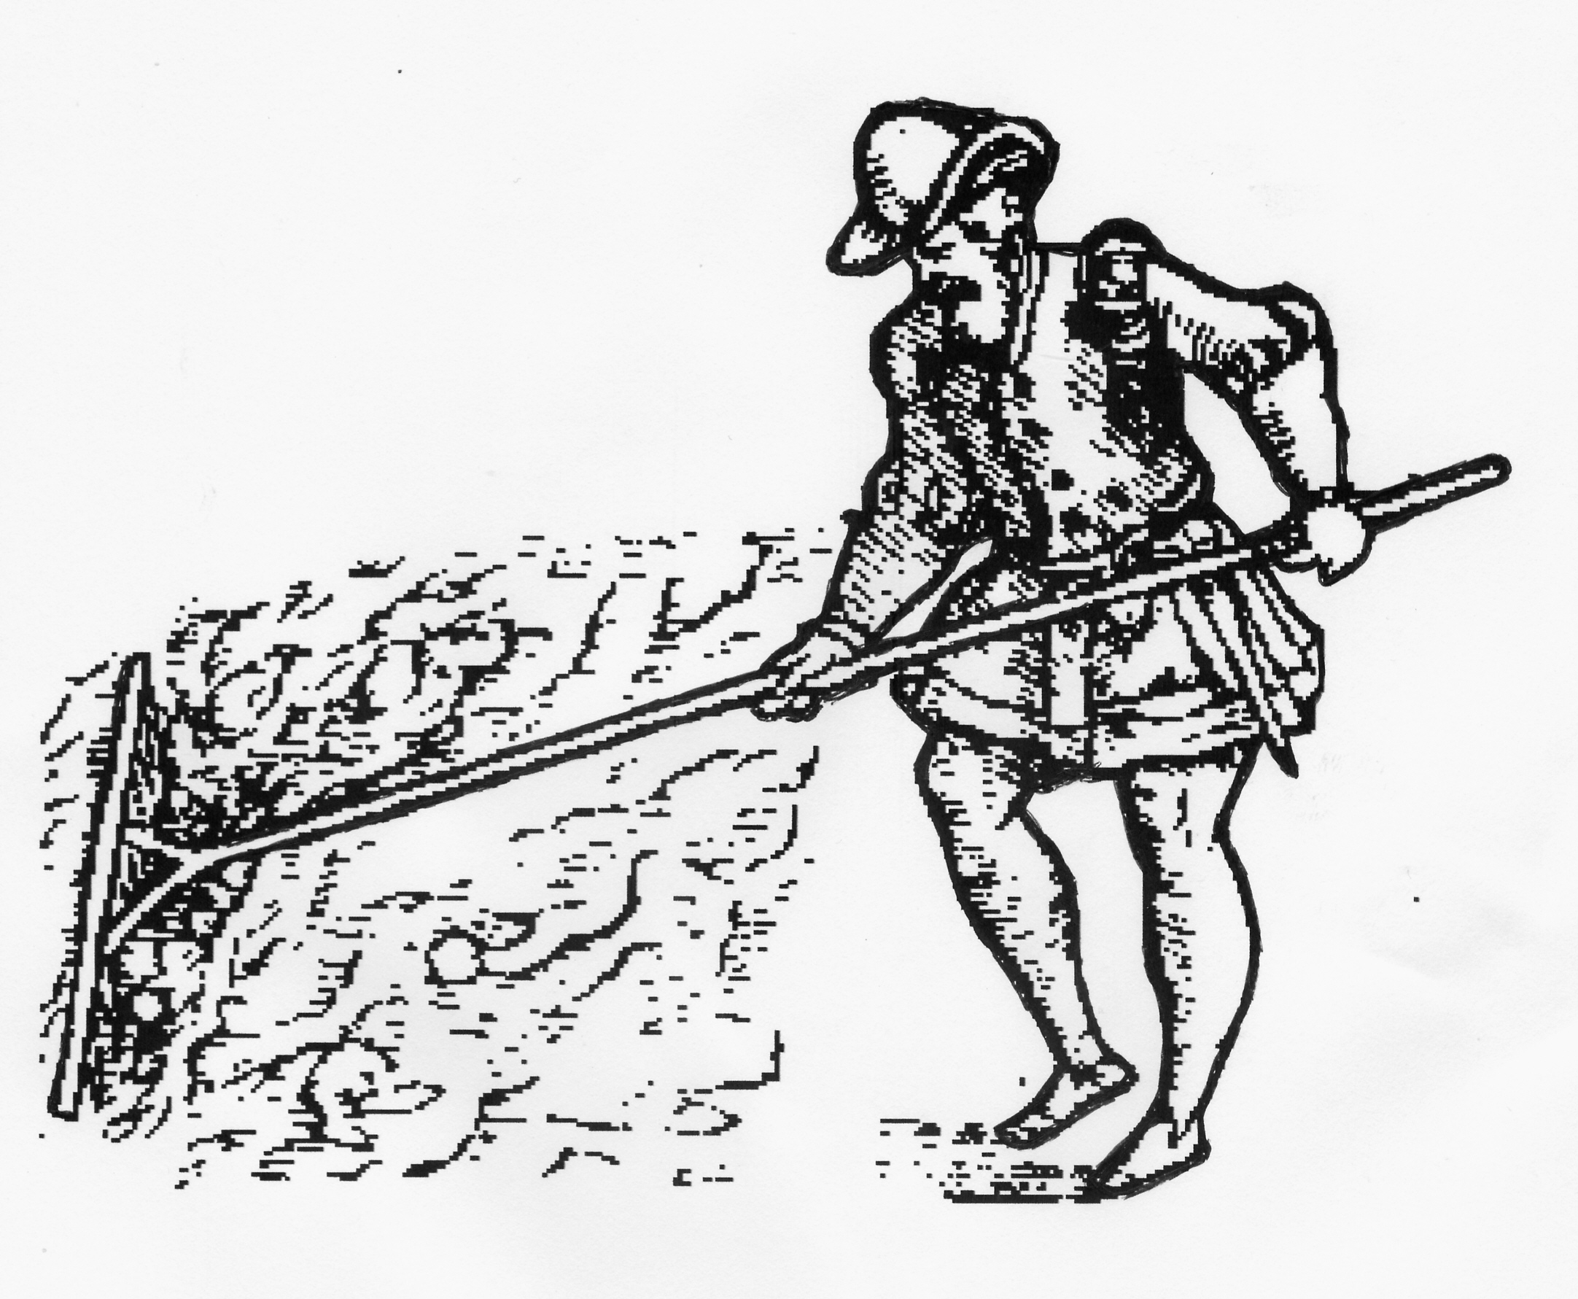
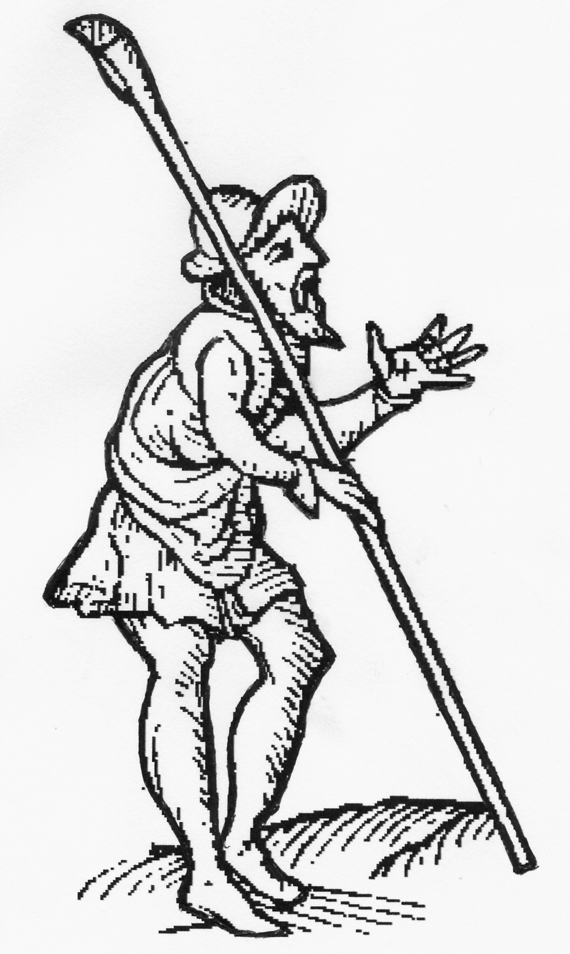
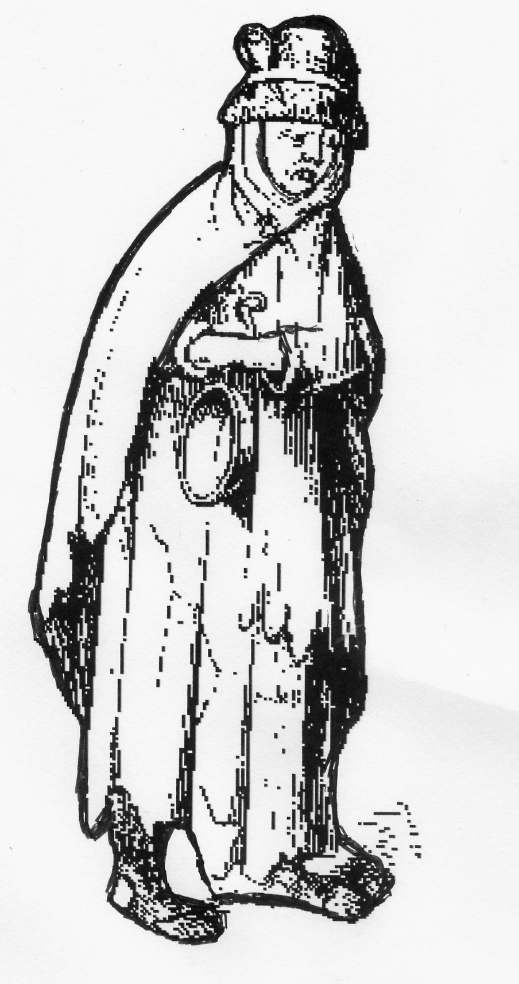
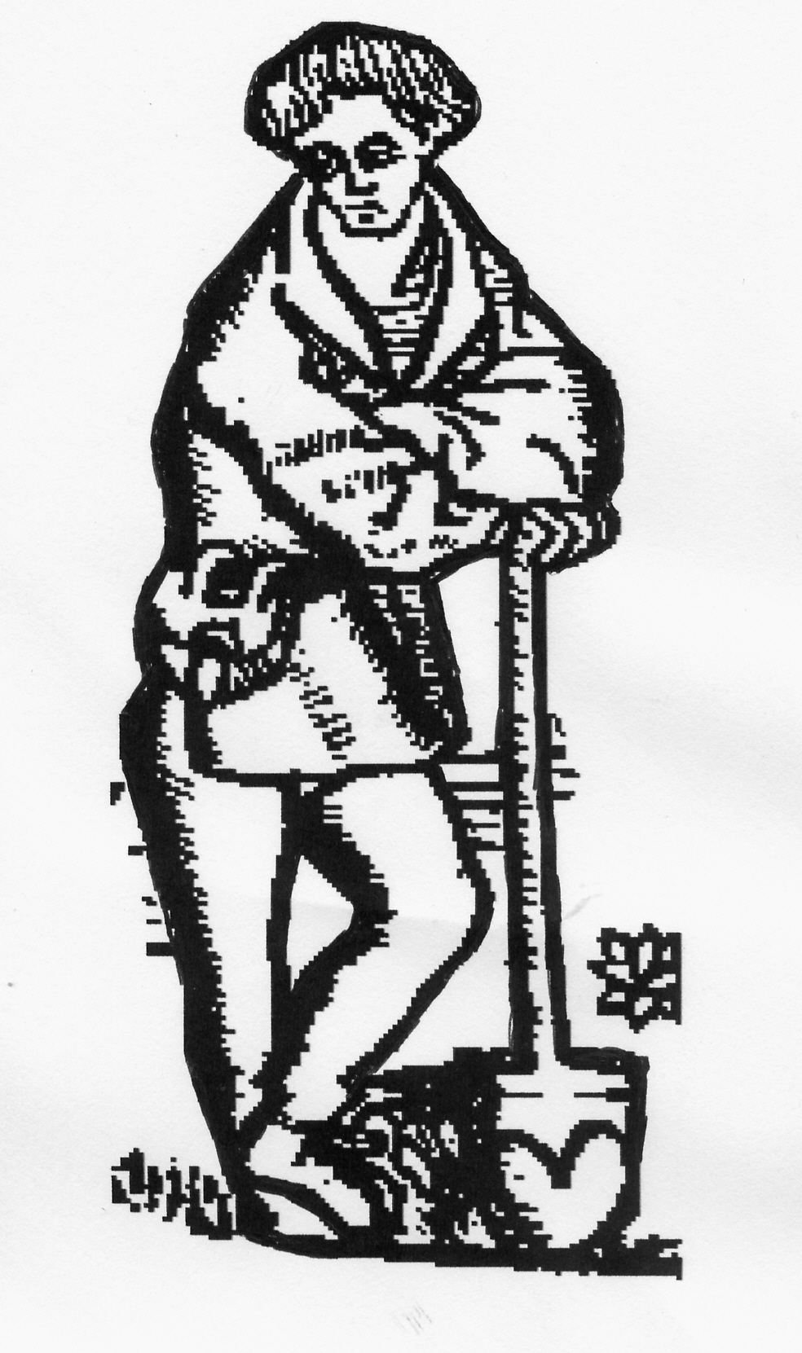
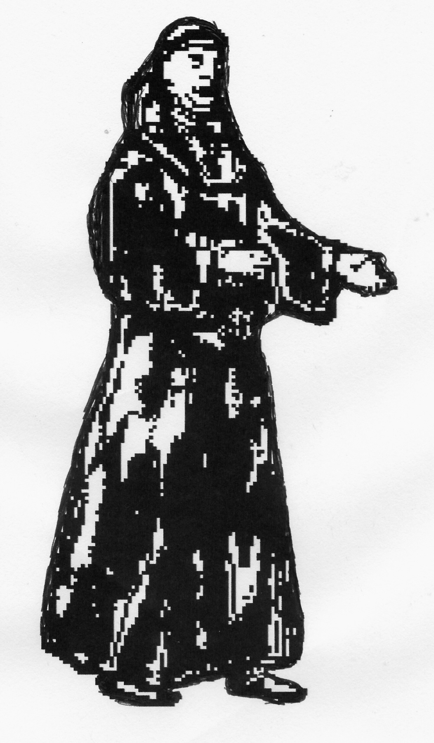
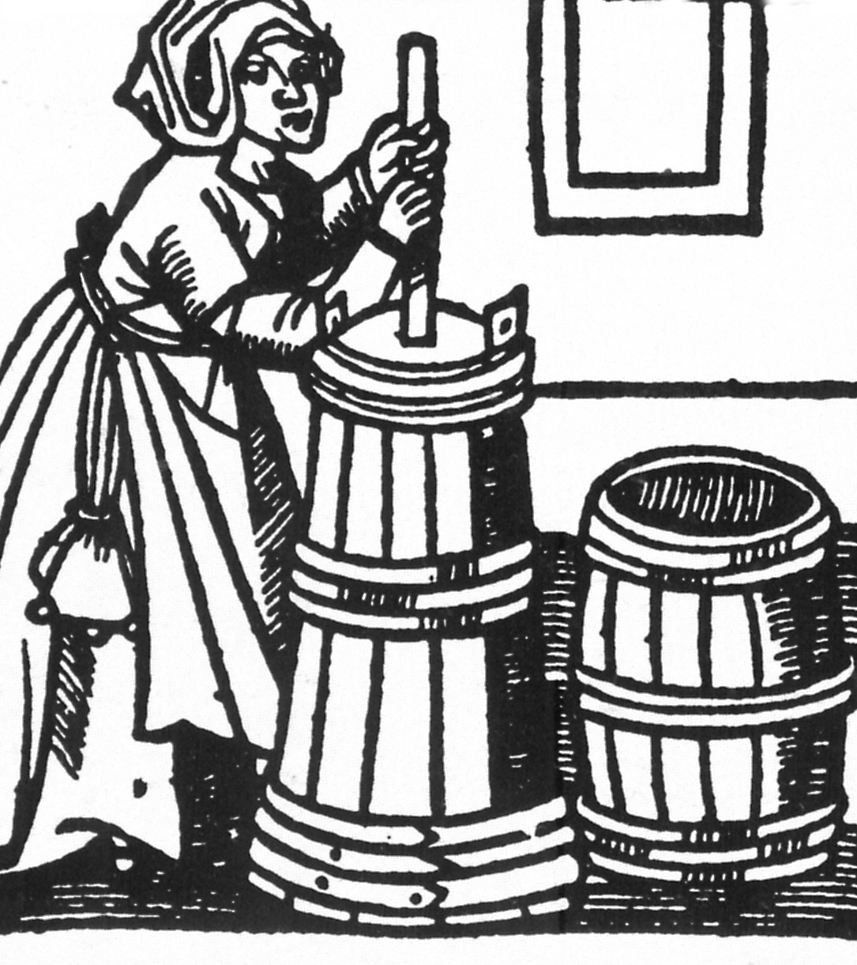
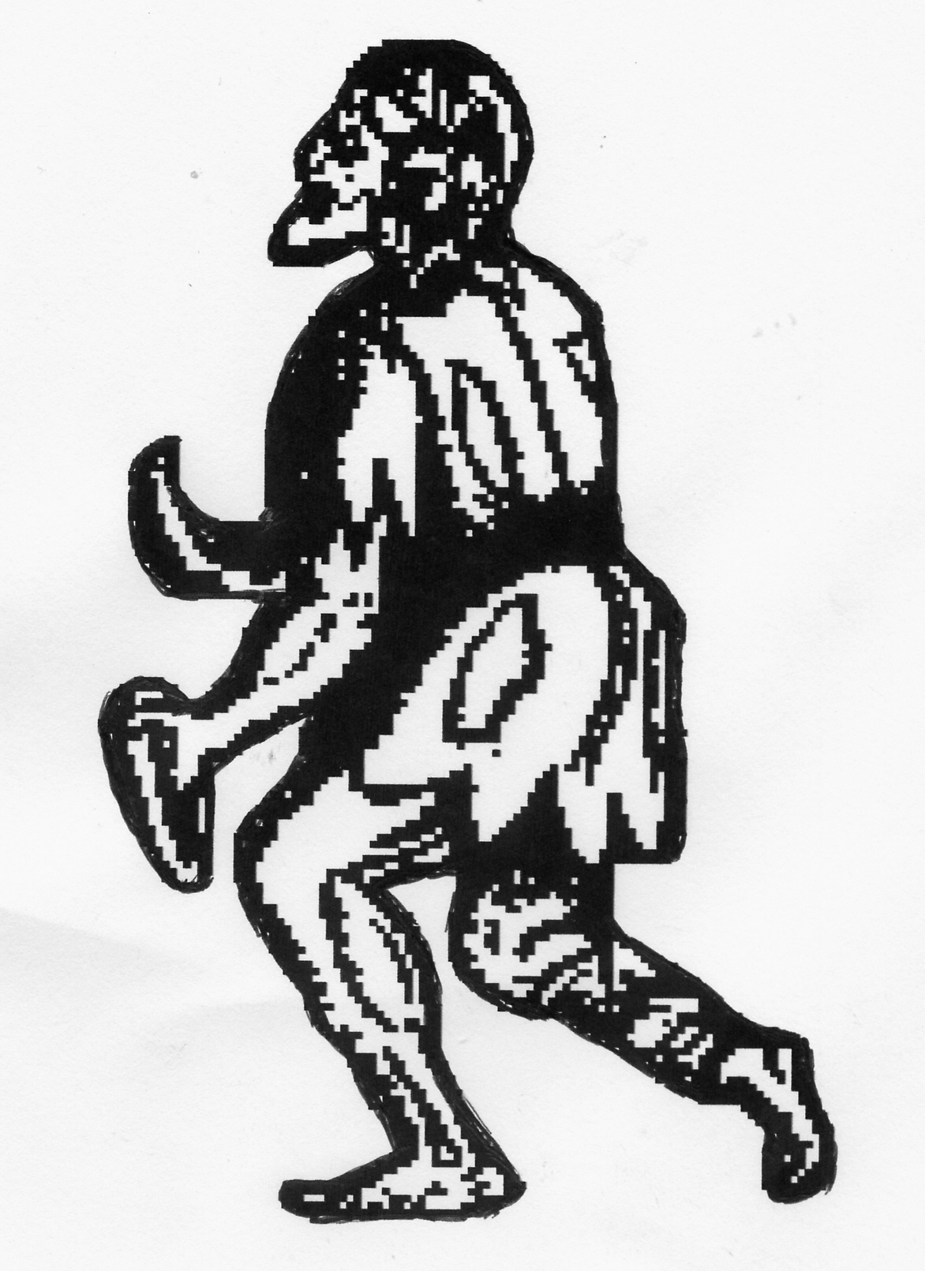
THE GREAT CHAIN OF BEING
1. The Sovereign
The Sovereign
The Nobility
Bishops
Knights
Esquires & Gentlemen
Citizens & Burgesses
Yeomen
Husbandmen, Cottagers & Labourers
Parish Priests
Women
Servants & Paupers

Slide 8
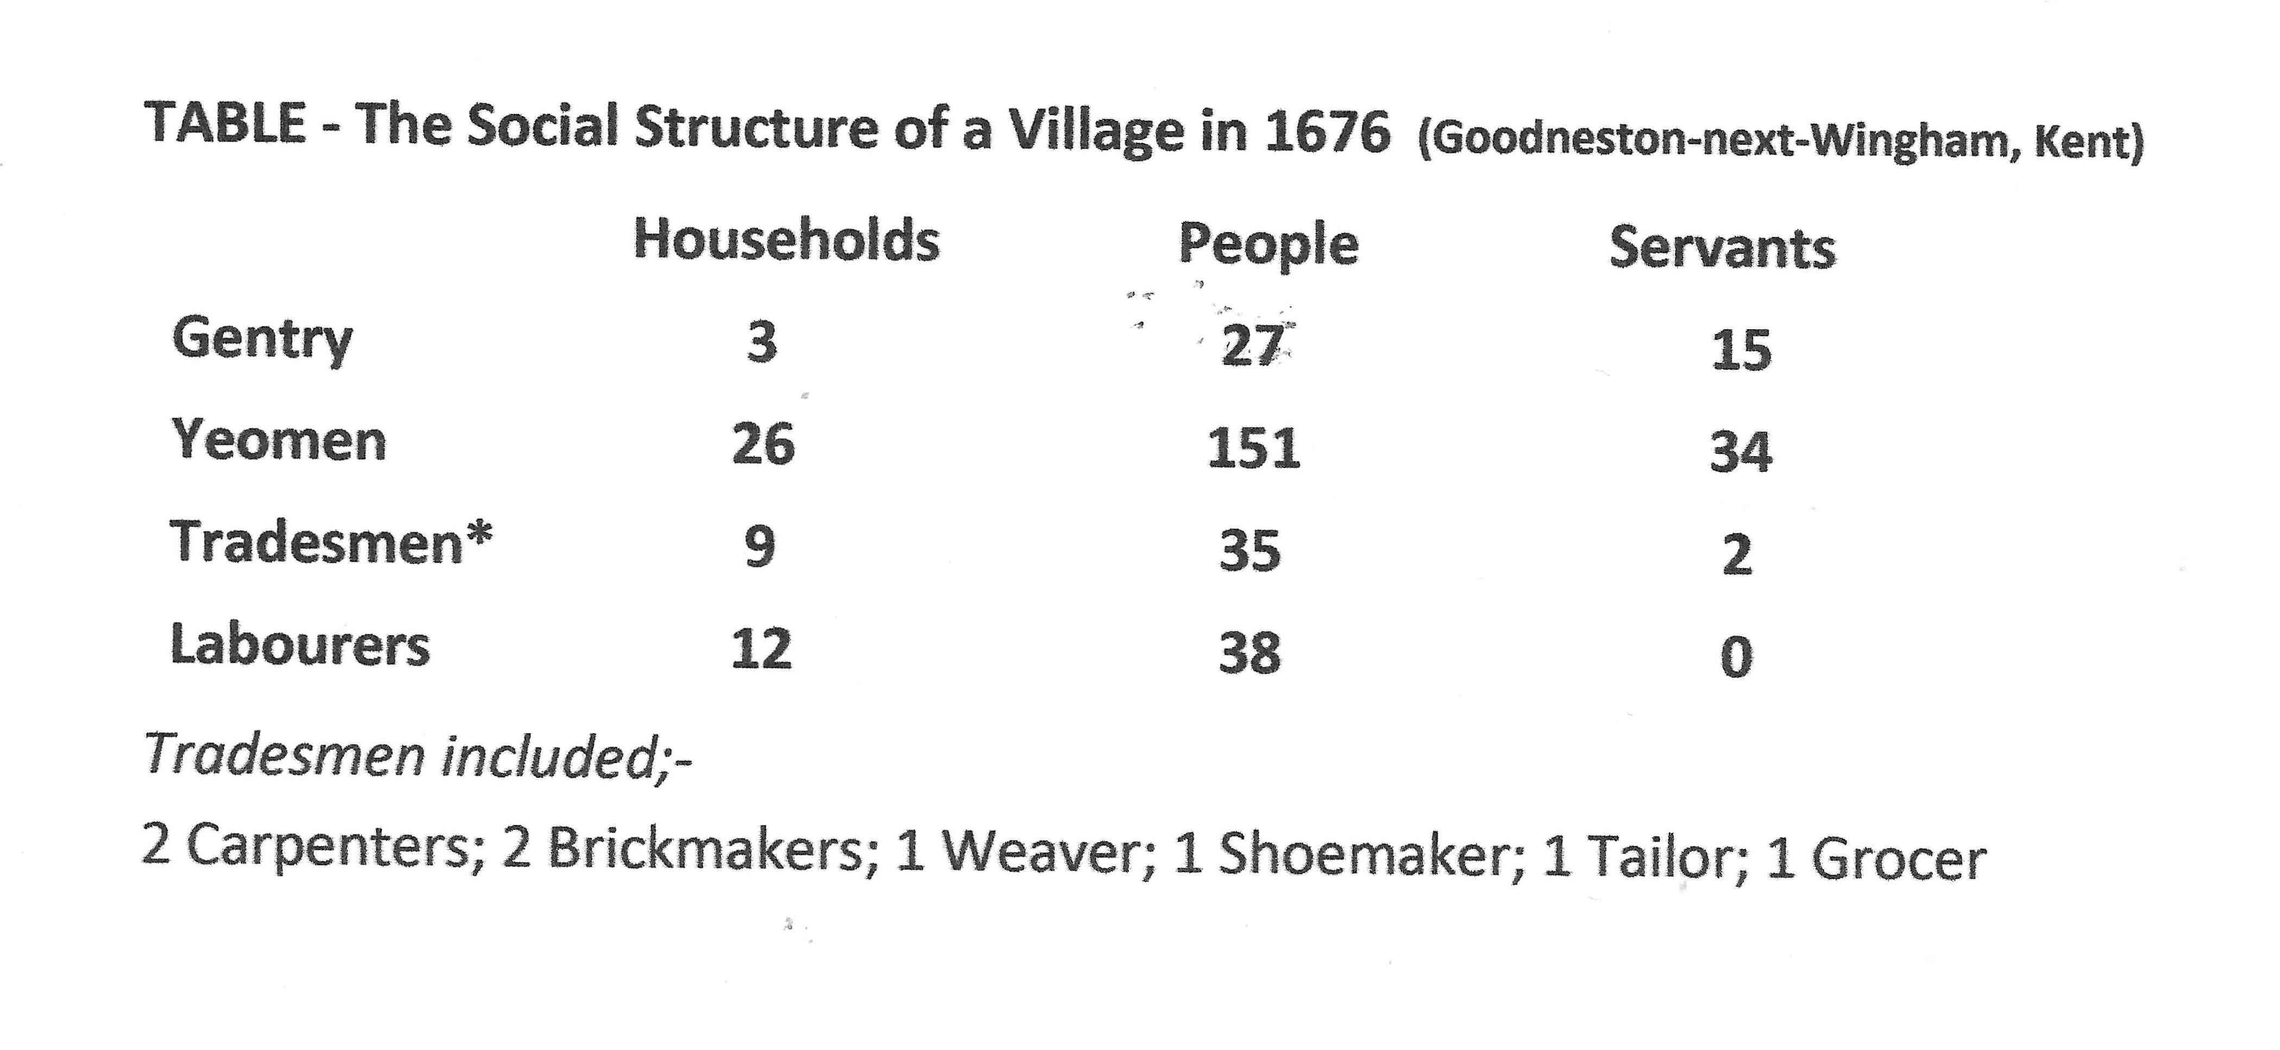

Slide 9
